Slide 1





Hatchlings Parent Workshop:
Session 3: Building a Routine
This program has been adapted from Dr. Betsy Diamant-Cohen’s Mother Goose on the Loose: Hatchlings
Notes:
[Slide to be shown as participants show up for the program]​

Slide 2

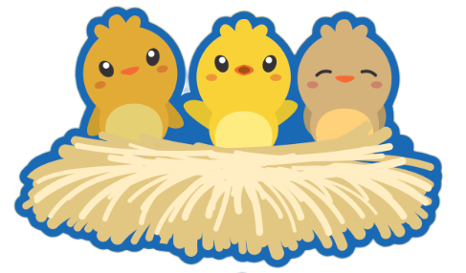
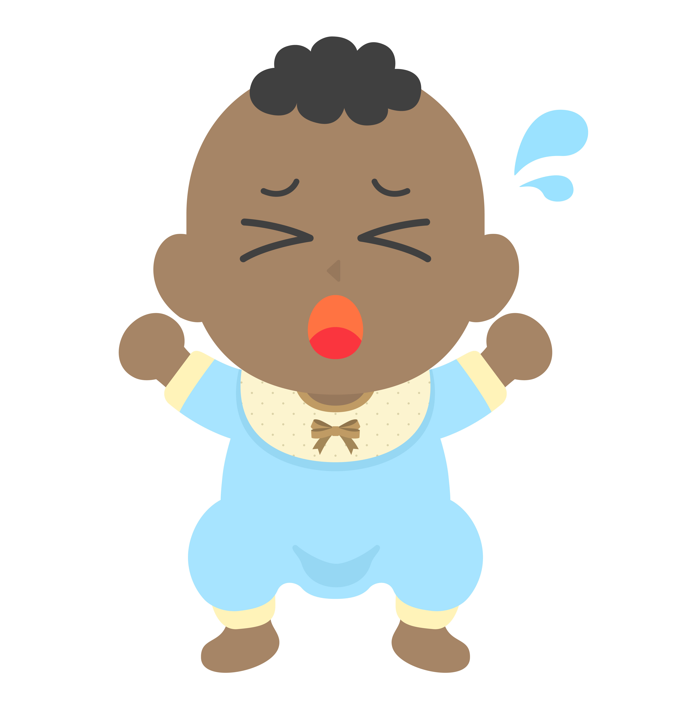
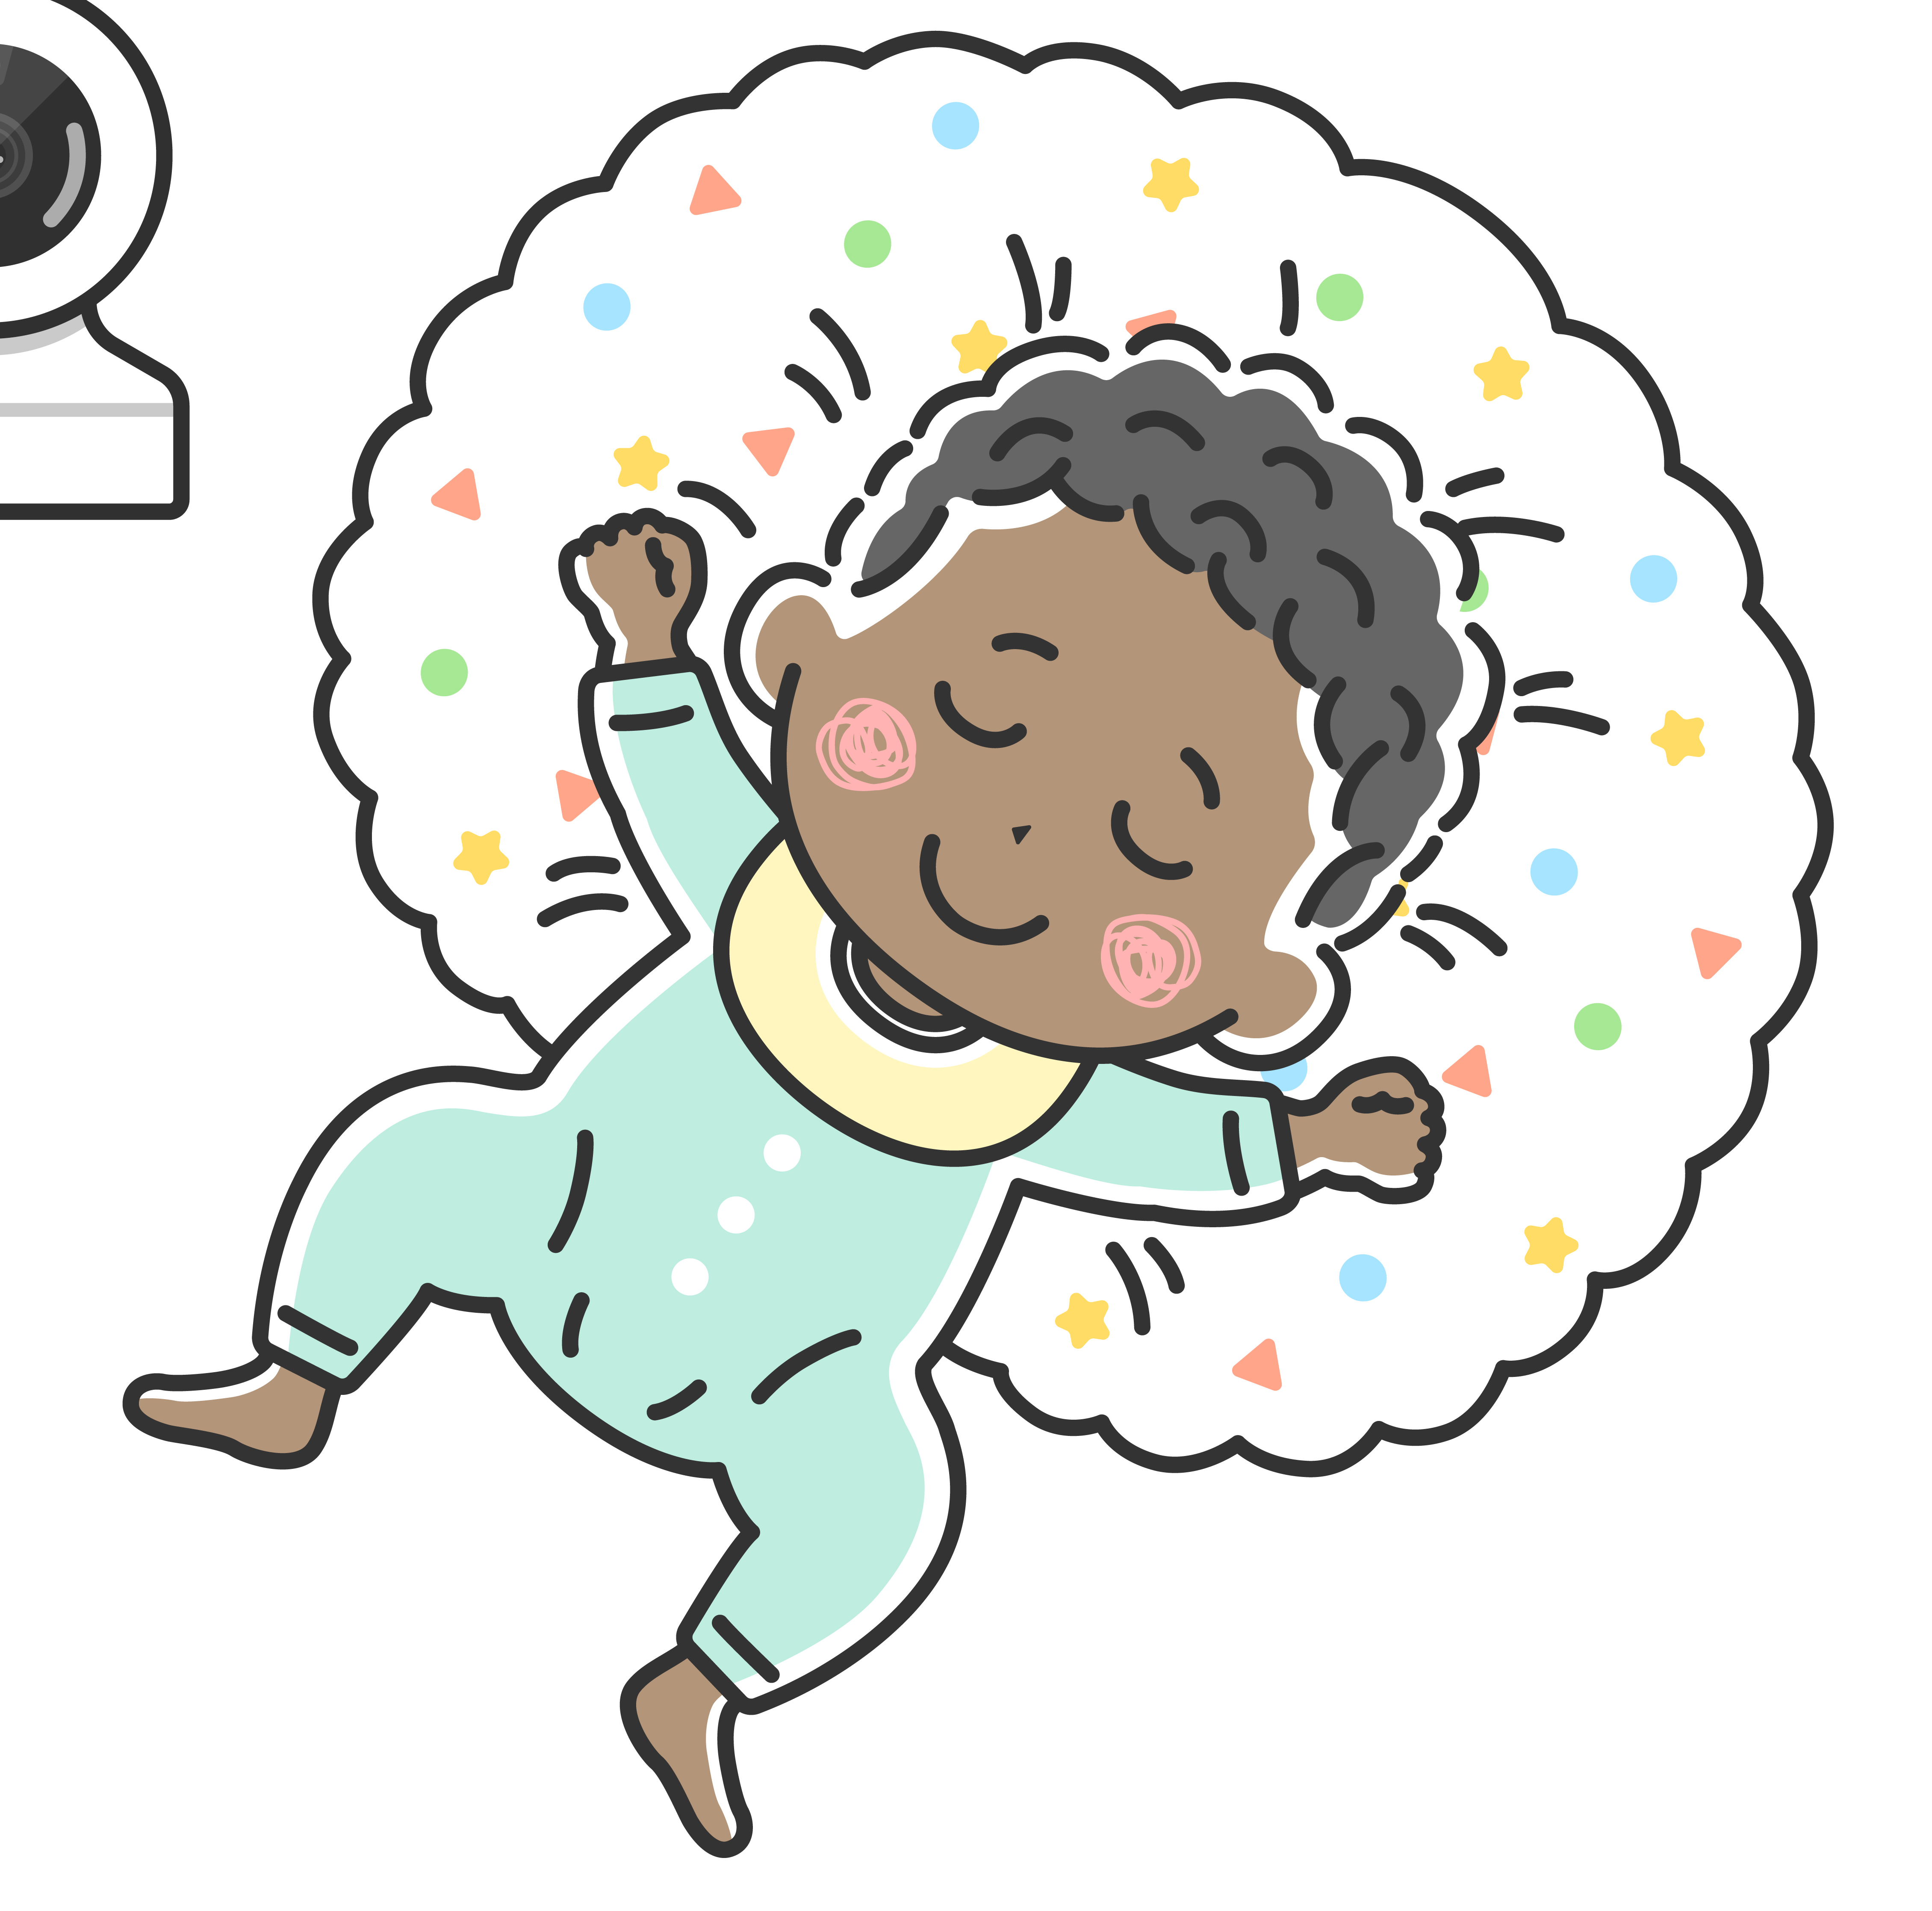
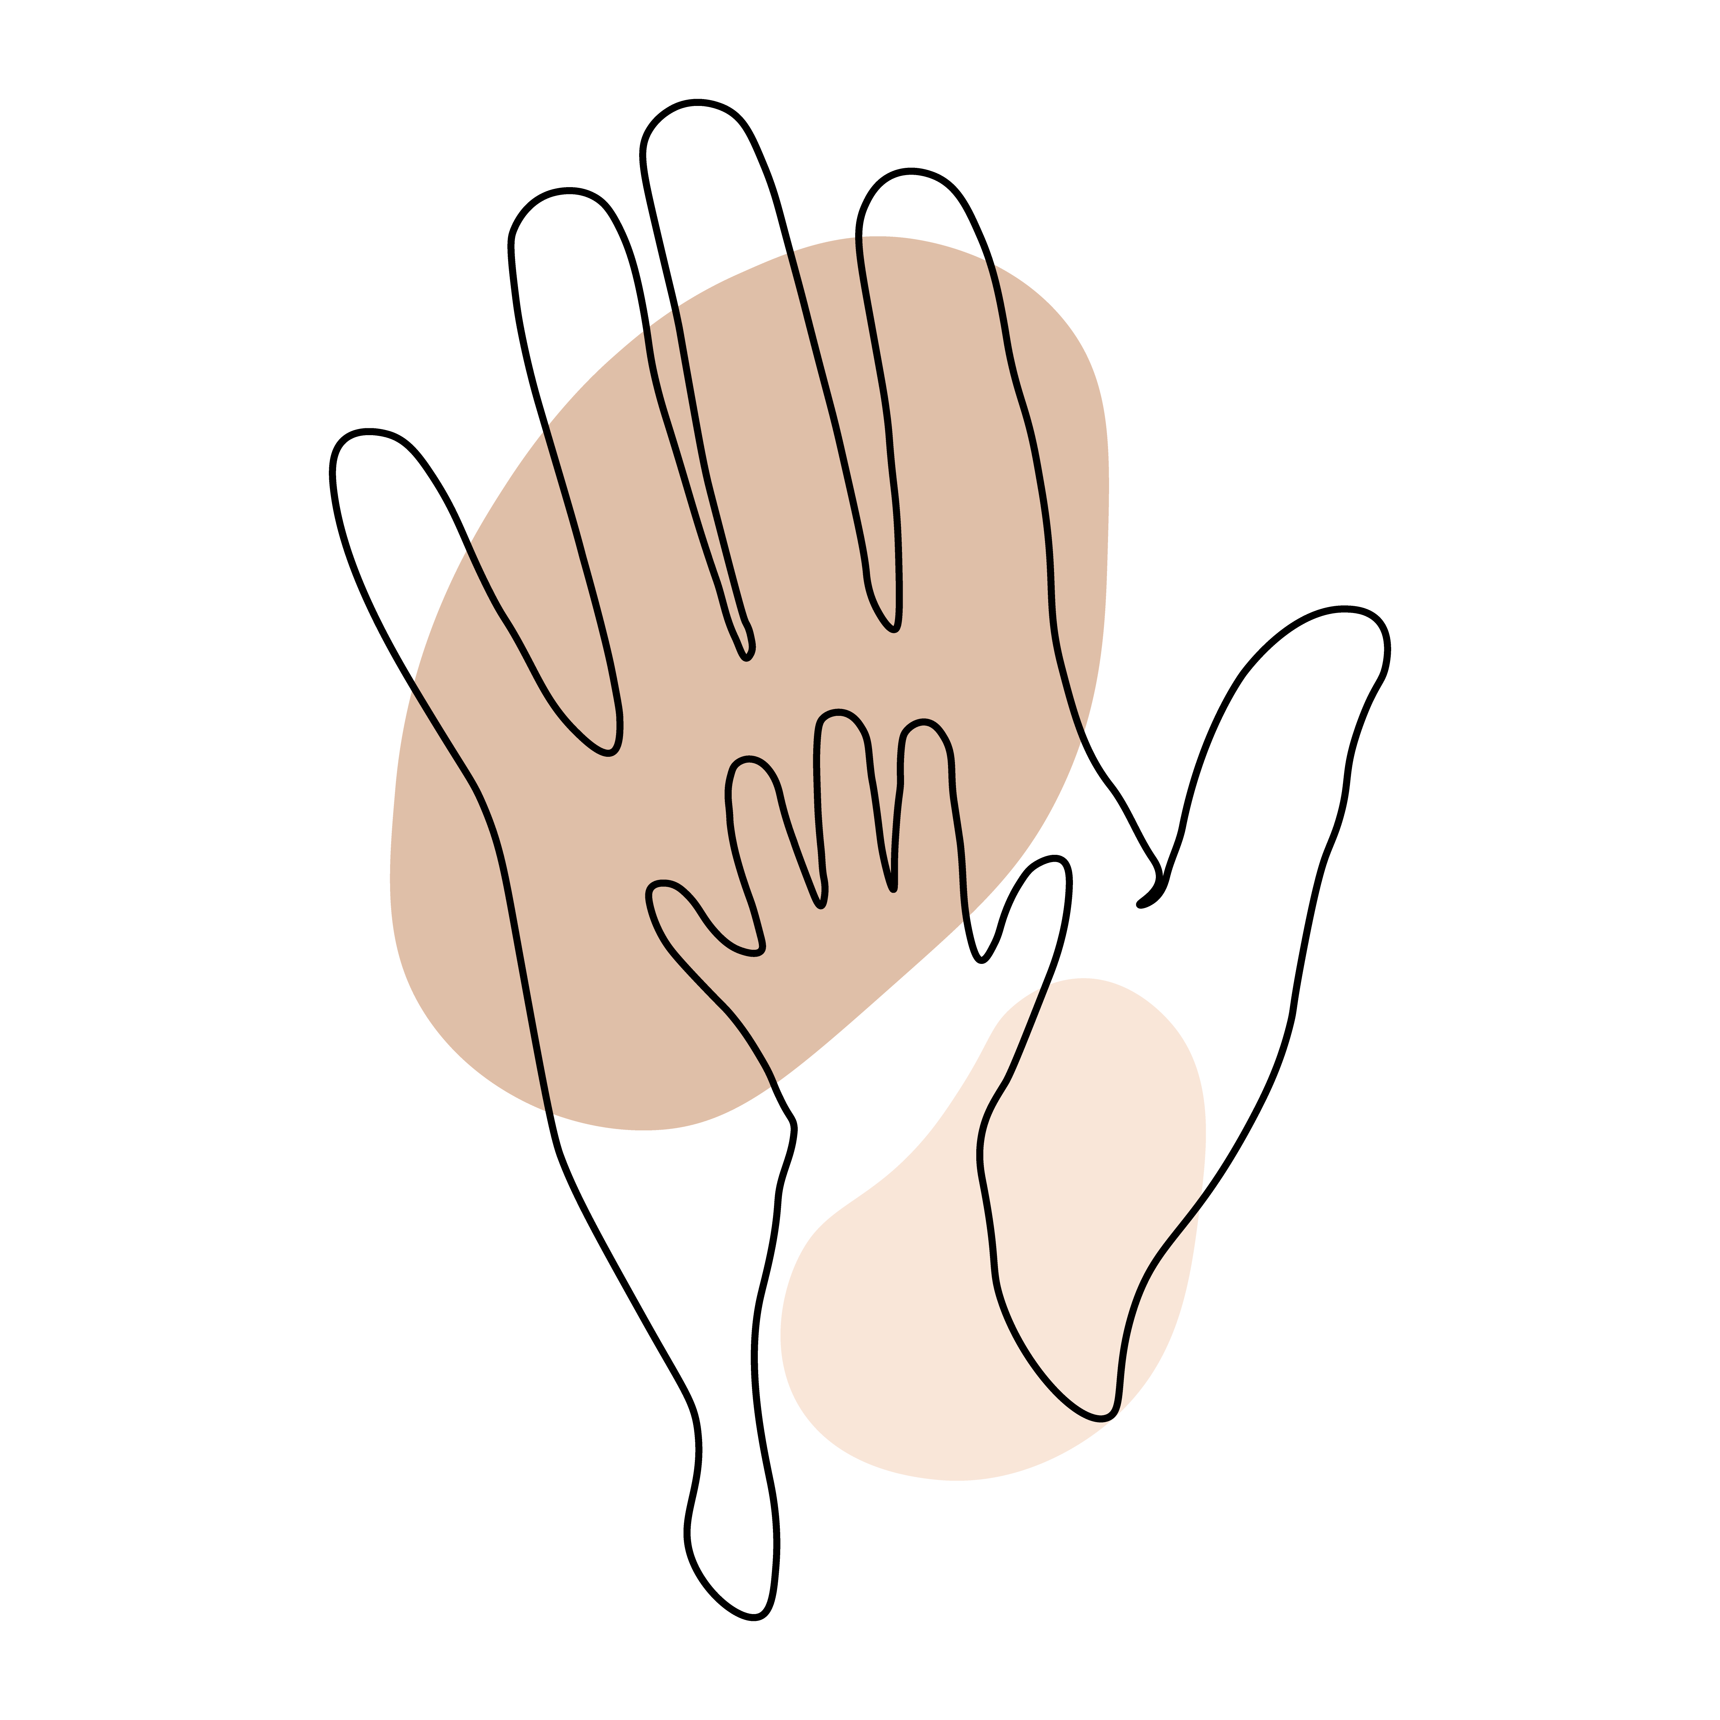
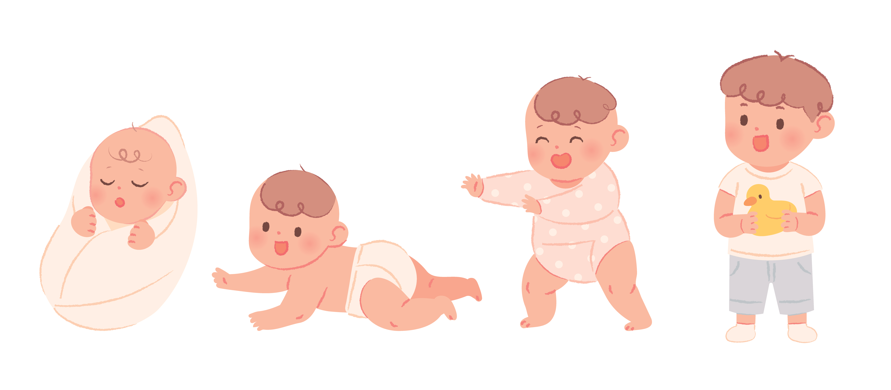
Session 3: Building a Routine
HELLO,
Hatchlings Families!
Let's get to know each other and the program.
Unexpected is expected
Calm down without the crowd
Respect baby's rest
Hands on exploration
Stay engaged; silence phones
Notes:
Welcome! We are so glad you could make it to Montgomery County Public Libraries: Hatchlings Parent Workshop here at the [enter branch]!
Before we get started, if you haven't signed in already, we ask that you please sign-in, make a name tag, and grab a tote bag—one per family. [If a family has multiples—reach out to us for an additional tote]. Since we will be using the materials in your tote bag for all three workshops, we will collect them at the end of each session. Please label your bag with your name, so we can give you the same bag back for each session. You will be able to take the bags home at the end of session 3.
If you have any questions, we’ll be happy to try to answer them for you. Then, find a seat in the circle. Make yourselves comfortable.
You are here for Session 3, where we will learn about building a routine with baby. This workshop has been adapted from the "Mother Goose on the Loose: Hatchlings" program, created by Dr. Betsy Diamant-Cohen. ​
​
As you can see [look around] this workshop is specifically targeted toward expectant parents and new parents. It is our hope that through these three workshops that you will leave feeling confident about how you can support your baby's growth and development from birth and beyond.
[Staff Introductions]
If you are comfortable doing so, let’s go around and you can introduce yourselves and say something about yourself. [If possible, then greet each person by name!]
Before we dive in any further, let's go over a few guidelines for getting the most out of this workshop.
-For those of you with newborns or young children with you here today, the "unexpected is expected." If your little ones cry or need something, it's OK. They will wiggle and make baby noises, and that's just fine. But, if they are crying loudly or becoming distracting, please feel free to step out of the room, and come back in when they are calmer. Sometimes, it is easier to calm baby down without the crowd. Feel free to take a break, leave the room, and rejoin us when you are ready.
-Respect baby's rest. This workshop is for you, so if your baby is sleeping, don’t wake them up! Babies need their sleep. We’re going to share different activities that you will be able to use at home to help with your baby’s healthy development. So please sing along and participate; you’ll have plenty of time to share the activities with your baby later.
-Hands on exploration: By coming here today to learn everyday simple things that you can do to support your baby's brain development, you are giving your child a big head start, right from the beginning!
-Stay engaged. We ask that you silence your phones during this workshop. In-fact, MCPL has a no photography or videography policy. We do not allow photos, audio, videos, recording or streaming of any kind to be taken inside the library, so please turn off your phones for the duration of the workshop.
Now that we've gone over the guidelines, let’s start off with a song – you will see that we are going to be doing a lot of that over the next hour or so! You will receive a copy of these slides at the end of each session along with the song book you will find in your tote.
[Suggested song: you may use a different hello or welcoming song]
WELL HELLO EVERYBODY
Well hello everybody, yes indeed,
Yes indeed, yes indeed.
Well hello everybody, yes indeed,
Yes indeed, my baby.

Slide 3
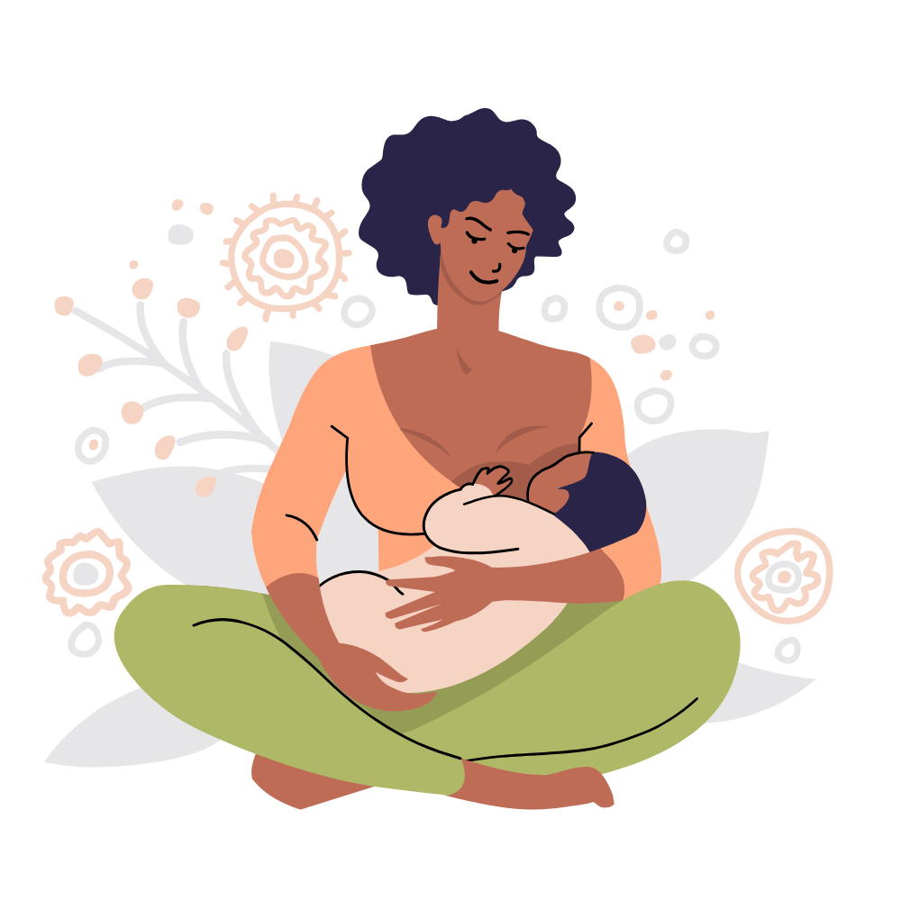

Session 3: Building a Routine
Learning Objectives: Session 3
Routine is important​
Framing baby's day​
Practice makes permanent ​
Building your community
DID YOU KNOW?
Routines help babies learn flexibility!
Notes:
We have several learning objectives for this session. ​
​
We're going to explore why routine is important to your baby. ​
​
We'll demonstrate the ways songs, rhymes, and poetry can help provide a framework for baby's day, when you use them consistently. ​
​
We'll talk about the idea that "Practice makes permanent." ​
​
Finally, we will talk about some different resources that are available to you and your family so that you can find all the support you need.​

Slide 4

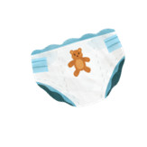

Session 3: Building a Routine
Pizza Pickle Pumpernickel ​
Pizza, pickle, pumpernickel, ​
My little baby deserves a tickle. ​
One for her nose, ​
One for his toes, ​
One for the tummy, ​
Where the cracker goes. ​
Frame baby's day with songs and rhymes.
• Diaper • Feeding • Outings • Bath • Bed​
I Am Hungry
Tune: "Frère Jacques"
​I am hungry!
(I am hungry) ​
What should I eat?
(What should I eat?) ​
Think I'll have some ice cream. ​
(Think I'll have some ice cream.) ​
Cold and sweet!
(Cold and sweet!)
Having established routines helps baby transition throughout the day.
Notes:
Frame baby's day with songs and rhymes. Babies thrive on predictability and routine. Their little worlds are full of action and stimulation, but providing a consistent routine offers safety and security. ​
​
Here are some ways you can frame baby's day with songs and rhymes. Use a song or rhyme at naptime, a different one at feeding time, and another one at bath time. Baby will come to recognize which activity each of those songs represents. ​
​
"Baby routines help promote happier parenting. Repetition helps both you and your baby adjust. Having a baby schedule gives you a plan; even if your day doesn’t go as expected. Plus, a routine gives you a sense of purpose. It also keeps you organized, especially when you’re feeling sleep-deprived and frazzled." (https://www.enfamil.com/articles/the-importance-of-baby-routines/) ​
​
These routines do not need to be on a rigid timetable, but should be familiar yet flexible! For example, during a growth spurt baby might veer a little bit from their established routine. They might need more sleep or wake up several times a night. But, always having a consistent song or rhyme for each activity will cue baby to what will come next. ​
​
Routines provide known patterns of predictability that lead to feelings of safety throughout baby’s day. Feeling safe allows them to be most receptive to new stimuli. The most routine parts of a day with baby tend to be: diaper changes, feeding/meal time, bath time, and bedtime. Familiarity with the typical pacing of a day helps your baby know what to expect, and that makes it easier to transition from one activity to the next. That’s why routines are useful and important.
​
Diaper changes are the perfect opportunity for fun and enriching connections with baby and an opportunity to promote language development, emotional regulation, focus, and so much more.​
​
Try this: ​
Eye Contact -- Start with eye contact. Loving connections begin with baby’s favorite activity -- looking at you! ​
Take it Slow -- Modeling calmness and patience will help ground baby in this moment of connection. ​
Narrate the diaper change – Narrate diaper changes by saying, “Now we’re going to wipe!” “And then we’re going to let you air dry for a bit,” “And now we’re going to apply some cream,” “Time for a soft new diaper!” ​
Integrate Activities -- When your baby is dry and secure in a fresh new diaper, it is the perfect time to introduce new, age-appropriate activities that are appropriate for your baby’s developmental stage. ​
​
Feeding: ​
​
When transitioning from one activity to the next, a specific song for each activity reminds babies of what is coming next. This helps them to remember the schedule, which leads to them feeling more secure. Since feeding time is a big part of the day it makes sense to use a transition song to introduce that.​
​
Every baby has their own unique needs with regards to feeding, but as you get to know each other you will learn what best suits you both. Remember that every baby is different and feeding schedules will change as they grow. You will develop a routine that works for you! ​
​
Let's try a couple of eating rhymes together. While newborns don't eat anything other than breast milk or formula, these are still some fun songs to sing. ​
​
Pizza Pickle Pumpernickel ​
Pizza, pickle, pumpernickel, ​
My little baby deserves a tickle. ​
One for her nose, ​
One for his toes, ​
One for the tummy ​
Where the cracker goes. ​
​
And ​
​
I Am Hungry (tune: Frère Jacques) ​
I am hungry! (I am hungry) ​
What should I eat? (What should I eat?) ​
Think I'll have some ice cream ​
(think I'll have some ice cream) ​
Cold and sweet! (Cold and sweet).

Slide 5

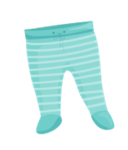
Session 3: Building a Routine
A daily routine builds a sense of security for baby.​
This Is The Way We Wash...​
Tune: "Here We Go Round The Mulberry Bush"
This is the way we wash our bellies,​
Wash our bellies, wash our bellies.​
This is the way we wash our bellies,​
So early in the morning.​
This Is The Way We Put On...​
Tune: "Here We Go Round The Mulberry Bush"
This is the way we put on our pants,​
Put on our pants, put on our pants.​
This is the way we put on our pants,​
So early in the morning. ​
Routines help reduce anxiety in both baby and adults.
Notes:
A daily routine gives your baby a blueprint of what to expect; it helps to build a sense of security for baby. When you and other caregivers are consistent, your baby will understand what to expect day after day. Your baby needs that foundation of feeling secure in order to bond, learn, and grow. ​
​
We've already talked about diaper changes and feeding. Let's try a song that can be used at bathtime! ​
​
This is the way we wash...​
This is the way we wash our bellies,​
Wash our bellies, wash our bellies.​
This is the way we wash our bellies,​
So early in the morning.​
​
Thanks for singing along! Now, let's change the words to get baby dressed. ​
​
This is the way we...​
This is the way we put on our pants,​
Put on our pants, put on our pants.​
This is the way we put on our pants,​
So early in the morning. ​
​
Remember, routines help reduce your anxiety, as well as baby's!​

Slide 6
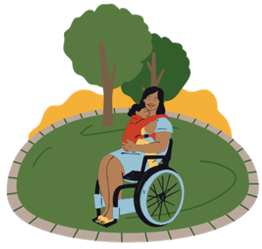
Session 3: Building a Routine
Smile, talk, sing, share books, and play with your baby throughout the day.
Acka Backa ​
Acka backa soda cracker, acka backa boo. ​
Acka backa soda cracker, up goes you! ​
Acka backa soda cracker, acka backa boo.
Acka backa soda cracker, I love you! ​
​
Can you Clap ​
Tune: "Mary Had A Little Lamb"
or
Tune: "Mary Wore A Red Dress" by Raffi
Can you clap with two hands,
Two hands, two hands? ​
Can you clap with two hands? ​
Clap clap clap clap clap​.
Singing, talking, and sharing books builds a baby's brain and their language skills.
Notes:
Now we're going to practice, because practice makes permanent … many of these tips may sound familiar if you attended sessions 1 and 2. ​
​
We want to give you lots of songs, rhymes, and games as well as tips for using books with your children from their earliest years. ​
Practicing here, then continuing to share them at home with your babies, will help to build their brains and their language skills at the same time. It won't happen all at once. Start with just one or two, and gradually introduce more. That way you and baby will grow into these habits together. ​
That's why we are so happy to see you all here today. ​
​
Scientists have discovered that babies hear words while they are still in the womb, and after they are born they can remember some of those words, and even tunes to songs! Early speech and language skills are associated with success in developing reading, writing, and social skills in early childhood and later in life. The more words your child knows, the easier it will be for them to learn to read. ​
​
Now, let's learn some new rhymes and songs. As always, we will do each one twice. ​
​
Acka Backa ​
Acka backa soda cracker, acka backa boo.
Acka backa soda cracker, up goes you! ​
Acka backa soda cracker, acka backa boo.
Acka backa soda cracker, I love you! ​
​
Can You Clap ​
Can you clap with two hands, ​
Two hands, two hands? ​
Can you clap with two hands? ​
Clap clap clap clap clap​.

Slide 7
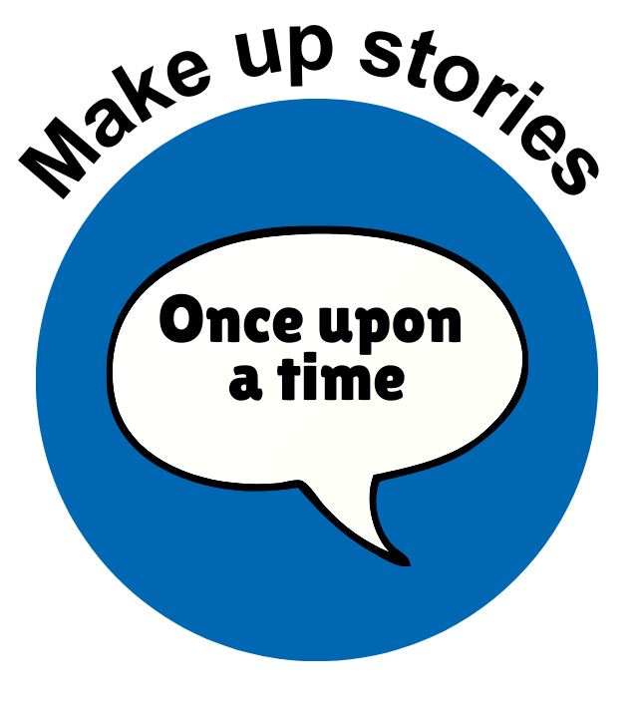


Session 3: Building a Routine
There are many ways to
share a story . . .​
Babies learn best when ​you talk directly to them, ​not when they listen to tv, ​an app, or to recorded music.​
Share books with your baby by talking, singing, playing, or asking questions.
Babies like seeing pictures of familiar things like faces, animals, clothing, toys, or other babies.
If baby responds, even with a sound or a smile, repeat the response and add on to it. Expand the conversation and describe your actions to baby.
Notes:
In addition to sharing songs and rhymes, be sure to share books with your baby every day. There are lots of different ways to share stories and books with your baby– by talking, singing, playing, and asking questions. If baby responds to you with a sound or a smile, repeat that response and expand on it by adding new information, or narrating your actions to baby. Brain research tells us that babies learn best when a real person talks or sings directly to them, rather than by listening to talking or singing on TV or via an app. ​
​
That's not to say that recorded music isn't valuable. It can be used to help adults get up and dance with baby or learn words to songs. It can also be used as an aid, just like we use shakers to make music. ​
​
When sharing books with baby, keep in mind: ​
​
Babies have short attention spans. Reading aloud introduces baby to words and to language use. However, most babies do not have the attention span to hear an entire book read aloud - sometimes even two pages is too much! They DO enjoy hearing your voice and looking at one or more pictures. Feel free to read just one or two pages aloud, or don’t read at all… simply talk about the book! You don't even have to start at the beginning. You can talk about the physical book, like the shape, how the pages feel, how the pages turn, or you can take a picture walk through the book and talk about what you see in the illustrations. ​
​
Newborns prefer high contrast black and white pictures. At birth, all of your baby’s senses are activated at once, flooding the brain with information. Looking at picture books with many colors may be TOO MUCH for them. Newborns like to focus on simple, high contrast black and white images that are easy for them to see and that hold their attention while allowing their minds to rest. By the time they are about 5 months old, many babies have developed good color vision. ​
​
A book is not the only way to share a story. Stories can be made up on the spot or inspired by the world around you.​
We are going to share a story with everyone now [Staff note: Read a book of your choice to families]

Slide 8
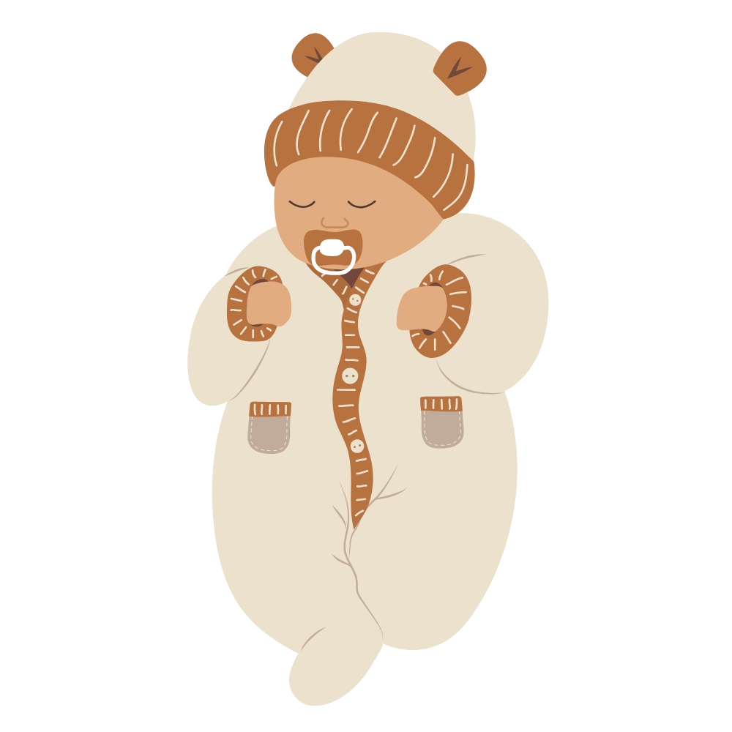
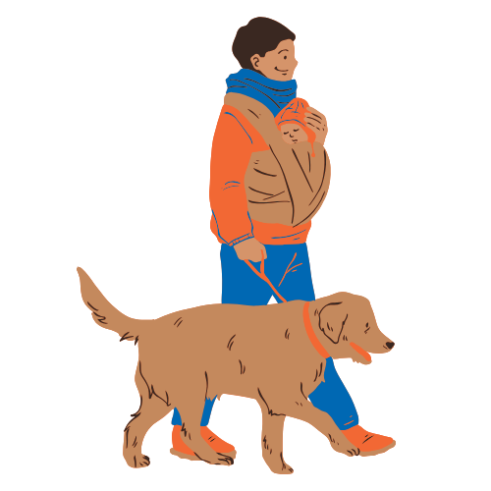
Session 3: Building a Routine
A happy baby is ready to learn​.​
Here Are Baby's Fingers
Tune: "Oh, Where, Oh, Where Has My LIttle Dog Gone?" by Septimuus Winner
Here are baby's fingers.
And here are baby's toes.
Here is baby's belly button.
Round and round it goes!
(Repeat with baby's ears,
nose, and belly button, etc.)
Watch your baby's face and talk about their reactions to different activities.​
This Little Baby Is Ready for a Nap​
This little baby is ready for a nap.
Lay baby down in a loving lap.
Cover baby up so they won't peep.
Rock the baby 'til they're fast asleep.
Substitute your baby's name for the word "baby" in any song or rhyme!​
Notes:
Science tells us that when we are warm, fed, safe, and snuggled up with someone we love, our brains release a chemical called serotonin. This makes us feel happy, which makes it easier for us to learn. When you snuggle with your child and sing and read together, their brains soak up the language they hear and the serotonin helps make that learning permanent. Snuggling, talking, and singing with your child helps get them ready to read. ​
​
This nurturing behavior helps to build early literacy skills while also strengthening the bonds between you. The same technique for strengthening personal bonds and building readiness skills applies to anyone involved in your baby’s life.
​
One way to help your baby bond with extended family and other caregivers is to use singing and reading. Ask relatives to sing and read to your baby, whether in-person or during a phone call or video call. Maybe even teach them some of the songs you've learned here today. It will be much more fulfilling, and your baby will benefit by sensing that the conversation or song is directed at them. ​
Watch your baby's face and talk to them about their reactions to different activities. Let's try singing a song and noticing baby's reactions: ​
​
Here are Baby's Fingers (tune of "Where Has My Little Dog Gone?")
Here are baby's fingers.
And here are baby's toes.
Here is baby's belly button. (PAUSE)
Around and round it goes!
Here are baby's little ears,
And here is baby's nose.
Here is baby's belly button. (PAUSE)
Around and round it goes!
​
That was great! Now we'll sing the song again, but this time, substitute your baby's name for the word "baby" in the song and sing about another body part. ​
[This song can also be sung as "WHERE are baby's fingers? WHERE are baby's toes? . . . OR it can spoken.]
​
[Repeat song with baby's name] ​
​
Speaking of fingers and toes, here's a rhyme that we call a finger play because you can use baby's fingers to act out the rhyme. ​
​
This Little Baby is Ready for a Nap​
This little baby is ready for a nap. (hold up your index finger) ​
Lay baby down in a loving lap. (put your index finger in the palm of baby's hand) ​
Cover baby up so they won't peep. (baby's fingers will instinctively wrap around your finger) ​
Rock the baby 'til they're fast asleep. (rock baby's hand back and forth)

Slide 9
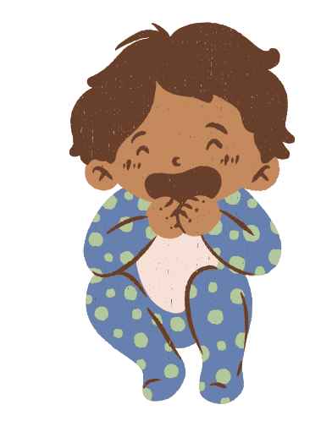
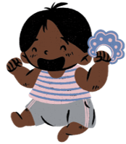
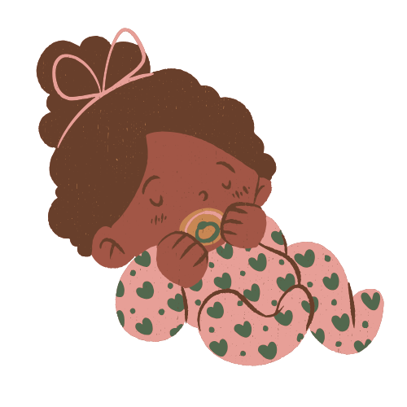

Session 3: Building a Routine
Rhymes & Songs
This is Big, Big, Big ​
This is big, big, big.
This is small, small, small.​
This is short, short, short.
This is tall, tall, tall.​
This is fast, fast, fast.
This is slow, slow, slow.​
This is yes, yes, yes.
This is no, no, no. ​
Who's That? ​
Who's that tapping on my shoulder?​
Who's that kissing on my head?​
You are tapping on my shoulder.​
You are kissing on my head. ​
We Clap Our Hands Together
Tune: "For He's a Jolly Good Fellow"
We clap our hands together, (3x)​
Because it's fun to do!​
We wave our arms together, (3x)​
Because it's fun to do!​
We wiggle our fingers together, (3x)​
Because it's fun to do!​
Pat-a-Cake
Tune: "Twinkle Twinkle Little Star"
Pat-a-cake, pat-a-cake,​
Baker's man.​
Bake me a cake as fast as you can.​
Pat it, and poke it, and mark it with a "B".​
Put it in the oven for Baby and me.​
Notes:
Now we are going to practice a variety of rhymes and songs you can do with baby. ​
​
[Pick songs/rhyme from the slide OR pick some of your favorites to share and do together]

Slide 10
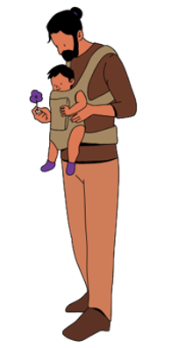
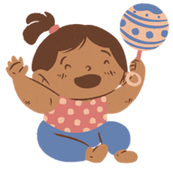
Session 3: Building a Routine
Babies are scientists!
I Have a Little Shaker
Tune: "We're Going to Kentucky" by Bob McGrath
I have a little shaker, I'll shake it in the air​.
I'll shake it over here, and I'll shake it over there​.
It can be a carousel, going round and round​.
It can be a shooting star, falling to the ground​.
I have a little shaker, I'll shake it in the air​.
I'll shake it over here, and I'll shake it over there​.
Shakers Away
Tune: "It's Raining, It's Pouring"
Shakers away, shakers away​.
Put your shakers away today​.
Playing with musical instruments sparks curiosity and encourages scientific exploration.​
Songs can help baby transition from one activity to the next.​
Notes:
Did you know that babies are scientists? They learn through observation. Playing with musical instruments sparks curiosity and encourages scientific exploration. Please take your shakers out of your kit. Your baby probably won’t do much more than simply hold it or taste it. That’s fine; children love to explore in whatever way they can, which, at this age, often means by using their mouths. Soon enough your child will be shaking the shaker to the beat! ​
​
Let's sing this shaker song together. Shake to the beat – gently! ​
​
I Have a Little Shaker (TUNE "Going to Kentucky")​
I have a little shaker, I'll shake it in the air.
I'll shake it over here, and I'll shake it over there.
It can be a carousel, going round and round.
It can be a shooting star, falling to the ground.
I have a little shaker, I'll shake it in the air.
I'll shake it over here, and I'll shake it over there.
​
Time to put the shakers back in the kits. Songs can help baby transition from one activity to the next, and singing a clean up song turns cleaning up into a fun game. As your babies get older, you will notice that they willingly put things away when you sing this song! ​
​
Shakers Away (TUNE: It's Raining, It's Pouring)​
Shakers away, shakers away, ​
put your shakers away today. ​
Shakers away, shakers away, ​
put your shakers away today. ​
(Sing as many times as needed.) ​
​
[Additional optional song depending on your time] ​
​
We’ll All Shake Our Shakers​
We’ll all shake our shakers, we’ll all shake our shakers, ​
We’ll all shake our shakers because it’s fun to do. ​
Shake them up high. (shake up high in a high voice) ​
Shake them down low. (shake down low in a low voice) ​
And shake them in the middleeeeeeeeeeeee, ​
(shake in front, using a normal voice) ​
Because it's fun to do!

Slide 11




Session 3: Building a Routine
Local Parent Groups​
Library Visits​
Recreation Center Programs​
County Agencies​
Family & Friends
Building connections where you are​.
The More We Get Together​
Tune: "Did You Ever See a Lassie?"
The more we get together, together, together. ​
The more we get together the happier we’ll be. ​
'Cause your friends are my friends. ​
And my friends are your friends. ​
The more we get together the happier we’ll be. ​​
Bringing baby to library programs can help ease separation anxiety and helps adults feel less isolated.​
Notes:
It's important to build connections where you are. Having a baby can be exhausting! New parents often feel tired, unsure, and vulnerable. It’s not surprising since the new responsibility in your life takes up most of your attention and you are probably not getting a full night’s sleep. Despite this, you all made the effort to come here in order to learn more about your babies and experience new ways to talk, sing, share books, and play with them. These babies are really lucky to have you as their parents! ​
​
Parenting is difficult, and taking care of yourself is an important part of taking care of your baby. Ask for and accept help. Keep in touch with people you care about and who care about you. Tell your partner, family and friends how you’re feeling. ​
​
Early socialization can help ease baby's separation anxiety, and it can help you feel less isolated as well. Even if you already have a network of friends and family who are eager to help you, there are easy ways to connect with other people and groups in your community. Coming to Hatchlings is one of them! You can also expand your support system by joining local parent groups, connecting with other parents and caregivers at library programs (yes, we also offer other programs for parents with babies) and recreational center programs, and exploring the variety of resources offered by local and county agencies. Libraries have information on how to connect with other county agencies that can provide you with additional help. We will talk about a few of them today and we are always available after the session to talk to you about others, if needed.
​
Montgomery County Infants and Toddlers Program
While we know that every child is unique and develops at their own pace, there are times when early intervention might be really beneficial for your baby. You are the expert on your child! And if you ever have questions about their development, or are concerned about it in any way, ask your child's pediatrician. If you think your child could have some special needs, Montgomery County Infants and Toddlers could help! It is totally free for county residents, and they serve families with children between birth and the start of the school year following their fourth birthday. Early intervention services are provided in the child’s natural environment (home and community settings where a child is during the day). Services are based on each individual child’s and family’s needs and may include services such as special instruction, family counseling, speech, occupational, and physical therapy. ​
​
WIC Benefits
The Special Supplemental Nutrition Program for Women, Infants and Children, also known as WIC, is a public health program that provides nutrition education, nutritious foods, breastfeeding support, and health care referrals for income-eligible women who are pregnant or post-partum, infants, and children up to age 5. To apply for WIC you’ll need to meet qualification guidelines and schedule an appointment with your local WIC agency. ​
​
SNAP Benefits
Another food assistance program is the Supplemental Nutritional Assistance Program, or SNAP (formerly known as the Food Stamp Program). It provides monthly financial benefits to eligible households to supplement their food purchase budget. ​
​
EveryMind
For additional support, EveryMind, is another organization that provides free and confidential help. Trained staff and volunteers are ready to provide supportive listening, information, resource referrals, and crisis intervention through telephone, text, and chat services. ​
​
If you would like more information about these organizations, please talk with us after today's session, or look at the informational flyer in your bags.
​
Let's sing one last song before we wrap up today's session. This is an old library favorite, so let's do it "together!" ​
​
The More We Get Together
The more we get together, together, together. ​
The more we get together the happier we’ll be. ​
'Cause your friends are my friends. ​
And my friends are your friends. ​
The more we get together the happier we’ll be. ​
​

Slide 12
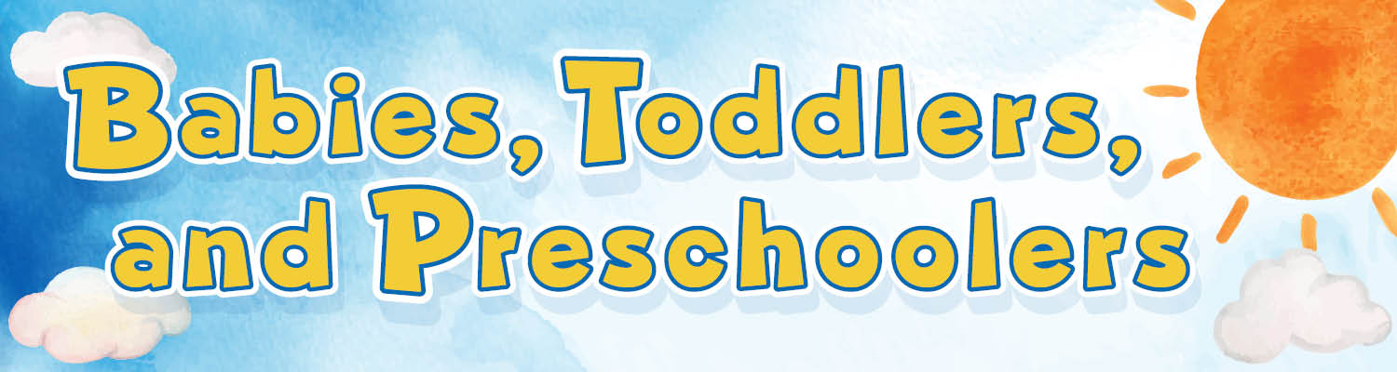



Session 3: Building a Routine
The library has so much to offer, and it’s all free!
Books
Friendly and helpful librarians
Storytimes and other children's events
Adult programs
Computers and Launchpad tablets
Other families
New friends
Baby
Storytime
Talk, Sing,
Read, Write & Play
Explore all the resources MCPL has to offer for babies, toddlers ​& preschoolers on our website!​
Notes:
Thank you so much for being here with us today. The library has so much to offer, and it's all free! Workshops like these are part of our library’s mission.
We have many free family programs and events for all ages, with songs, rhymes, stories, and more. ​
At any of our branches you can find:
Books
Friendly and helpful librarians
Storytimes and other children's events
Adult programs
Computers and Launchpad tablets
Other families
New friends
Make visiting the library part of your weekly routine. Library staff are happy to help you find what you are looking for. That is our job!
When you and your baby are ready, we’d love to see you again at these programs. They are a great way to find new ways to play with your baby and also to meet other new parents. We love seeing families playing here together. ​
Plus, anyone can get a library card and borrow books, movies, music, and more! And it is all for free. ​You can explore all the resources MCPL has to offer babies, toddlers, preschoolers, and their caregivers on our website.

Slide 13
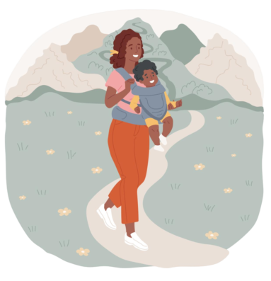
Session 3: Building a Routine
Thanks for coming!
Before you leave…
Take your kit home with you​
Get a library card! ​
Ask about other programs for you and baby ​
We hope to see you at the library!
Are there any questions?
Notes:
Does anyone have a question about anything we have done or discussed today? ​I hope it has been fun and helpful. ​​
​
Hatchlings was created especially for expectant and new parents and their babies. ​
​
It’s been a pleasure getting to know you and your babies over the past three weeks. We look forward to watching your family grow at the library. ​
​
Before you leave, please: ​
Take your kits home​
Get a library card, if you don’t already have one​
Ask about other programs for you and baby ​
​
Thank you again for attending our Hatchlings Parent Workshops.​​

