Slide 1



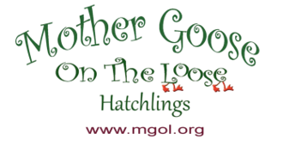

Hatchlings Parent Workshop:
Session 2: Read, Talk & Sing with Baby
This program has been adapted from Dr. Betsy Diamant-Cohen’s Mother Goose on the Loose: Hatchlings
Notes:
[Slide to be shown as participants show up for the program]​

Slide 2

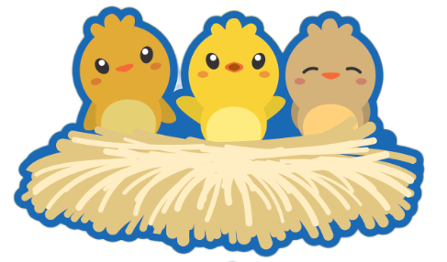
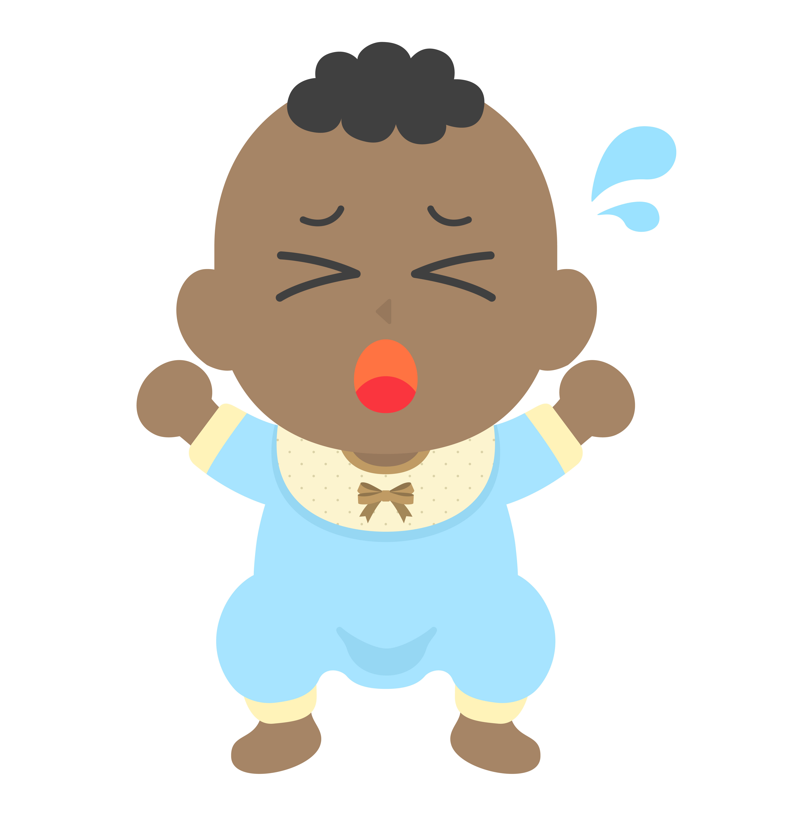
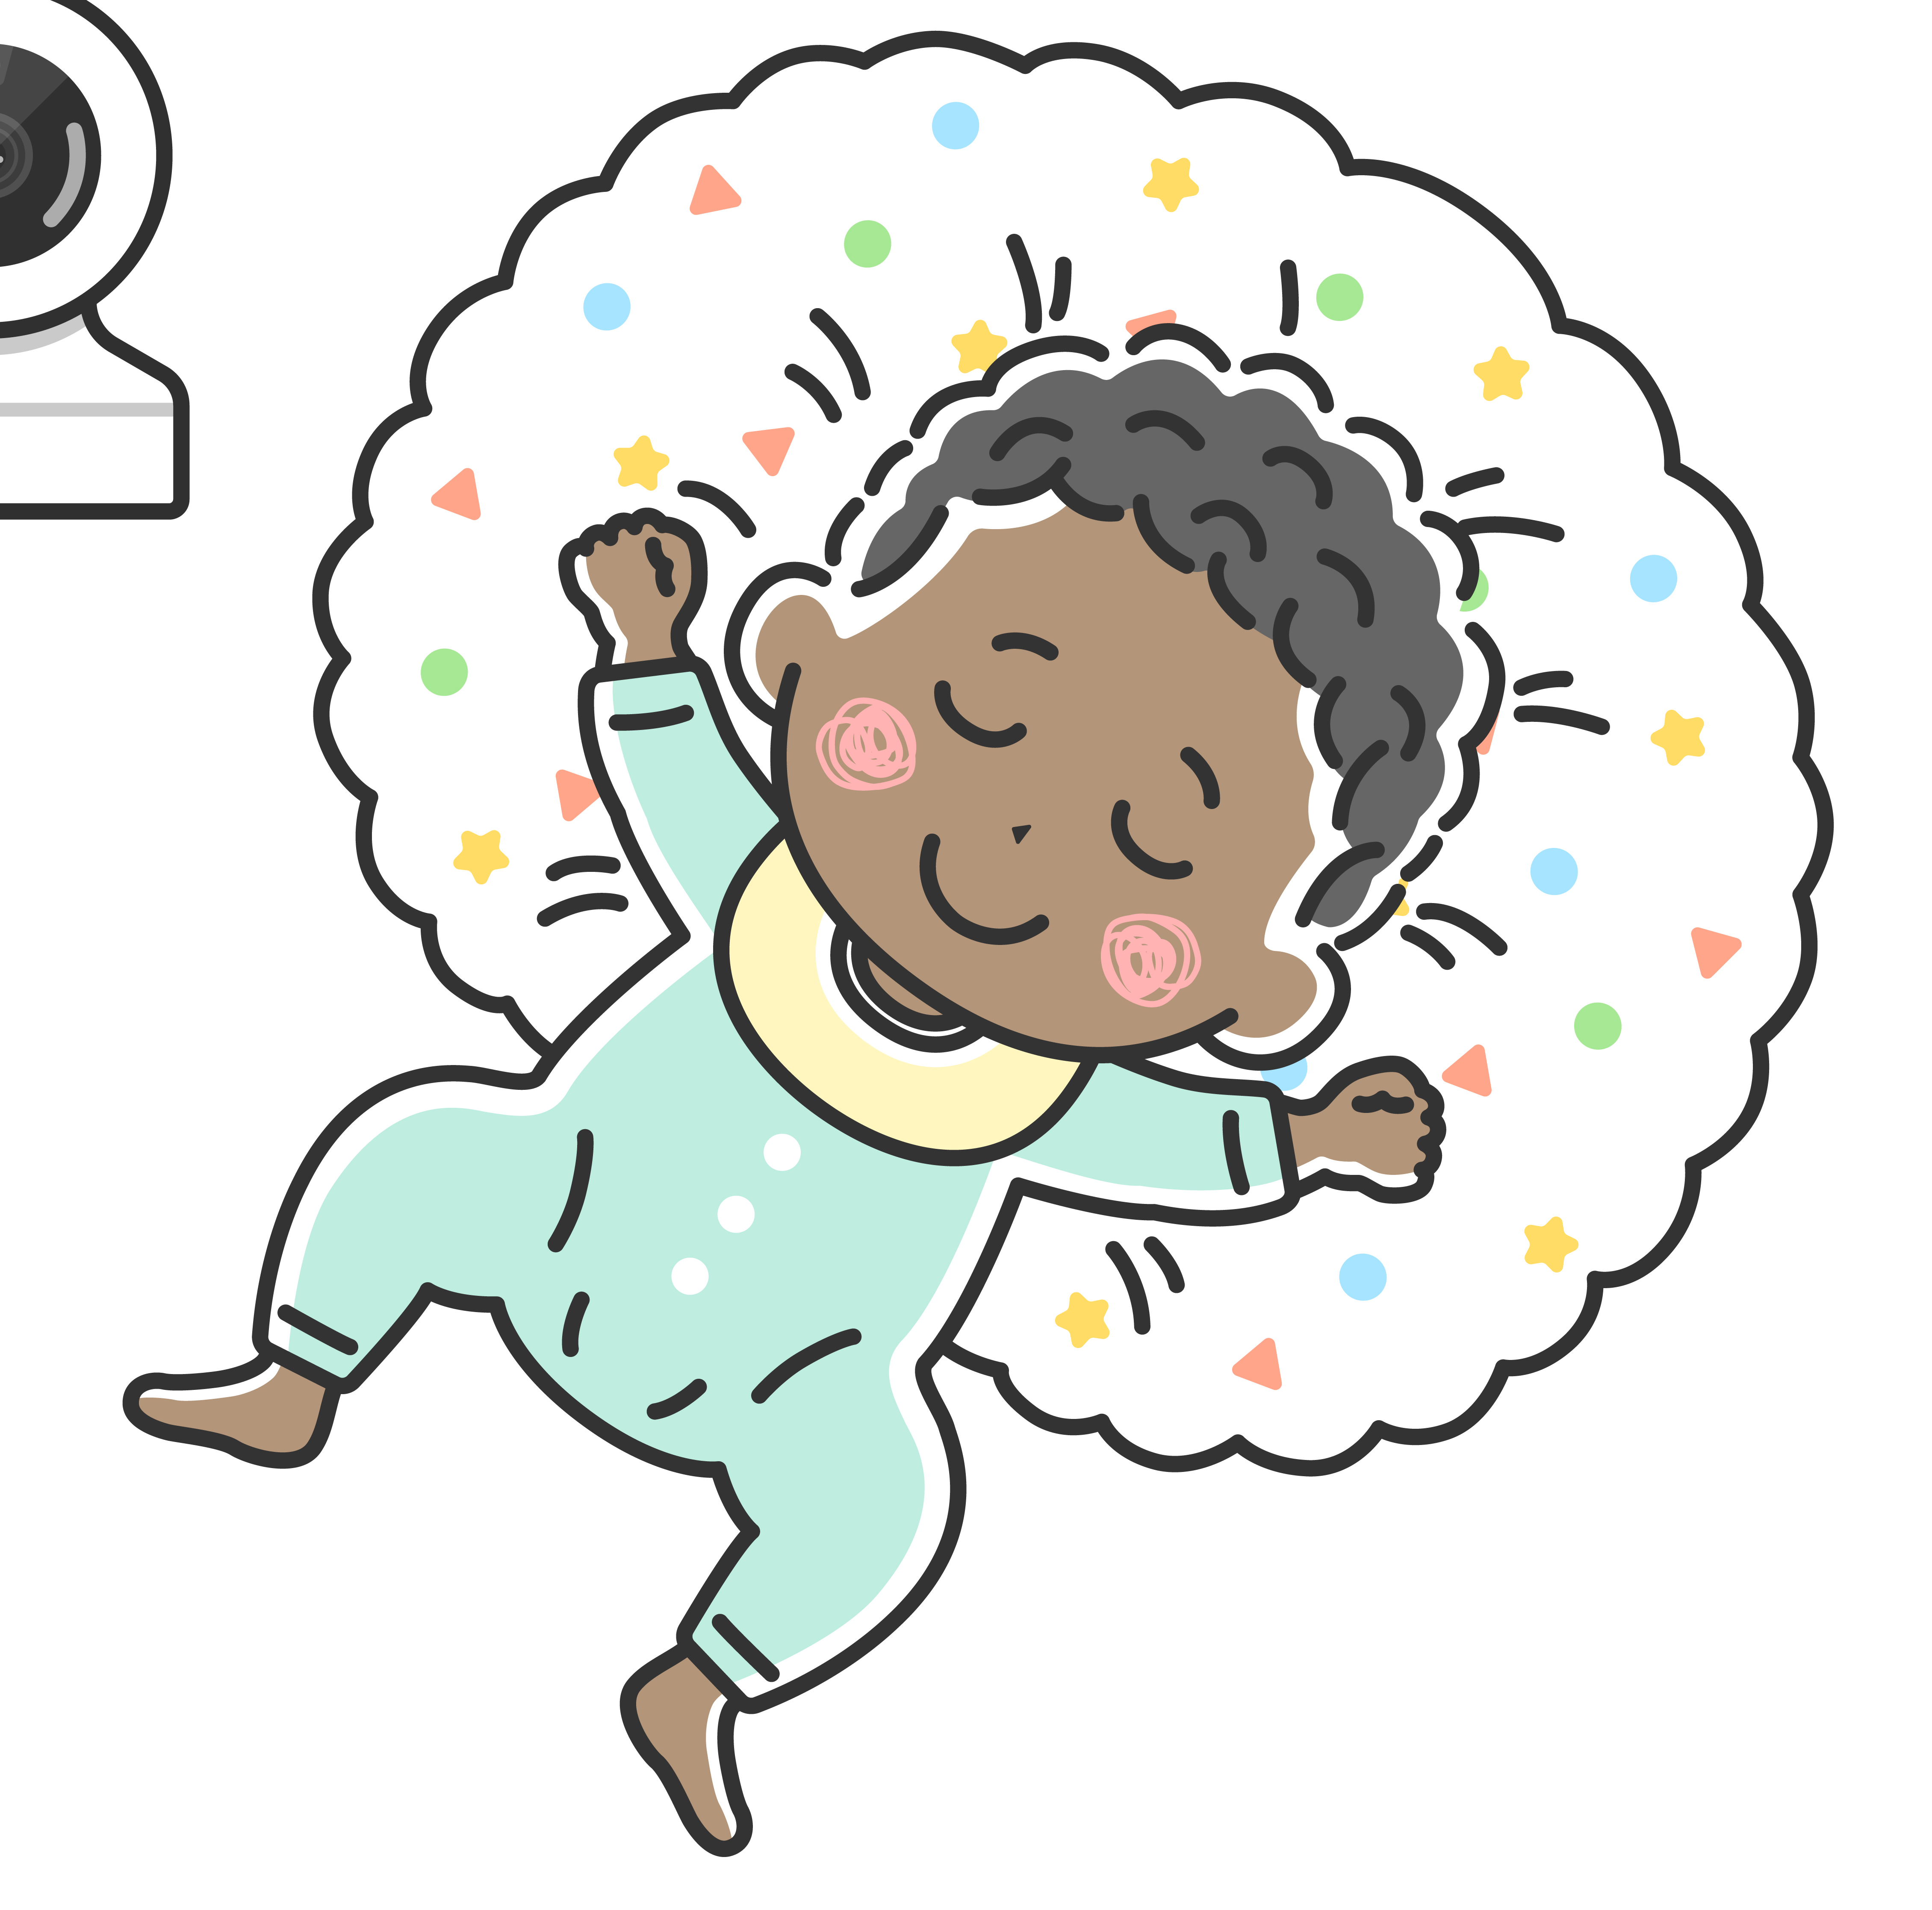
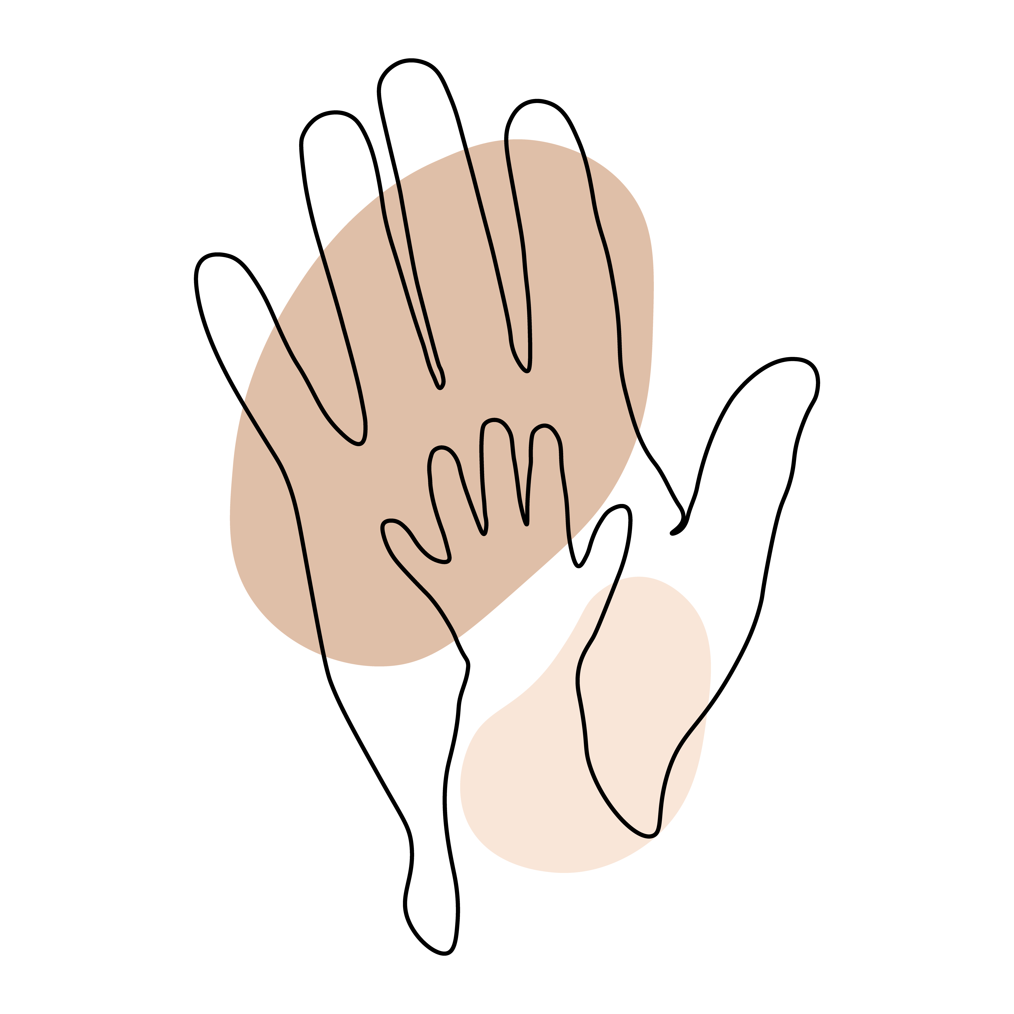
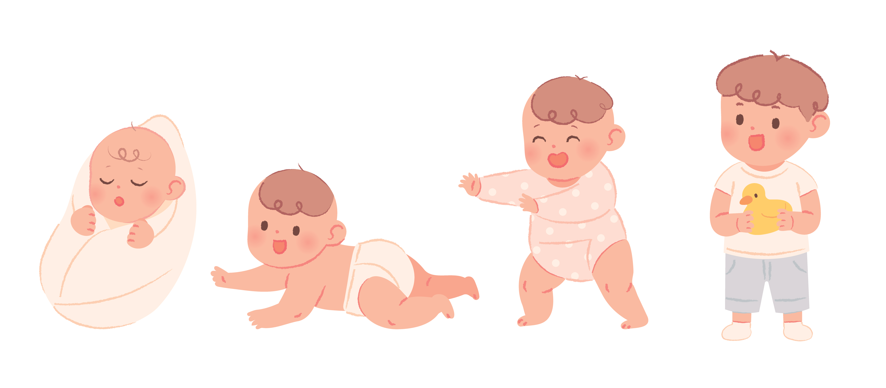
Session 2: Read, Talk, & Sing with Baby
HELLO,
Hatchlings Families!
Let's get to know each other and the program.
Unexpected is expected
Calm down without the crowd
Respect baby's rest
Hands on exploration
Stay engaged; silence phones
Notes:
Welcome! We are so glad you could make it to Montgomery County Public Libraries: Hatchlings Parent Workshop here at the [Insert Library]!
Before we get started, if you haven't already, we ask that you please sign-in and pick up the tote bag with your name on it. As a reminder we will be using the materials in your tote bag for the remaining two sessions. You will be able to take the bags home at the end of session 3.
If you have any questions, we’ll be happy to try to answer them for you. Please find a seat in the circle and make yourselves comfortable.
You are here for Session 2, where we will learn about reading, talking, and singing with baby. This workshop has been adapted from the "Mother Goose on the Loose: Hatchlings" program, created by Dr. Betsy Diamant-Cohen.
As you can see [look around] this workshop is specifically targeted toward expectant parents and new parents. It is our hope that through these three workshops that you will leave feeling confident about how you can support your baby's growth and development from birth and beyond.
It’s so good to see some familiar faces, let’s remind each other of our names. I’ll go first. [Staff Introductions followed by customer introductions]
As a refresher, let's go over a few guidelines for getting the most out of this workshop.
-For those of you with newborns or young children with you here today, the "unexpected is expected." If your little ones cry or need something, it's OK. They will wiggle and make baby noises, and that's just fine. But, if they are crying loudly or becoming distracting, please feel free to step out of the room, and come back in when they are calmer. Sometimes, it is easier to calm baby down without the crowd. Feel free to take a break, leave the room, and rejoin us when you are ready.
-Respect baby's rest. Babies need their sleep. If your little one is sleeping, don't feel like you need to wake them. You are here to learn the tools that you will be able to take home with you. You can still sing along and participate, so you're ready for when they are awake.
-Hands on exploration: By coming here today to learn everyday simple things that you can do to support your baby's brain development, you are giving your child a big head start, right from the beginning!
-Stay engaged. We ask that you silence your phones during this workshop. In fact, MCPL has a no photography or videography policy. We do not allow photos, audio, videos, recording or streaming of any kind to be taken inside the library, so you don't need those phones anyway.
Now that we've gone over the guidelines, let’s start off with a song – you will see that we are going to be doing a lot of that over the next hour or so! You will receive a copy of these slides at the end of each session along with the song book you will find in your tote.
Suggested song: [you may use a different hello or welcoming song]
WELL HELLO EVERYBODY
Well hello everybody, yes indeed,
Yes indeed, yes indeed.
Well hello everybody, yes indeed,
Yes indeed, my baby.

Slide 3
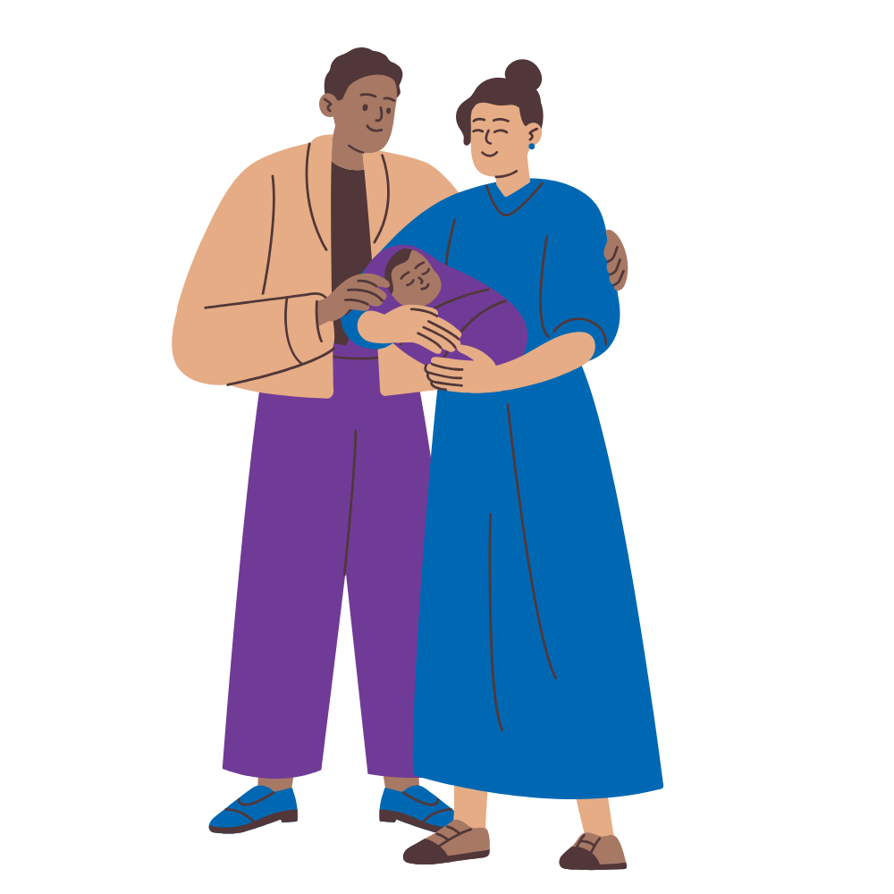

Session 2: Read, Talk, & Sing with Baby
Learning Objectives: Session 2
Discover ways to create a language-rich environment for baby
Explore ways to use books and conversation to foster language
Learn new rhymes and songs
When you are feeding your baby, talk about your day.
Notes:
Today's session is all about creating a language-rich environment for baby, through rhymes, songs, books, and conversation.
We're also going to introduce you to a variety of rhymes and songs for your "parenting toolkit." You might already know some of these, and others might be new to you. You might even learn how to use old favorites in new ways!
TIP: Try to have screen-free mealtimes together, free from distractions, and have conversations with baby and other family members, discussing the events of everyone's day. Practice this early by singing a song or talking softly to baby while they are nursing or sucking on a bottle.

Slide 4
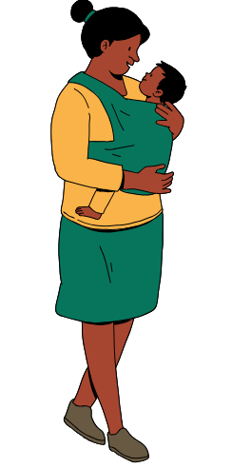
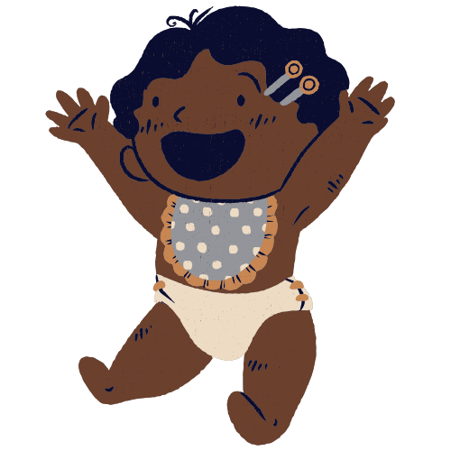
Session 2: Read, Talk, & Sing with Baby
Singing, talking, and sharing books with babies builds their brains and their language skills.
Little Miss Muffet
Little Miss Muffet sat on a tuffet
Eating her curds and whey.
Along came a spider
Who sat down beside her
And frightened Miss Muffet away!
Baa, Baa, Black Sheep
Tune: "Twinkle Twinkle Little Star"
Baa, baa, black sheep, have you any wool?
Yes sir, yes sir, three bags full.
One for the mister, and one for the dame,
And one for the little kids who live down the lane.
Baa, baa, black sheep, have you any wool?
Yes sir, yes sir, three bags full.
DID YOU KNOW?
Nursery rhymes are a great way to introduce baby to new and unusual vocabulary.
Notes:
Singing, talking, and sharing books with babies builds their brains and their language skills too!
Scientists have discovered that babies hear words while they are still in the womb and they can remember some of what they have heard, even after birth! Children who have a strong language base and a positive feeling about books from early on have better language skills than those whose caregivers waited until later to expose them to books and reading.
That is why we are offering this program. We want to give you lots of songs, rhymes, and games as well as tips for using books with your children from their earliest years. Doing them here and continuing to share them at home with your babies will help to build their brains and their language skills at the same time.
Repetition of rhymes is good for the brain! It teaches babies how their language works, and it helps to improve their memory, concentration, spatial intelligence, and reasoning skills. Because these verses are made up of patterns, they are easy to remember. Nursery rhymes are organized so that similar sounds jump out at you, which does not always happen in everyday conversation. Nursery rhymes help your child’s brain segment words into syllables and enables them to hear similarities between words that rhyme or words that start with the same sounds. They are also a great introduction to stories since many contain a beginning, a middle, and an end (this is called sequencing, and it will help to build the foundation for learning counting and math skills later on!). Most importantly, they are fun (and often funny).
During the rest of the program, I will recite each rhyme twice. The first time you can listen; the second time, recite the rhyme along with me. If you already know the rhyme, please feel free to say it both times.
Let's start with a rhyme:
Little Miss Muffet
Little Miss Muffet sat on a tuffet
Eating her curds and whey.
Along came a spider
Who sat down beside her
And frightened Miss Muffet away!
[Now do it together]
Great, job! Let's sing another classic together:
Baa, Baa, Black Sheep
Baa, baa, black sheep, have you any wool?
Yes sir, yes sir, three bags full.
One for the mister, and one for the dame,
And one for the little kids who live down the lane.
Baa, baa, black sheep, have you any wool?
Yes sir, yes sir, three bags full.

Slide 5
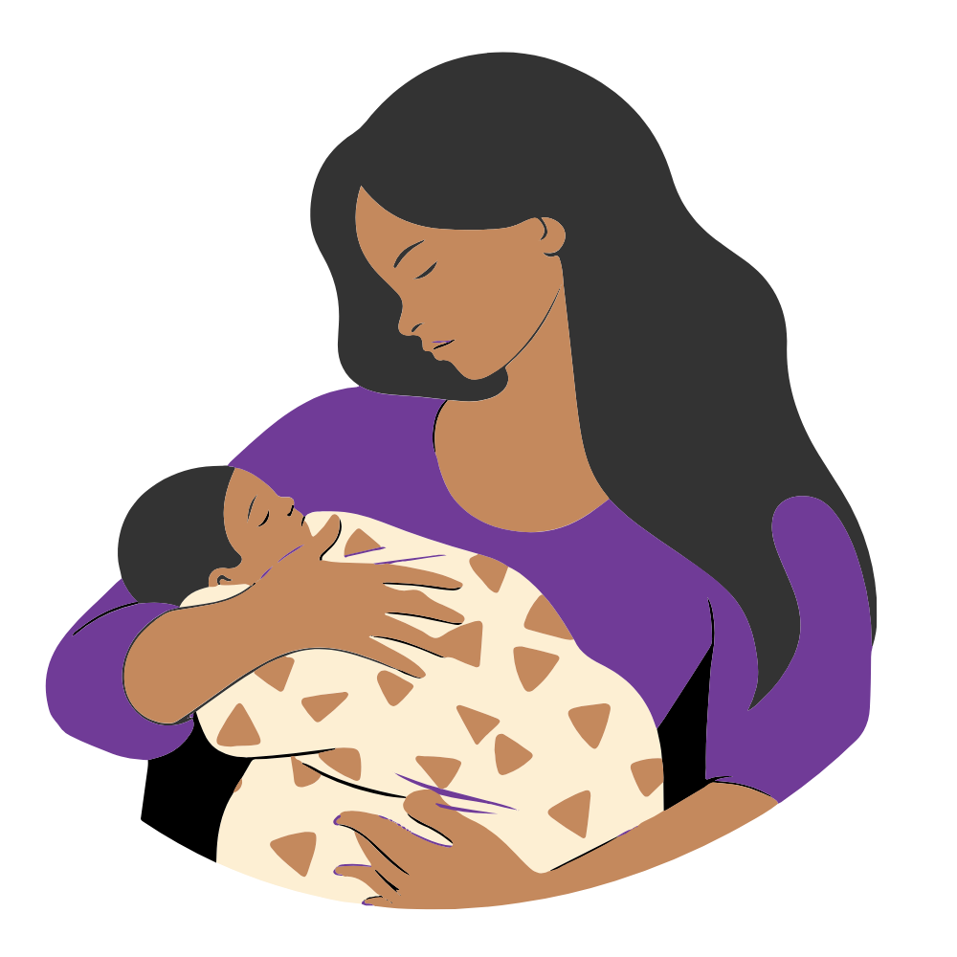
Session 2: Read, Talk, & Sing with Baby
All the Little Babies
Tune: "Single Ladies (Put A Ring On It)" by Beyoncé
All the little babies - all the little babies
All the little babies - all the little babies
All the little babies - all the little babies
Now put your hands up.
Oh, oh, oh, oh, oh, oh, oh, oh!
You can share songs with baby at any time during the day. And you can always make up a song to your favorite tune.
Bouncing My Little Baby...
Tune: "Bumping Up and Down in My Little Red Wagon" by Raffi
Bouncing up and down with my little baby.
Bouncing up and down with my little baby.
Bouncing up and down with my little baby.
Love my little baby.
Bouncing to the left and hug my baby.
Bouncing to the right and hug my baby.
Stay in the middle and hug my baby.
Love my little baby.
If you are having fun, your baby will have fun too!
Notes:
That was a lot of fun!
You can share songs with your babies at any time during the day. And you can always make up a song to your favorite tune.
We love singing songs at our storytimes and lots of children’s librarians make up songs to their favorite tunes too!
When you are smiling and enjoying playing with rhythms, rhymes, and sounds, your baby learns these are fun and will enjoy them too.
We are going to sing a song to a tune, we are sure you all have heard. We are going to sing a little of Beyonce’s “All the Single Ladies” but we are going to change the words to “All the Little Babies”.
All the Little Babies
All the little babies - all the little babies
All the little babies - all the little babies
All the little babies - all the little babies
Now put your hands up.
Oh, oh, oh, oh, oh, oh, oh, oh!
Another song that you may be familiar with is "Little Red Wagon." Here we've changed the words to create a fun bounce for you and baby. Please remember bouncing with newborns should be done very gently. Newborns do not have well-developed neck muscles so always support your baby's head when bouncing. Let's give it a go.
Bouncing My Little Baby...
Bouncing up and down with my little baby.
Bouncing up and down with my little baby.
Bouncing up and down with my little baby.
Love my little baby.
Bouncing to the left and hug my baby.
Bouncing to the right and hug my baby.
Stay in the middle and hug my baby.
Love my little baby.

Slide 6
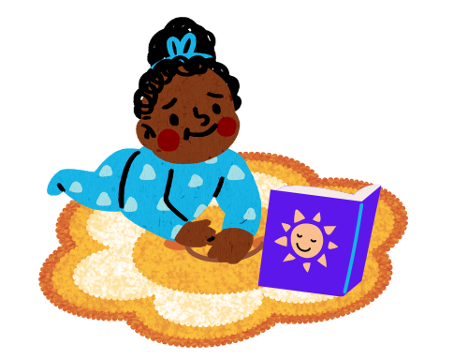
Session 2: Read, Talk, & Sing with Baby
Make time for tummy time!
Quick Tips
It's best to try tummy time when your baby seems most happy.
Most babies can start tummy time shortly after birth for a few minutes each day, gradually increasing as babies gets older.
Tummy time on a regular basis is good for strengthening head, neck, and upper body muscles, plus it develops the coordination needed for rolling over.
Tummy time should always be supervised by an adult!
Notes:
Now, let's talk a little bit about making time for tummy time.
When your baby is awake and seems most happy, put a clean blanket on the floor, and place your baby on the blanket, tummy side down. That’s tummy time! If your baby is up for it, try it now. Place a blanket on the floor. Take your board book out of your kit. Open up the book and place it in front of your baby, with the pictures facing them, like this. [demonstrate]
Babies often want to lift their heads to look at the pictures! If your baby is a newborn, start out slowly, with just 2-5 minutes of tummy time, but you can work your way up to a full hour a day (although it can be broken into parts) by the time your baby is 3 months old. Babies who do not like tummy time do better when lying chest-to-chest with a parent who talks and plays with them during this time.
Many pediatric organizations recommend giving babies “Tummy Time” on a regular basis to strengthen head, neck, and upper body muscles. This helps babies develop the strength and coordination needed for rolling over, crawling, reaching, and playing. Even newborns benefit from Tummy Time.
Tummy Time should always be supervised by an adult. And, although Tummy Time is important for early muscle development, it is crucial that babies sleep on their backs and not on their stomachs to prevent SIDS [Sudden Infant Death Syndrome]. This applies to nap time as well as to bedtime.
"Babies are actually safer [sleeping] on their backs. When a baby is on their back, the air tube is on top of the food tube. When baby spits up, liquid flows back into the stomach, not the lungs. When baby is on their stomach, fluid can pool at the opening of the air tube and may cause choking." (Michigan Department of Heath and Human Services)

Slide 7
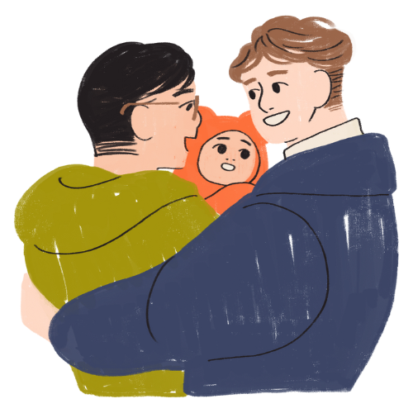
Session 2: Read, Talk, & Sing with Baby
Rhymes and Games
Smiling at your baby is very important.
Peek A Boo
Peek a boo, I see you, I see you hiding there.
Peek a boo, I see you, I see you smiling there.
PEEK A BOO!
This Is Big, Big, Big
Round And Round The Garden
Here Are Baby's Fingers
Try to match the words you sing or say
with visual cues. Sing or talk about sizes,
or name body parts.
Peek a Boo is a fun way to engage with baby.
Notes:
By the age of 3 months, your baby will be able to engage in "smile talk." They'll start a "conversation" with a broad smile and gurgling in the hopes of getting your attention. They start to recognize the most important people in their lives, and will prefer the familiar faces of their caregivers, especially when they are smiling at them! By responding to these "conversations" you are letting your baby know that they are important, and that they can trust you to be there to respond to their needs. As you get to know baby better, you will see what they need and enjoy most.
One of the most essential interactions to help your baby's brain develop is called "serve and return." This happens when children and their grown-up caregivers interact in meaningful ways. Baby will reach out for interaction through babbling and gestures, and the caregivers respond to them. For instance, if your baby says ‘goo,' look her in the eyes, smile, and say back “and Goo to you too!” Then pause and wait for your baby to respond. When an infant or young child babbles, gestures, or cries, and an adult responds with eye contact, words, or a hug, neural connections are built and strengthened in the child’s brain that support the development of communication and social skills. The neurons, which are reinforced through repetition of this serve and return, build the structure in the brain for future learning. A simple game of peek-a-boo is the perfect example of this kind of interaction!
Research says that at least one stable and committed relationship with a supportive parent, caregiver or other adult helps children build self-esteem and resilience. This is an important skill that begins in the first few years, and extends into adulthood. (Center on the Developing Child at Harvard University).
Let's try playing peek-a-boo now! Remember, it is the grown-up who "hides" not the infant!
[Play peek-a-boo]
Great! Now let's try doing peek-a-boo with a rhyme together:
Peek A Boo
Peek a boo, I see you, I see you hiding there
Peek a boo, I see you, I see you smiling there
PEEK A BOO!
Oftentimes, rhymes and songs have an element of play to them. Playing with your child is important. One way you can do this is by trying to match the words you sing or say with visual cues. Sing or talk about sizes, or name body parts. Some examples of these types of rhymes are "This is Big, Big, Big" "Round and Round the Garden" and "Here are Baby's Fingers."
Here are Baby's Fingers (tune of "Oh, Where, Oh, Where Has My Little Dog Gone?" written by Septimus Winner
Here are baby's fingers.
And here are baby's toes.
Here is baby's belly button. (PAUSE)
Around and round it goes!
Here are baby's little ears,
And here is baby's nose.
Here is baby's belly button. (PAUSE)
Around and round it goes!
[This song can also be sung as "WHERE are baby's fingers? WHERE are baby's toes? . . . OR it can spoken.]

Slide 8
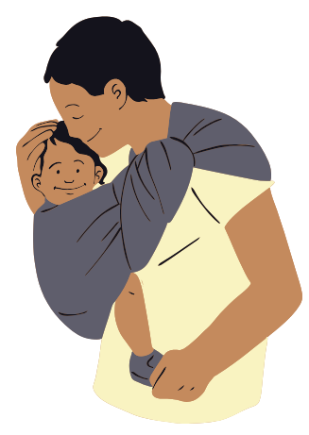
Session 2: Read, Talk, & Sing with Baby
Words are full of fun sounds.
Your Name Song
Tune: "Your Name Is..." by Bob McGrath
Your name is _____ that's your name,
Your name is ____ always the same,
Your name is ____ all the time,
Your name is ____ isn't that fine.
Quick Tips
Tapping out your child's name helps them hear the syllables and sounds in words.
Gently bounce your baby to the syllables of the words.
Clap baby's hands or bounce your finger while baby holds on to it.
Baby's name is one of the first words they recognize.
Notes:
When we read, sing, and talk to young children they begin to understand that words—like music—are made up of discrete sounds. This is called phonemic awareness. Later, children use that knowledge of sounds to build words and read. Research shows that children who are familiar with breaking down words into syllables are more successful when learning to read.
Experts tell us that the ability to move to a steady beat is fundamentally linked to language skills. (The Ability to Move to a Beat Is Linked to the Consistency of Neural Responses to Sound - PMC)
There are a number of rhythm games you can play with your child that will help develop their listening skills. Anything can be a drum! You can use a book, a box, or anything else that you can tap, including body parts.
In fact, tapping out your child's name helps them hear the syllables and sounds in words. Let's practice tapping out baby's name.
[All try simultaneously or show some examples yourself]
Another way to practice this is by gently bouncing your baby to the syllables of the words. You can also clap baby's hands or bounce your fingers while baby holds on to it.
There are many developmental milestones you'll experience with your baby in their first year. Although all children develop at their own rate, one of the milestones you will see at about 4 or 5 months is when baby learns to recognize their own name. You can help this along with Repetition. When you’re playing with or talking to your child, use their name a lot. Address them directly and look right at them. Use their name and talk to them about what makes them special: their beautiful eyes, their cute cheeks, their happy smile, etc. Using an affectionate tone and warm facial expressions when you look at them and say their name will help them to associate their name with positive feelings and love.
Let's sing and clap a song with baby's name.
Your Name Is...
Your name is _____ that's your name,
Your name is ____ always the same,
Your name is ____ all the time,
Your name is ____ isn't that fine.

Slide 9
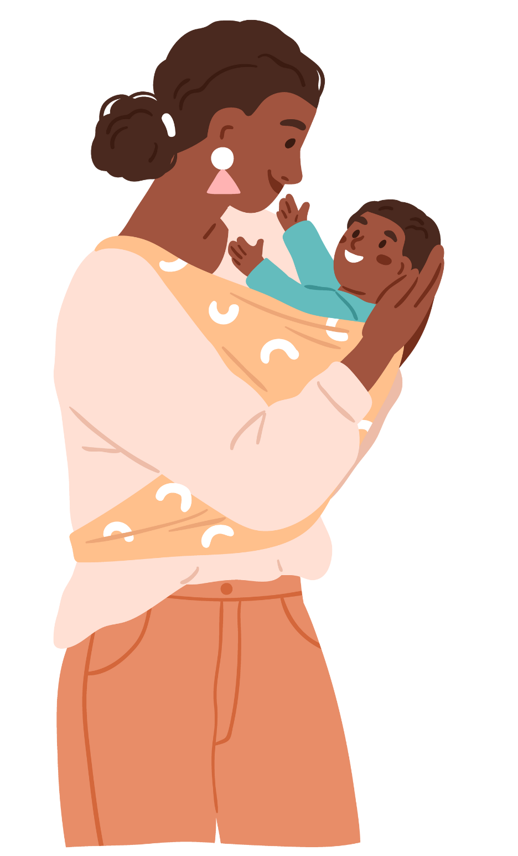
Session 2: Read, Talk, & Sing with Baby
Songs
Babies learn movement
words by acting them out
We Walk and We Walk and We Stop!
Sway
Tiptoe
Dance
Walk
Slide
Baby Hokey Pokey
Tune: "The Hokey Pokey"
Our Arms Go Up and Down
Tune: "The Farmer In The Dell"
Movement fires up the brain and helps babies learn new words to describe motion.
Notes:
Playing music, singing, and dancing are all great ways to have fun with your newborn while helping baby's brain grow.
Your baby loves dancing with you. Babies learn movement words by acting them out. Movement fires up the brain and helps babies learn new words to describe motions, like sway, tiptoe, dance, walk, slide. Can you think of other movement words to practice with baby?
[Pause for response]
In addition to building your child’s vocabulary, there are lots of other ways that movement helps to support your child’s learning:
Words like up and down, over and under, through and around, begin to develop your child’s spatial awareness and lay the foundation for learning math concepts.
Gently encouraging cross-lateral movements helps to develop coordination and a strong connection between the right and left lobes of the brain.
Bouncing, swaying, and dancing help to develop balance; a sense of rhythm, pattern, and sequence; and spatial-temporal reasoning (the ability to think about and plan how objects move).
Playful movement creates a positive attitude toward learning.
There are so many songs about movement and motion, such as We Walk and We Walk and We Stop, or Baby Hokey Pokey, or My Little Baby Loves Dancin', and many others.
Singing songs with your baby, like Head, Shoulders, Knees and Toes or Our Arms Go Up and Down help them learn to identify their body parts later. Let's try one right now!
[Pick your favorite to do with the group]

Slide 10
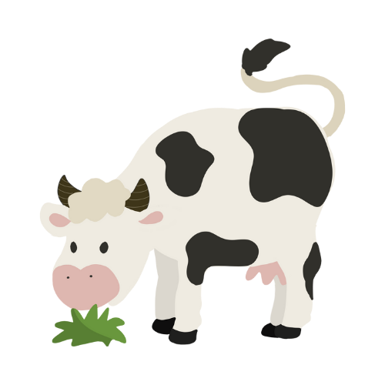
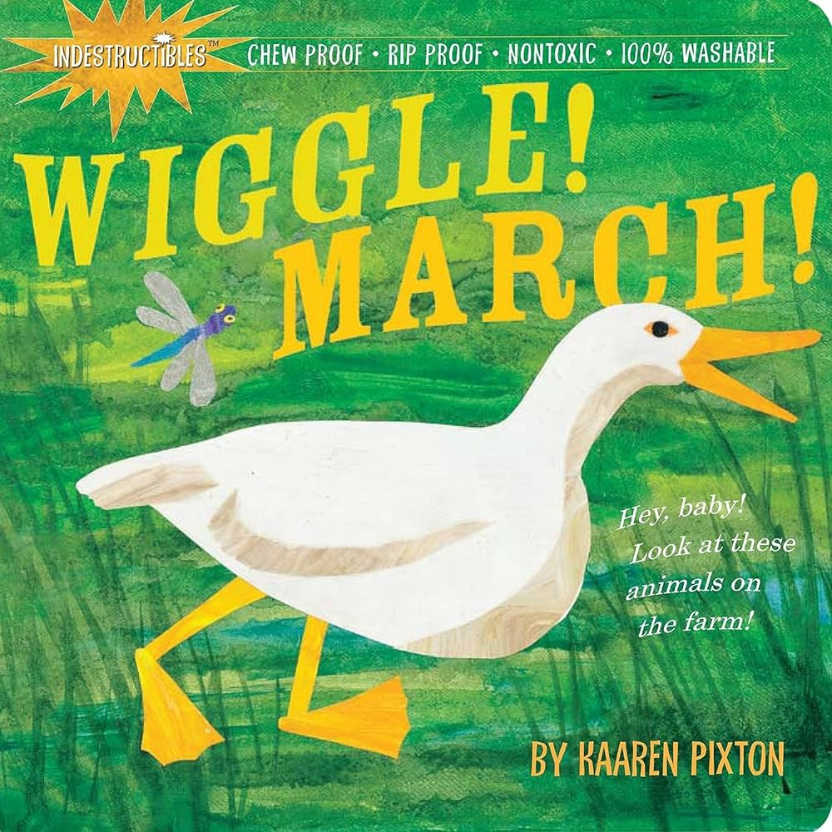
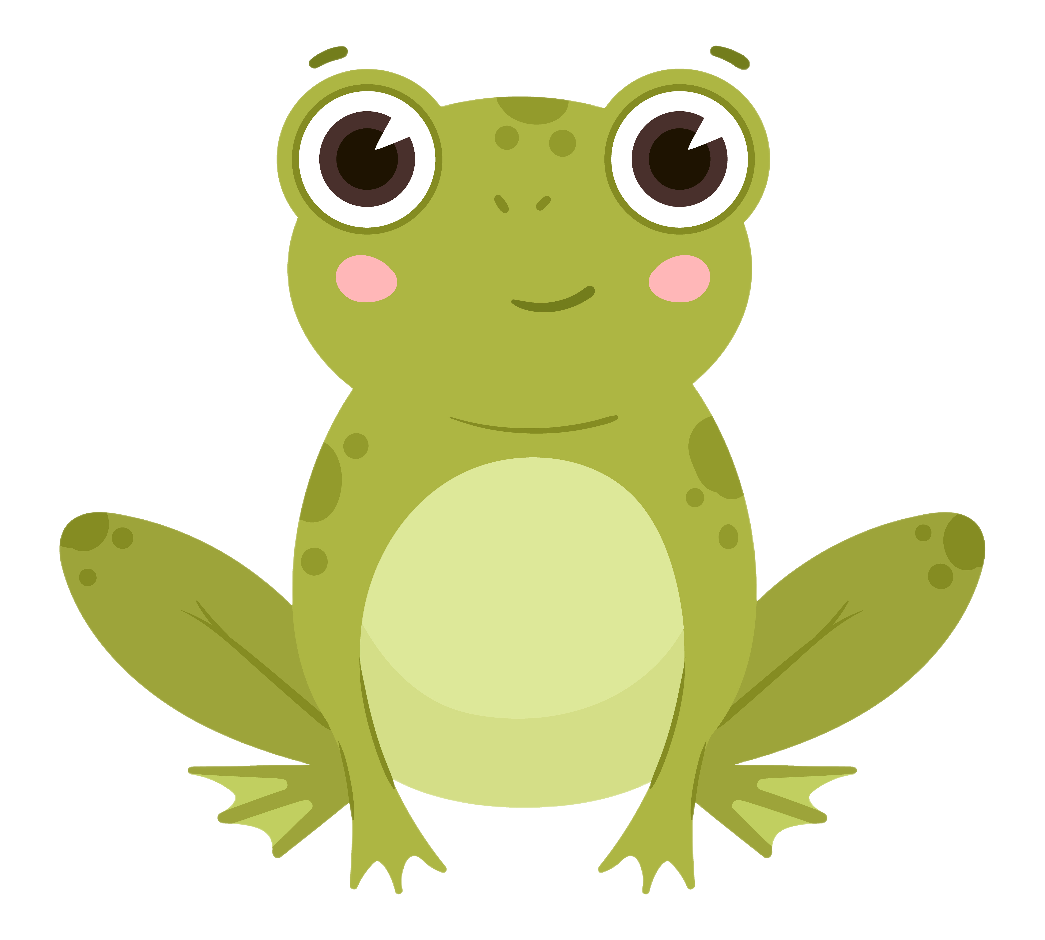
Session 2: Read, Talk, & Sing with Baby
Songs
Babies love listening to and making animal sounds.
I Went to Visit the Farm One Day
Tune: "Oats and Beans and Barley" by Raffi
I went to visit the farm one day.
I met a horse along the way.
What do you think the horse did say?
Neigh, neigh, neigh!
Making animal sounds helps children hear the small sounds in words. This helps with learning how to read.
When Cows Get Up in the Morning
Various traditional tunes
When cows get up in the morning,
They always say, Good Day! (2x)
They say, moo moo, moo moo,
That is what they say.
They say, moo moo, moo moo,
That is what they say.
Little Frog
Little frog, on a log.
Sings his song all day long.
Ribbit, ribbit, ribbit. . .
Animal sounds are different in other languages.
Notes:
Animal sounds are fun for baby to hear and to make.
Remember how we tapped out baby's name to help them hear the different sounds or syllables within words? Hearing and making animal sounds helps baby hear the smaller sounds in words.
The words we use for animal sounds are different depending on the language spoken. These differences offer practice for the specific mouth shapes needed to pronounce words correctly in that language. So, if you speak more than one language at home, make sure to teach baby the animal sounds in all the languages you speak, to get them off to a good start! Can anyone share an example of this that they know of? [Pause to share]
In your kits, there is an indestructible book [hold up book]. Take it out and feel it for a minute. These books are made out of specially treated Tyvek, the material used on the bright yellow signs around construction sites. So, it is really durable. [demonstrate.]
Now that you have your book, join in this song about the sounds the animals make. It’s very easy to pick up, so you should be singing along with me by the second verse.
All of your books should have a picture of a horse in them. Please open up your books to the horse picture and show it to your baby as we sing together.
This song goes to the tune of "I Went to Visit the Farm One Day"
I Went to Visit the Farm One Day
I went to visit the farm one day.
I met a horse along the way.
What do you think the horse did say?
Neigh, neigh, neigh!
Now let’s go to the [choose another animal] picture.
I went to visit the farm one day.
I met a [ANIMAL] along the way.
And what do you think the [ANIMAL] did say?
[ANIMAL SOUND]
There are lots of songs with animal sounds. Another example is "When Cows Get Up in the Morning..."
Now let's put away our books. We can even sing about it, to let baby know it's clean-up time.
[Sing: Books Away]
Books Away
Books away, books away,
Let's put our books away today.
Now look in your bag and find the frog puppet. Puppets are a multi-sensory way to engage with baby, both visually and through touch.
Let's ask baby some questions about the frog. Remember to pause before giving them the answer. Even though they are too young to say words, you are establishing the framework and rhythm of conversation.
What color is the frog? (green)
What does the frog say? (ribbit)
Here's a little poem about a frog:
Little Frog on a Log
Little frog on a log
Sings his song all day long
Ribbit, ribbit, ribbit...
Now let's put away our frogs. We can sing about it, to let baby know it's clean-up time.
[Sing: Frogs Away]
Frogs Away
Frogs away, frogs away
Let's put our frogs away today.
There's also a songbook in your bag. You'll take it home after session 3, so you can continue to sing these and other songs!

Slide 11
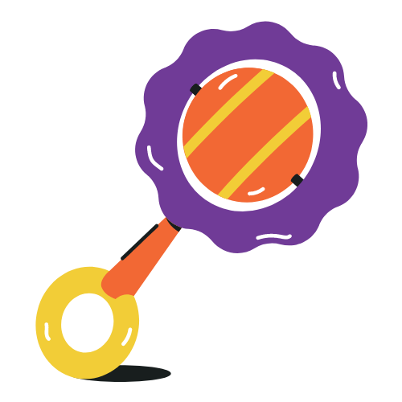
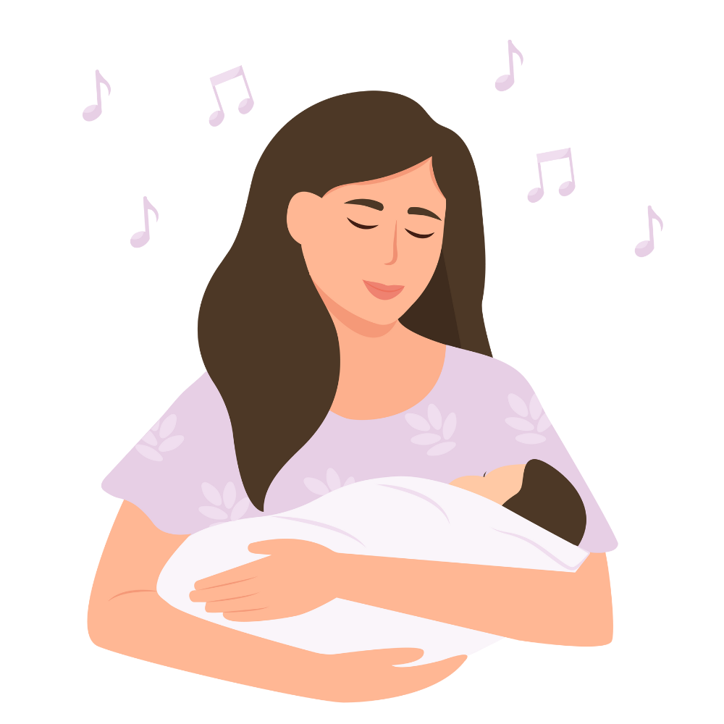
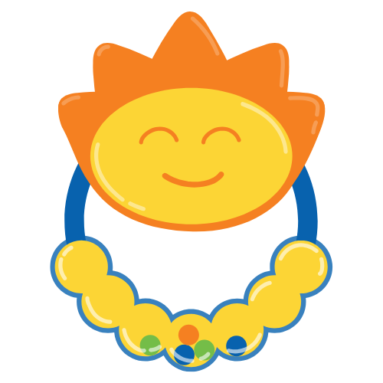
Session 2: Read, Talk, & Sing with Baby
Songs
Shakers are an easy
way for babies to access and create music
Shake Your Shakers in the Air
Tune: "London Bridge Is Falling Down"
Shake your shakers in the air,
Shake them here, shake them there.
Shake your shakers in the air,
Shake your shakers!
We All Shake Our Shakers
Tune: "For He's a Jolly Good Fellow"
We all shake our shakers (3x)
Because it's fun to do.
Shake them up high, shake them down low,
And shake them in the middle.
Shakers Away
Tune: "It's Raining It's Pouring"
Shakers away, shakers away.
Put our shakers away today.
Singing clean-up songs makes cleaning up fun.
Notes:
Shakers are an easy way for babies to access and create music. Please take your shaker(s) out of your bag. At this age, your baby probably won’t do much more than simply hold it or taste it.
That’s fine; children love to explore in whatever way they can, which often means using their mouths. Soon enough your child will be shaking the shaker to the beat!
Here's a simple song to the tune of "London Bridge is Falling Down":
Shake Your Shakers in the Air
Shake your shakers in the air,
Shake them here, shake them there.
Shake your shakers in the air,
Shake your shakers!
When children play with shakers, they are not ‘just shaking’. They are learning about the different movements their bodies can make, about music, and also about concepts. They are making music with someone and sharing a special moment in time that is real and live. Shakers also allow children to explore and experiment with cause and effect.
Here's another song about our shakers:
We All Shake Our Shakers
We all shake our shakers,
We all shake our shakers,
We all shake our shakers
Because it’s fun to do.
Shake them up high. [shake up high, sing in a high voice]
Shake them down low. [shake down low, sing in a low voice]
And shake them in the middle. [shake in front, using a normal voice]
Many traditional Mother Goose rhymes are also great choices for using shakers with babies. They have steady beats, good rhyming patterns, and they use lots of unusual words.
Now it's time to put our shakers back into the kits. Remember our clean-up song?
Shaker Away
Shakers away, shakers away,
put your shakers away today.
Shakers away, shakers away,
put your shakers away today.
(Sing as many times as needed.)
Singing a song when it is time to collect toys turns cleaning up into a fun game. As your babies get older, you will notice that they are more willing to put things away when you sing this song!

Slide 12
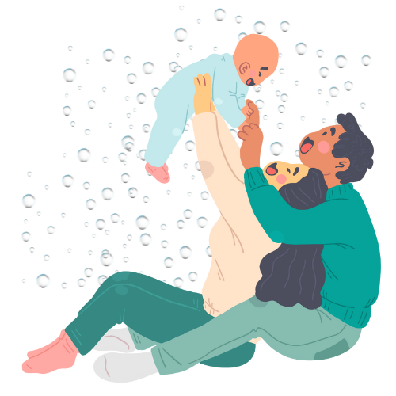
Session 2: Read, Talk, & Sing with Baby
Bubbles are fun and beneficial to babies' development.
Babies love
bubbles!
There are Bubbles in the Air
Tune: "Put Your Finger In The Air" by Woody Guthrie
There are bubbles in the air, in the air. There are bubbles in the air, in the air.
There are bubbles in the air.
There are bubbles everywhere.
There are bubbles in the air, in the air.
Bubbles can help build eye-hand coordination.
Notes:
Did you know that play is baby's work? It provides your child with the opportunity to practice their home language(s) and to encounter new words. Play also helps develop a child's natural curiosity and problem-solving skills and enables them to make connections and understand what they see, hear, and experience in their everyday life. (https://literacytrust.org.uk/)
Are you ready to explore ways to play? One of my favorite things to do with babies is to blow bubbles. And there are important early childhood developmental reasons to use them!
Bubble-play helps babies with their visual tracking, which strengthens their eye muscles and prepares babies to use those eyes for reading! At 2-3 months of age, babies can see much more clearly than when they were newborns. Newborns can only see about a foot in front of them - but by 8 weeks, many babies can begin to visually track moving objects like bubbles, stimulating coordination between baby’s brain and eye movements. Young babies can practice tracking the bubbles through the air, both vertically and horizontally, watching their erratic movement and changing shape.
Bubbles also build eye-hand coordination, as babies and toddlers reach out to try to pop the bubbles. Walking toddlers and infants may follow the bubbles on their feet and practice their gross-motor moving skills. Newborns don’t have a very good sense of how to maneuver their body parts, but over time, their brains and muscles strengthen, and their hand-eye coordination improves dramatically. When a baby reaches their arm out to try to touch a bubble, their brain is learning how to send important signals to their arm and hand in order to grasp a desired object. This movement of toddlers and older babies also helps them develop balance and body awareness.
Let's start with a song you might recognize. We're going to sing the first verse of “If You’re Happy and You Know It.” There are many ways to participate: If your baby is in your arms, you can do a two-finger clap. If your baby is in a car seat or stroller on the go, you can slowly clap for them; OR you can just softly bounce your baby while singing too!
If You’re Happy and You Know It
If you’re happy and you know it, clap your hands.
If you’re happy and you know it, clap your hands.
If you’re happy and you know it
And you really want to show it,
If you’re happy and you know it, clap your hands.
Now we are going to take a few minutes to play with the bubbles.
[IF YOU DON'T HAVE BUBBLES EMAIL THE EARLY LITERACY PROGRAM MANAGER]
We are going use the tune to If You’re Happy and You Know It to sing a song about bubbles.
There are Bubbles in the Air
There are bubbles in the air, in the air
There are bubbles in the air, in the air
There are bubbles in the air, there are bubbles everywhere
There are bubbles in the air, in the air.
Wasn't that fun! Bubbles can be a great bonding tool for you and your baby, because everyone loves bubbles!

Slide 13
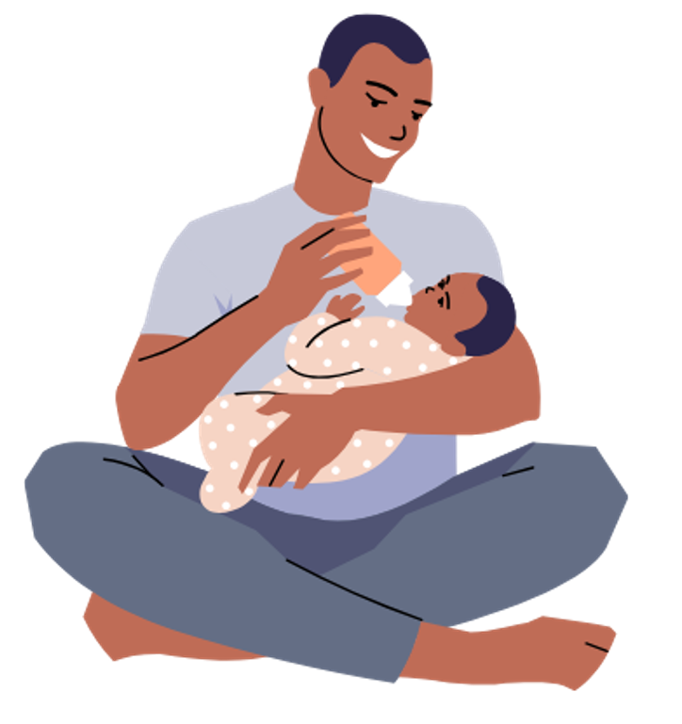
Session 2: Read, Talk, & Sing with Baby
Make sure to talk, sing, read, and play with your baby
every day.
You Are My Sunshine
Tune: "You Are My Sunshine" by Jimmie Davis and Charles Mitchell
You are my sunshine,
My only sunshine.
You make me happy when skies are grey.
You'll always know, dear.
How much I love you.
I love you more and more every day.
The more words your baby is exposed to, the better!
Notes:
Make sure you talk, sing, read, and play with your baby every day. Remember, the more words your baby is exposed to, the better! The number of vocabulary words children know and can use when entering kindergarten is directly related to future success in school. Studies have shown that children who hear more vocabulary in their early years are better able to recognize those words in print when learning to read, so they are likely to pick up reading skills more quickly and easily than children who didn’t have that exposure.
We know that having a baby can be exhausting! New parents often feel tired, unsure, and vulnerable. It’s not surprising, since the new responsibility in your life takes up most of your attention and you are probably not getting a full night’s sleep. Despite this, you all made the effort to come here in order to learn more about your babies and experience new ways to talk, sing, share books, and play with them. These babies are really lucky to have you as their parents.
Let's sing one more song together. "You Are My Sunshine" makes a soothing lullaby, and we're going to change up the last line a little bit to emphasize our happiness and love.
Your Are My Sunshine
You are my sunshine
My only sunshine
You make me happy when skies are grey
You'll always know, dear
How much I love you
I love you more and more every day.

Slide 14
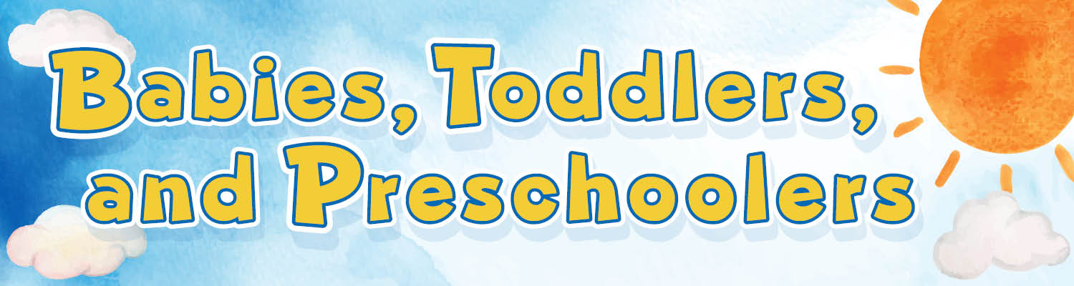
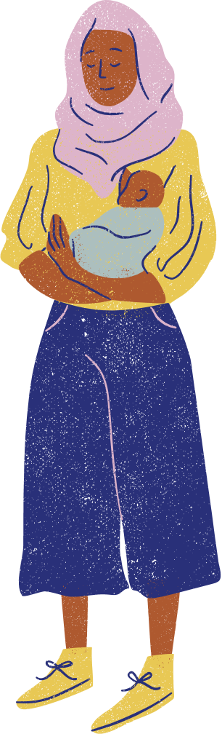



Session 2: Read, Talk, & Sing with Baby
The library has so much to offer, and it’s all free!
Books
Friendly and helpful librarians
Storytimes and other children's events
Adult programs
Computers and Launchpad tablets
Other families
New friends
Baby
Storytime
Talk, Sing,
Read, Write & Play
Explore all the resources MCPL has to offer for babies, toddlers ​& preschoolers on our website!​
Notes:
Thank you so much for being here with us today. The library has so much to offer, and it's all free! Workshops like these are part of our library’s mission.
We have many free family programs and events for all ages, with songs, rhymes, stories, and more.
At any of our branches you can find:
Books
Friendly and helpful librarians
Storytimes and other children's events
Adult programs
Computers and Launchpad tablets
Other families
New friends
Make visiting the library part of your weekly routine. Library staff are happy to help you find what you are looking for. That is our job!
When you and your baby are ready, we’d love to see you again at these programs. They are a great way to find new ways to play with your baby and also to meet other new parents. We love seeing families playing here together.
Plus, anyone can get a library card and borrow books, movies, music, and more! And it is all for free. You can explore all the resources MCPL has to offer babies, toddlers, preschoolers, and their caregivers on our website.

Slide 15
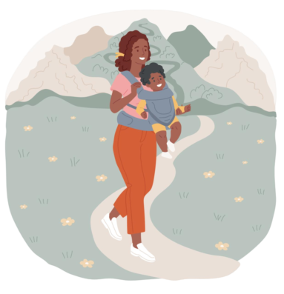
Session 2: Read, Talk, & Sing with Baby
Thanks for coming!
Before you leave…
Return kits
Get a library card!
Ask about other programs for you and baby
See you at session 3 on (insert date)
Are there any questions?
Notes:
Does anyone have any questions about anything we have done or discussed today? I hope it has been fun and helpful.
Hatchlings was created especially for expectant and new parents and their babies.
There is one more session in this series next week.
We look forward to seeing you next week for session 3, where we will explore how books, songs and rhymes can help to establish a routine with your baby.
Before you leave, please:
Return kits
Get a library card, if you don’t already have one
Ask about other programs for you and baby
Thank you again for being here today.

Slide 16
Session 2: Read, Talk, & Sing with Baby
EXTRA!
OPTIONAL SLIDES BELOW
This slide serves as a divider; slides following this are optional, and can be added back into the presentation at appropriate points according to the presenter's discretion.
Notes:
This slide serves as a divider; slides following this are optional and can be added back into the presentation at appropriate points according to the presenter's discretion.

Slide 17

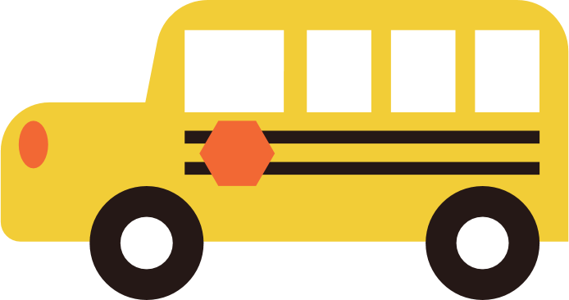


Session 2: Read, Talk, & Sing with Baby
Tune example:
The Wheels on the Bus
Any song is good! You can always change the words.
Have fun and be playful! Talk about the things you see!
This is a great tune for traveling!
Notes:
Another fun way to introduce animal sounds to babies and help them learn language is by changing words to familiar songs and rhymes!
Even if you only have a few songs in your toolkit, you can simply change up the words to keep things new and interesting for both you and baby.
Last week, we sang “The Wheels on the Bus” but we substituted the names of animals and the sounds they make. Let’s do that again!” Even though it's not part of the original song, you can sing about different animals and the sounds they make as they ride on the bus.
Let's try it with some familiar pets:
The _____ on the Bus
The dogs on the bus say "Woof woof woof!
"Woof woof woof! Woof woof woof!"
The dogs on the bus say "Woof woof woof!"
All around the town.
The cats on the bus say "Meow, meow, meow!
Meow, meow, meow! meow, meow, meow!"
The cats on the bus say "Meow, meow, meow!"
All around the town.
The birds on the bus say "Tweet, tweet, tweet!
Tweet, tweet, tweet! Tweet, tweet, tweet!"
The birds on the bus say "Tweet, tweet, tweet!"
All around the town.
This is also a great song to play around with while traveling, as you can sing about all the things you see while looking out the window!

