Slide 1
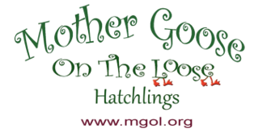

Hatchlings Parent Workshop:
Session 1: Baby’s Brain
This program has been adapted from Dr. Betsy Diamant-Cohen’s Mother Goose on the Loose: Hatchlings
Notes:
[Slide to be shown as participants show up for the program—no text needed]

Slide 2
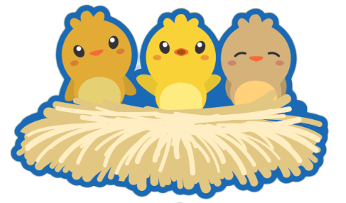
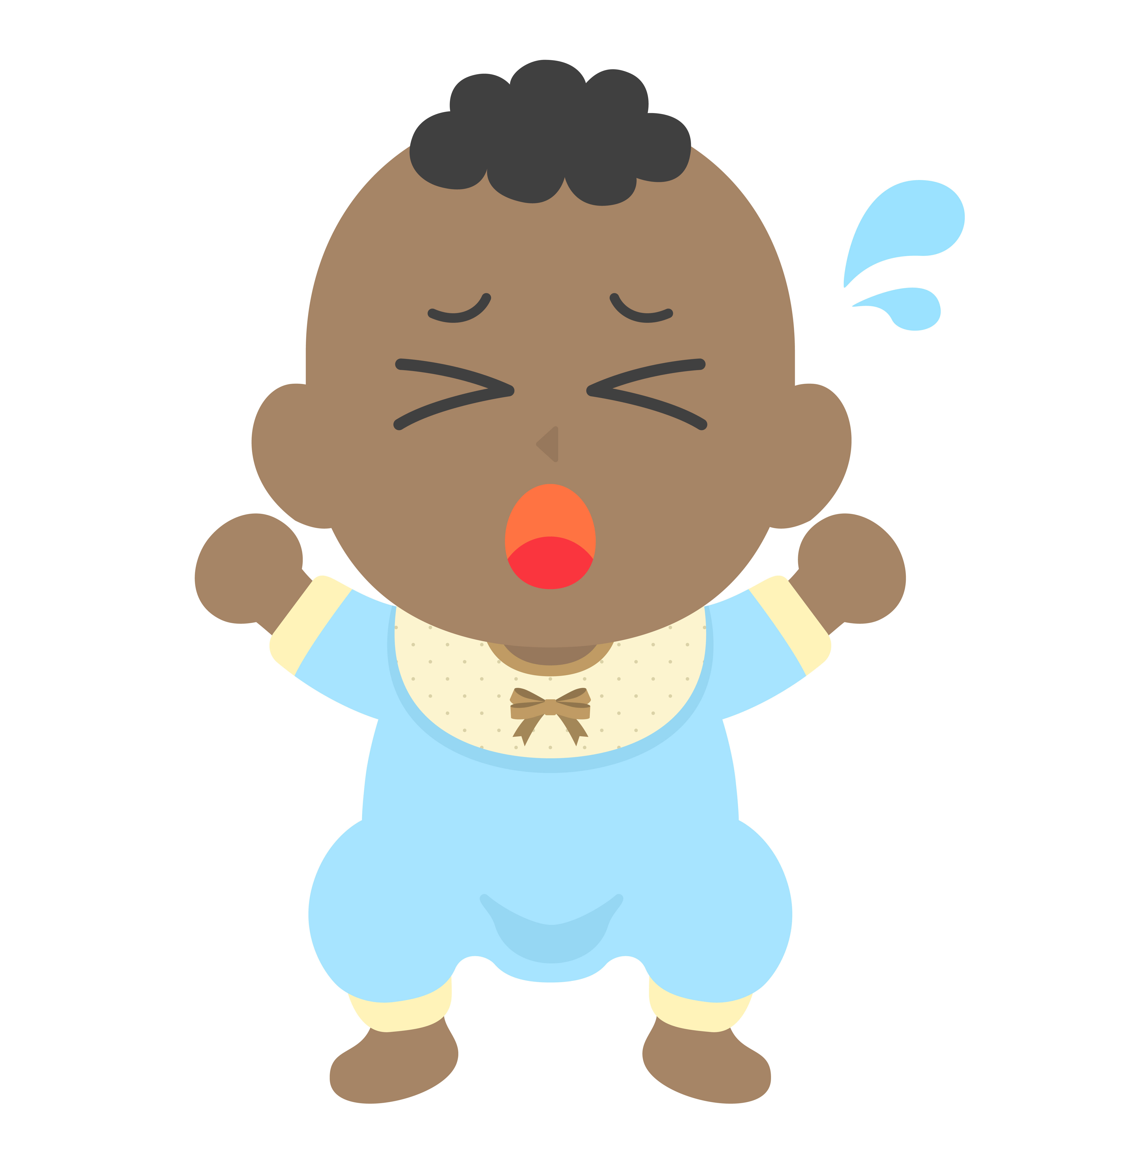
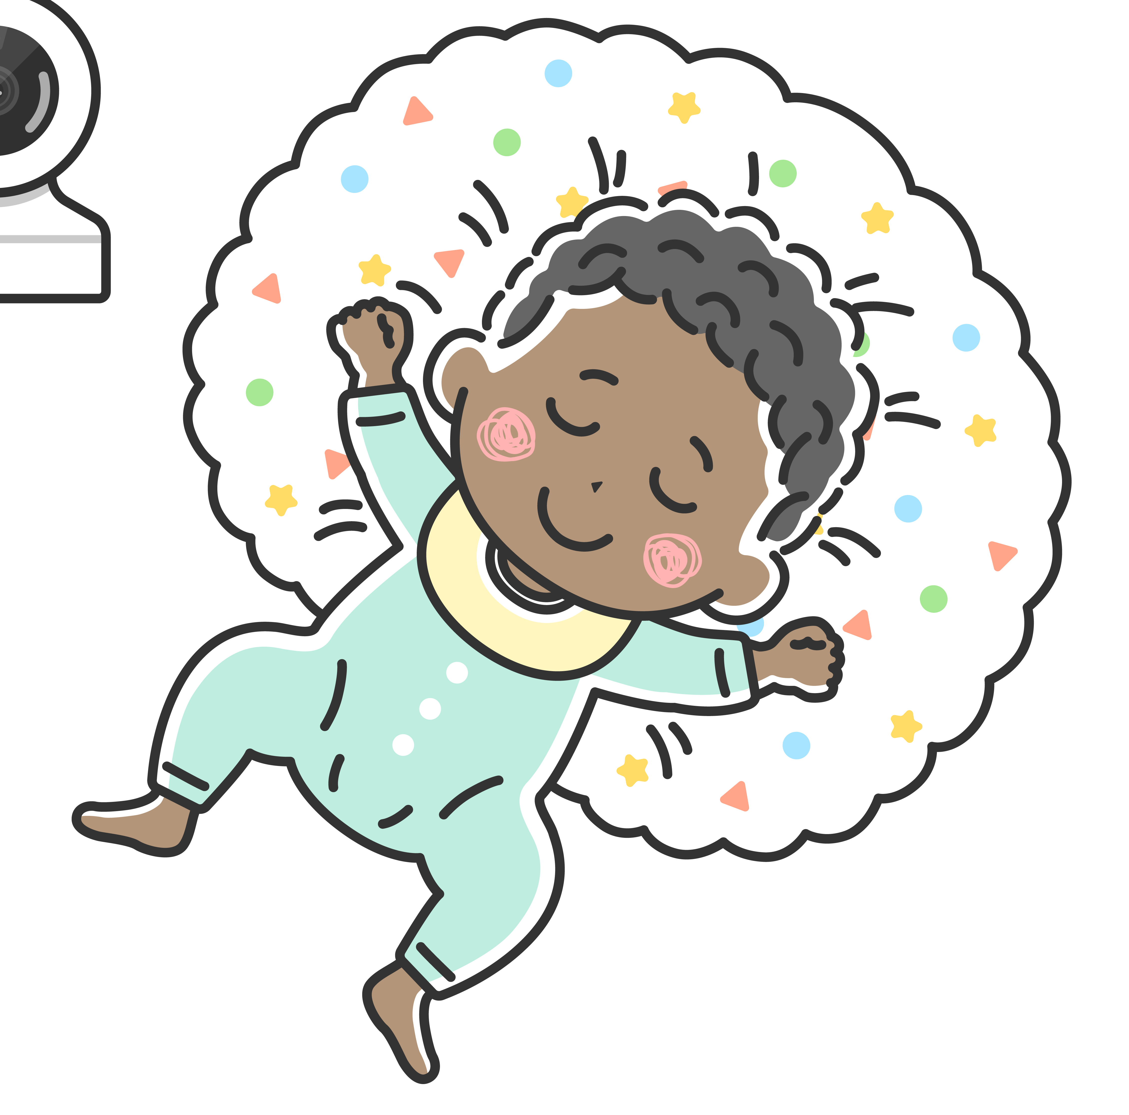
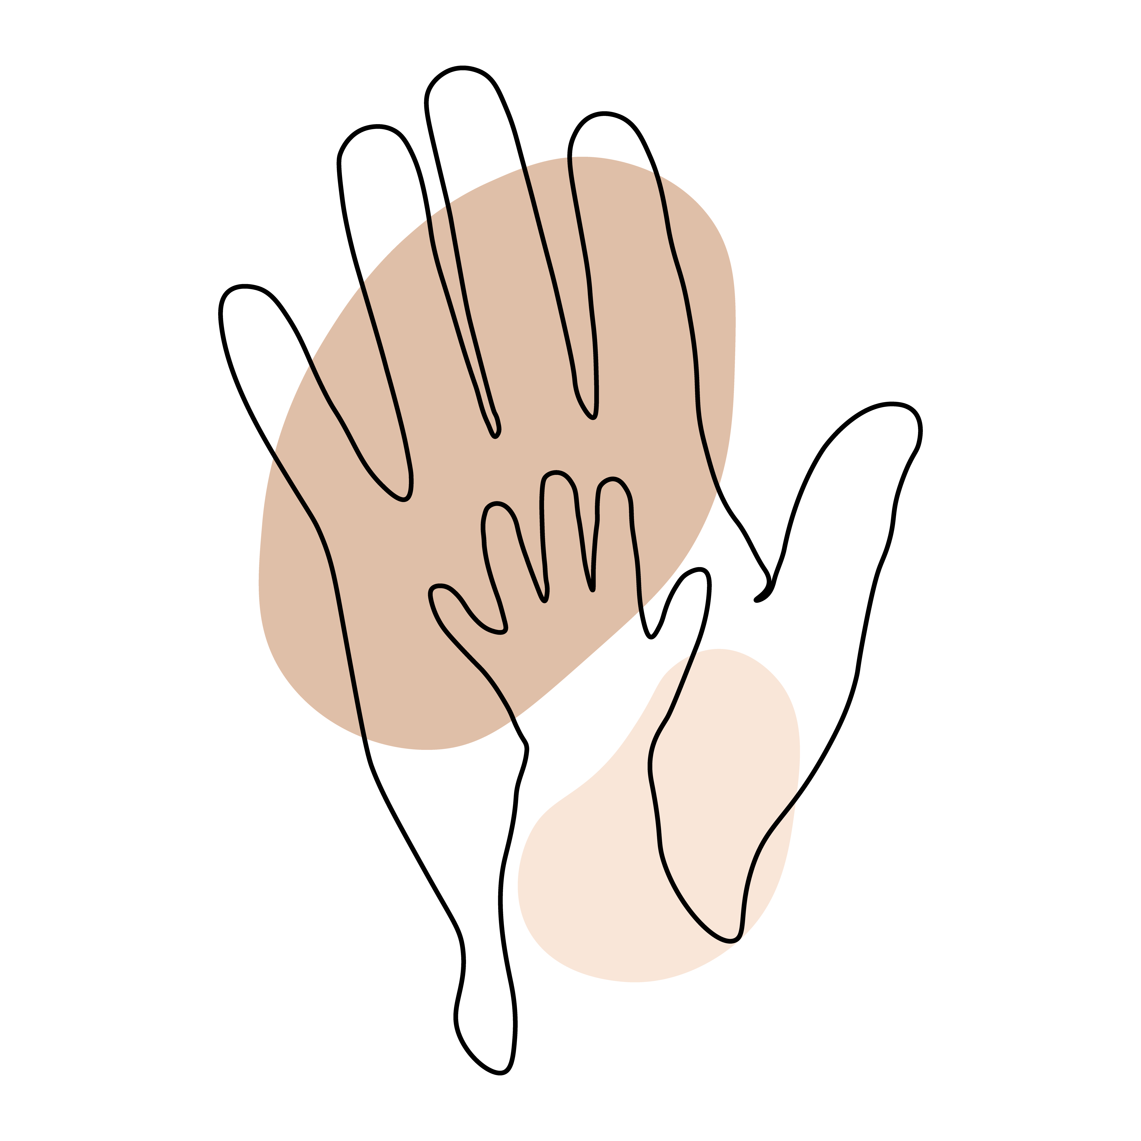
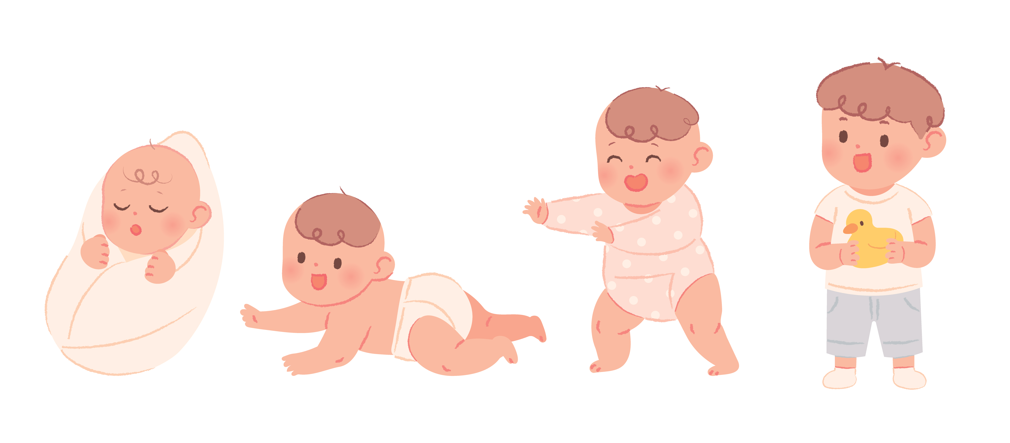
Session 1: Baby’s Brain
HELLO,
Hatchlings Families!
Let's get to know each other and the program.
Unexpected is expected
Calm down without the crowd
Respect baby's rest
Hands on exploration
Stay engaged; silence phones
Notes:
Welcome! We are so glad you could make it to Montgomery County Public Libraries: Hatchlings Parent Workshop here at the [Insert Library]!
Before we get started, if you haven't signed in already, we ask that you please sign-in, make a name tag, and grab a tote bag—one per family. [If a family has multiples—reach out to us for an additional tote]. Since we will be using the materials in your tote bag for all three workshops, we will collect them at the end of each session. Please label your bag with your name, so we can give you the same bag back for each session. You will be able to take the bags home at the end of session 3.
If you have any questions, we’ll be happy to try to answer them for you. Then, find a seat in the circle. Make yourselves comfortable.
You are here for Session 1, where we will learn about your baby's brain. This workshop has been adapted from the "Mother Goose on the Loose: Hatchlings" program, created by Dr. Betsy Diamant-Cohen.
As you can see [look around] this workshop is specifically targeted toward expectant parents and new parents. It is our hope that through these three workshops that you will leave feeling confident about how you can support your baby's growth and development from birth and beyond.
[Staff Introductions]
If you are comfortable doing so, let’s go around and you can introduce yourselves and say something about yourself. [If possible, then greet each person by name!]
Before we dive in any further, let's go over a few guidelines for getting the most out of this workshop.
-For those of you with newborns or young children with you here today, the "unexpected is expected." If your little ones cry or need something, it's OK. They will wiggle and make baby noises, and that's just fine. But, if they are crying loudly or becoming distracting, please feel free to step out of the room, and come back in when they are calmer. Sometimes, it is easier to calm baby down without the crowd. Feel free to take a break, leave the room, and rejoin us when you are ready.
-Respect baby's rest. This workshop is for you, so if your baby is sleeping, don’t wake them up! Babies need their sleep. We’re going to share different activities that you will be able to use at home to help with your baby’s healthy development. So please sing along and participate; you’ll have plenty of time to share the activities with your baby later.
-Hands on exploration: By coming here today to learn everyday simple things that you can do to support your baby's brain development, you are giving your child a big head start, right from the beginning!
-Stay engaged. We ask that you silence your phones during this workshop. In-fact, MCPL has a no photography or videography policy. We do not allow photos, audio, videos, recording or streaming of any kind to be taken inside the library, so please turn off your phones for the duration of the workshop.
Now that we've gone over the guidelines, let’s start off with a song – you will see that we are going to be doing a lot of that over the next hour or so! You will receive a copy of these slides at the end of each session along with the song book you will find in your tote.
[Suggested song: you may use a different hello or welcoming song]
WELL HELLO EVERYBODY
Well hello everybody, yes indeed,
Yes indeed, yes indeed.
Well hello everybody, yes indeed,
Yes indeed, my baby.

Slide 3
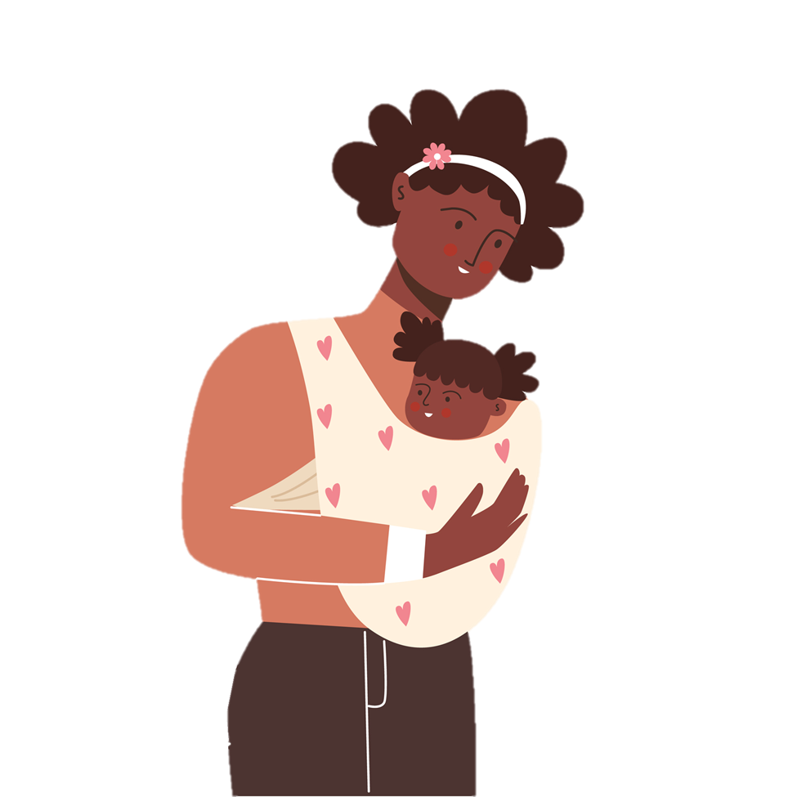
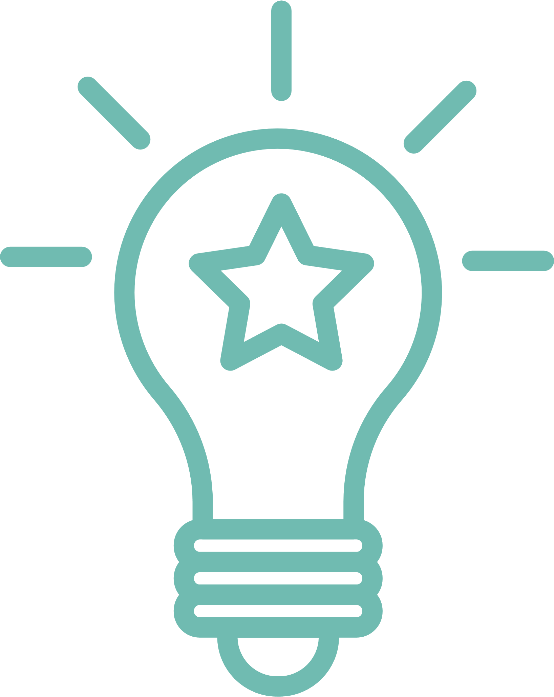
Session 1: Baby’s Brain
Learning Objectives: Session 1
Understanding your baby's brain
  How it functions
  How it grows
  How it learns
Simple ways to support your baby's brain development
  Talk
  Sing
  Share Books
  Play
DID YOU KNOW?
You are your child's first teacher!
Notes:
Today we're going to explore your baby's brain development.
We'll start by learning how your baby's brain functions, how it grows, and, most importantly, how it learns!
That's important stuff to know, because you, as parents, are your baby's first teacher.
Then we'll take a look at the different ways you can boost your baby's brain development. Don't worry, these are simple activities you easily can incorporate into your baby's daily routine. In fact, you are probably doing a lot of them already!
[OPTIONAL ADDITION:]
Talk, sing, share books, and play.
Talk, sing, share books, and play.
Talk, sing, share books, and play.
Talk, sing, share books, and play. Hooray!

Slide 4
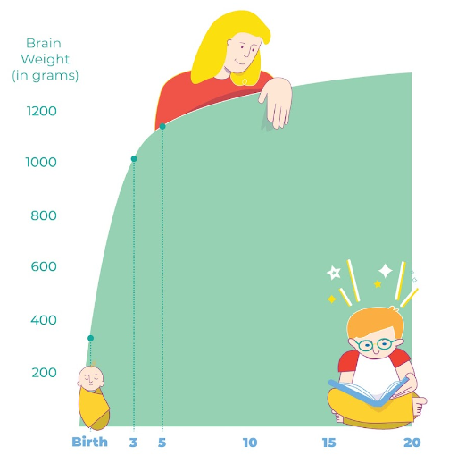
Session 1: Baby’s Brain
Most connections in the brain are formed during the first 3 years of life.
80% of brain development occurs during the first 3 years of life
This number jumps to 90% by age 5
That’s why it’s never too early to talk, sing, share books and play.
Notes:
There is powerful scientific evidence showing the importance of singing, talking, playing, and sharing books in a child's first years.
Research has shown that most connections in the brain are formed during the first three years of life. From birth to age 5, a child’s brain develops more than at any other time in life. We know that 80% of brain development occurs during a child's first three years and reaches 90% by age 5. A newborn baby has all of the brain cells (neurons) they’ll have for the rest of their life, but it’s the connections between these cells that really make the brain work. Parents and caregivers who give attention, respond, and interact with their child are literally building the child’s brain.
One index of neurologic development is the change in gross brain weight with age. The most rapid period of brain growth is during the first 2 years of life. The brain more than triples its weight in the first 24 months. You can see on this chart that brain weight increases dramatically from birth to age 3 but note that there is not much increase from age 5 to age 20.
During this initial period of rapid growth, the brain forms more that 1 million new neural connections every second, which allows children to develop new skills like smiling, talking, and dressing themselves. That's why it's never too early to talk, sing, share books, and play with your child.

Slide 5
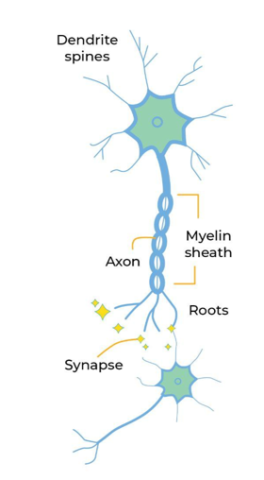
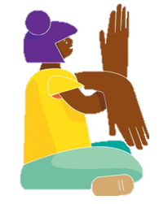
Session 1: Baby’s Brain
We learn through connections.
At birth, Baby's brain is filled with billions of cells called neurons. ​
A child's brain produces more than a million neural connections each second.
After birth, the brain grows 1% per day for the first three months of life.
60% of a baby's energy goes to its developing brain.
DID YOU KNOW? A baby's brain doubles in size in the first year of life.
Notes:
First, let’s talk a little about the brain and how it works.
Our brains are full of cells, called neurons, and they look like that tiny, tree-shaped neuron on the screen. When a child is born, there are billions of these neurons in their brain. According to the Center on the Developing Child at Harvard, “More than 1 million new neural connections are formed every second in the first few years of life.” We are going to show you how these neural connections work using our hands and arms. Please join us!
Let’s make a neuron together. [Put wrist of one hand on the bent elbow of the other with fingers facing down. Wiggle bottom fingers!] the part of the brain that looks like the tree roots, those are the dendrites. The dendrites send signals to other neurons.
The tree trunk part is called the axon. [Rub lifted arm]. The axon transmits signals between the bottom of the neuron and the top. At the top, we have the cell body [show palm]. The branch-like parts coming out of the cell body are the dendrite spines. [Wiggle top fingers]. The dendrite spines receive and respond to signals from other neurons.
Each time the dendrite spines of one neuron connect with the roots of another neuron, a signal is sent between them. This connection is called a synapse.
Each of these connections causes the neuron to gain weight because the dendrite spines get bigger and thicker as they absorb new signals, new information. Did you know? After birth, the brain grows 1% per day for the first three months of life and doubles in size in the first year of life.
[Source: https://www.zerotothree.org/resource/distillation/22-statistics-you-need-to-know-about-childhood-brain-development/]
This process of neurons connecting and growing is called learning. Every time a baby feels, smells, tastes, hears – new connections are made! 60% of a baby's energy goes to its developing brain. Connections are made with emotions too, not just with the senses. When a baby feels loved when you sing them a lullaby, when you comfort them when they are upset, this creates a new experience and a new synapse.
People never stop learning. But, as we get older most synapses connect to ones that are already there, instead of forming totally new ones. That's why what we do with our children in their earliest years makes such a difference – because the foundations of their brains are being built!

Slide 6
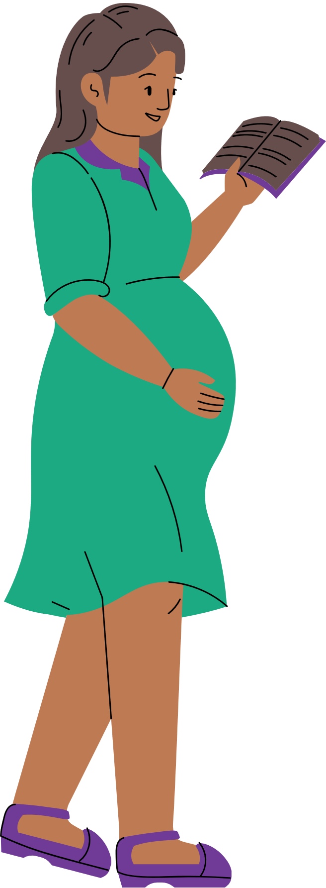
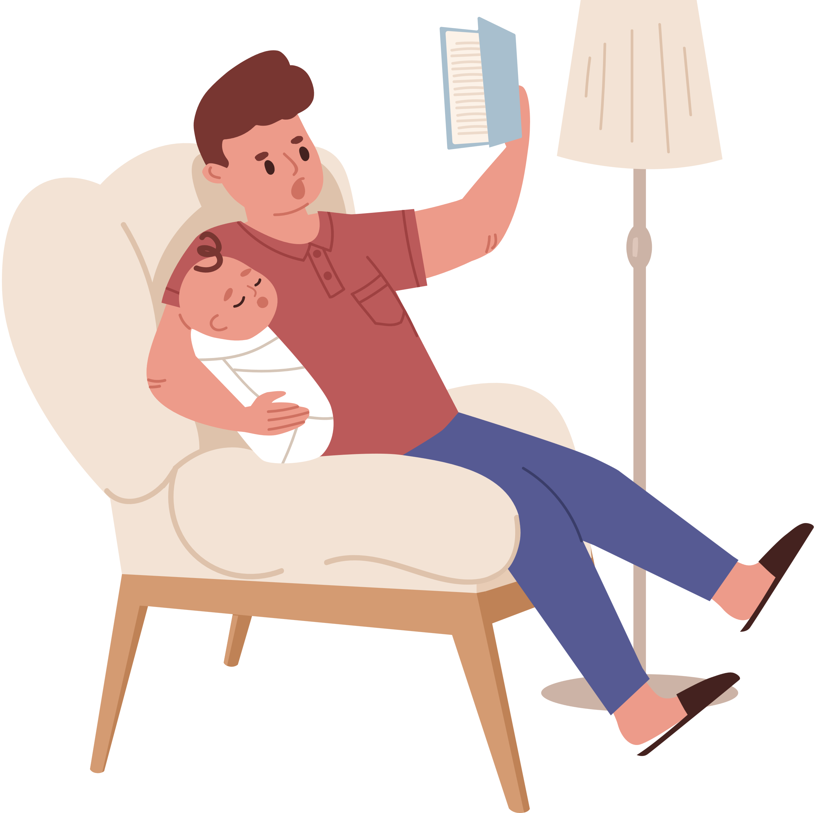

Session 1: Baby’s Brain
Parents play a crucial role in baby’s brain development.
To your child your voice is the most beautiful sound in the world.
Babies prefer your face, your voice, your touch, and even your smell.
Q: What are some simple ways you can help your baby's development?
Notes:
Parents play a crucial role in baby's brain development. You are an important part of the developmental equation. Babies prefer human stimuli—your face, voice, touch, and even smell—over anyone else's.
To your child, your voice is the most beautiful sound in the world. Even if you don’t sing as beautifully as someone on your playlist, your child will love hearing you sing. Singing to your child is a type of sharing that helps you feel more connected to each other, and the quality of your voice doesn’t make a difference.
One way to help baby's brain development is to narrate your day to baby! "Now I am washing the dishes. After I wash the dishes, we will put on our shoes and jackets and go outside to play." Then, when you are done, look baby in the eye and say, "Now I am putting on your shoes! Which shoe should we put on first? (Pause) Let's put your shoe on your left foot first... now your right foot." And so on. In this way you expose your baby to new vocabulary and concepts.
When you ask questions and pause, you are also teaching them the rhythm of conversation, even though they are too young to answer. Babies love back-and-forth conversations; they will smile or coo and babble back to you when you talk or sing to them. Make sure you listen and respond to the noises your babies make and be sure to allow some time for them to respond back to you. These exchanges help to build those strong, healthy brain connections!
Your baby’s brain is wired to learn language, but they need to hear a lot of words and conversation from you to build the connections they will need to talk and later to read. Just like they need nutritious food, they also need language to grow and develop. This is true even for babies and/or parents who do not use spoken language, such as parents or children who are Deaf and communicate using American Sign Language.
Communication is the key, no matter what language you use. If you speak more than one language, you should expose your baby to all the languages you speak. It will not confuse them; it will build even more connections in their brains!
What are some other simple ways you can help your baby's development? [hopefully someone says reading books!]

Slide 7
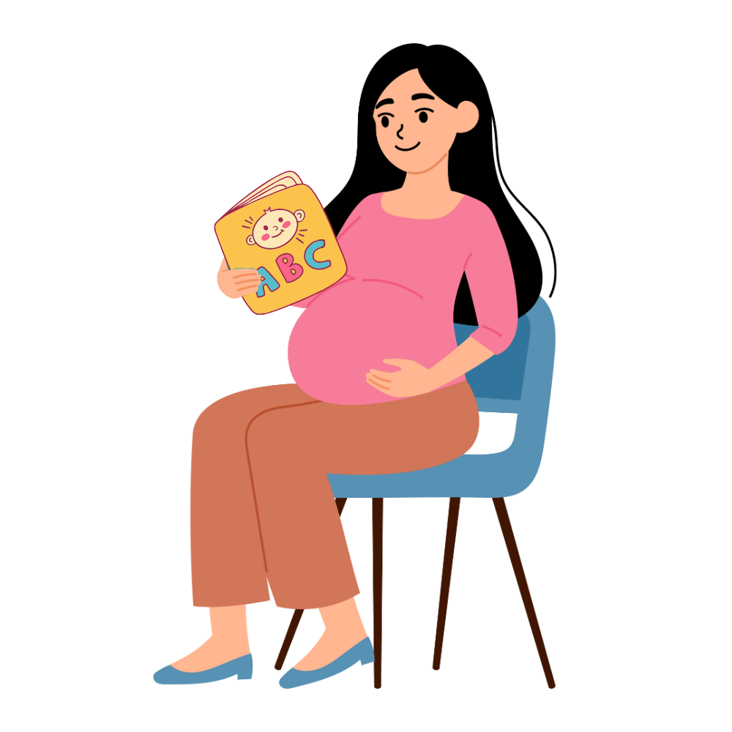
Session 1: Baby’s Brain
Board books are best for babies.
Black and white pictures are the easiest for newborns to see.
Children love hearing the same stories over and over.
Repetition is good for baby’s brain.
Notes:
Reading books to baby is an important (and easy!) way to help their development.
Board books are a great choice, because they are very sturdy, and they are often simple enough for the youngest listeners.
When choosing books to share with newborns, keep in mind that those with high contrast black and white pictures are the easiest for newborns to see. When a baby is born, there is so much to see, hear, taste, and smell, it can be overwhelming. It is better to introduce babies to pictures their eyes can see and process more easily. It helps them to focus.
No matter what your voice sounds like, to your child it is the most beautiful sound in the world. They love to hear you! Babies are comforted by the voices they recognize as well as the stories that are repeated to them. By choosing a special book to repeat, you are creating a familiar, comforting ritual.
Sharing books not only builds connection with you, but it also builds language and early literacy skills – in every language you are using! Lifelong learning and reading develop from the very beginning.

Slide 8
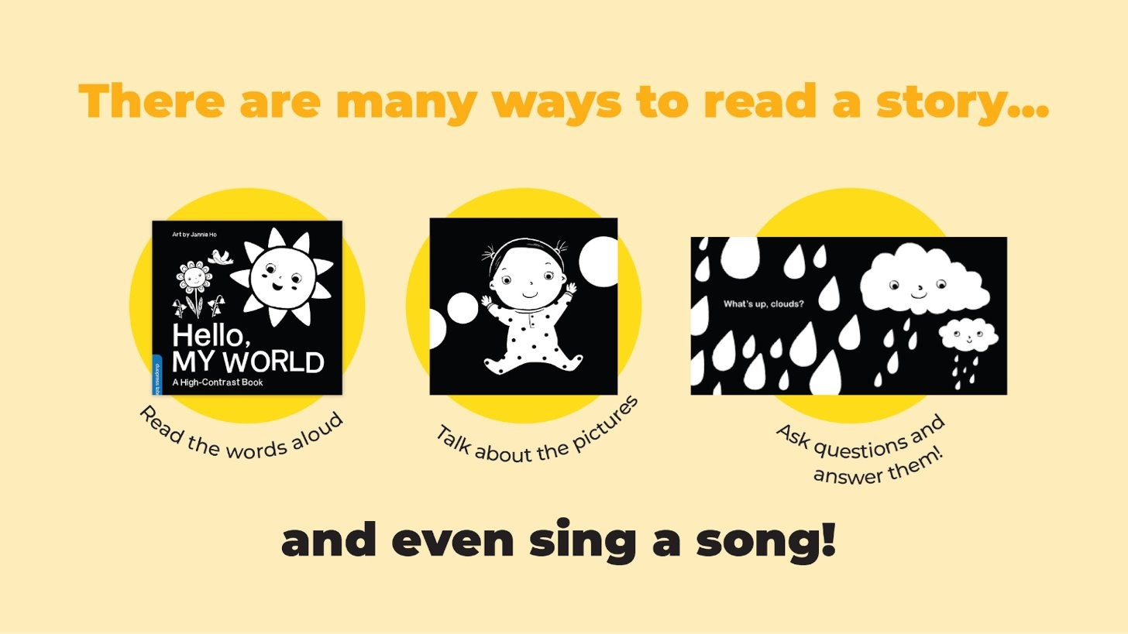
Session 1: Baby’s Brain
There are many ways to read a story.
Read the words
aloud
Talk about the
pictures
Ask questions, pause, then answer them
Notes:
Many people think the best way to use books with babies is to read them aloud, start to finish, but usually babies don’t have the attention span for an entire book.
You can do so many things, like:
read just one or two pages
look at one picture and talk about it
ask questions and answer them
sing the book to a familiar tune
Connecting the pictures in books with words for everyday things around us gives babies building blocks for communication. That's why talking about the pictures is another great way to share books. I am sure you can think of some other ways too!
It is not always easy to think of what to say, so let’s practice it now. [distribute board books, or have parents take the board book out of the bag of goodies]
Choose a page from your board book and describe to your baby what you see or talk about a nice memory it brings up. No need to be embarrassed-- everyone will be doing it at the same time, so we are not paying attention to each other. I will do it too, for a couple of minutes.
[Give a couple of minutes]
GREAT JOB!
Sharing books with your baby during this workshop will help you to become more comfortable sharing books together at home. Try to notice what pages/images your baby is paying special attention to. You may even have favorites of your own. Your baby will become more familiar with the sounds too, so these favorite pages will be an additional way to comfort them when they need calming.
Don’t be surprised if baby seems extra attentive or happy when you repeat the way you read and describe pictures. Children love repetition and learn from it.

Slide 9
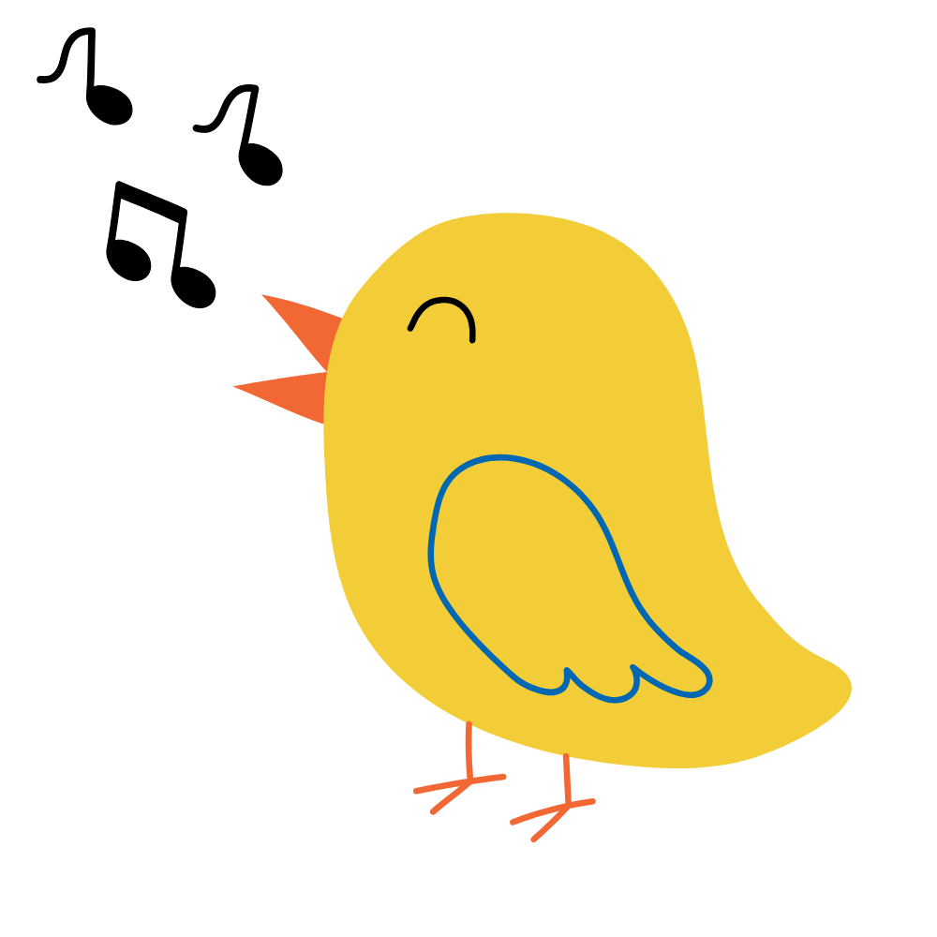
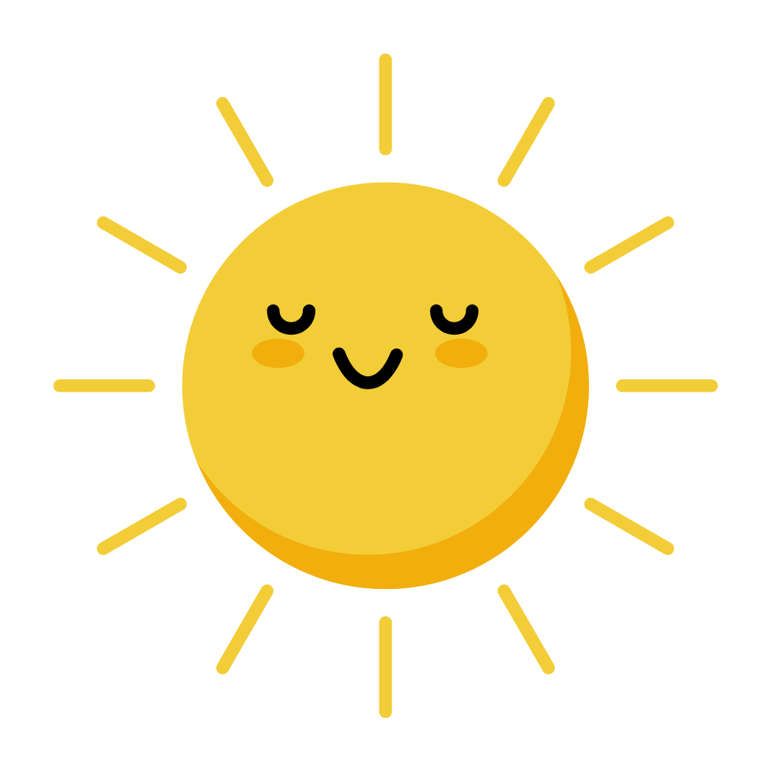
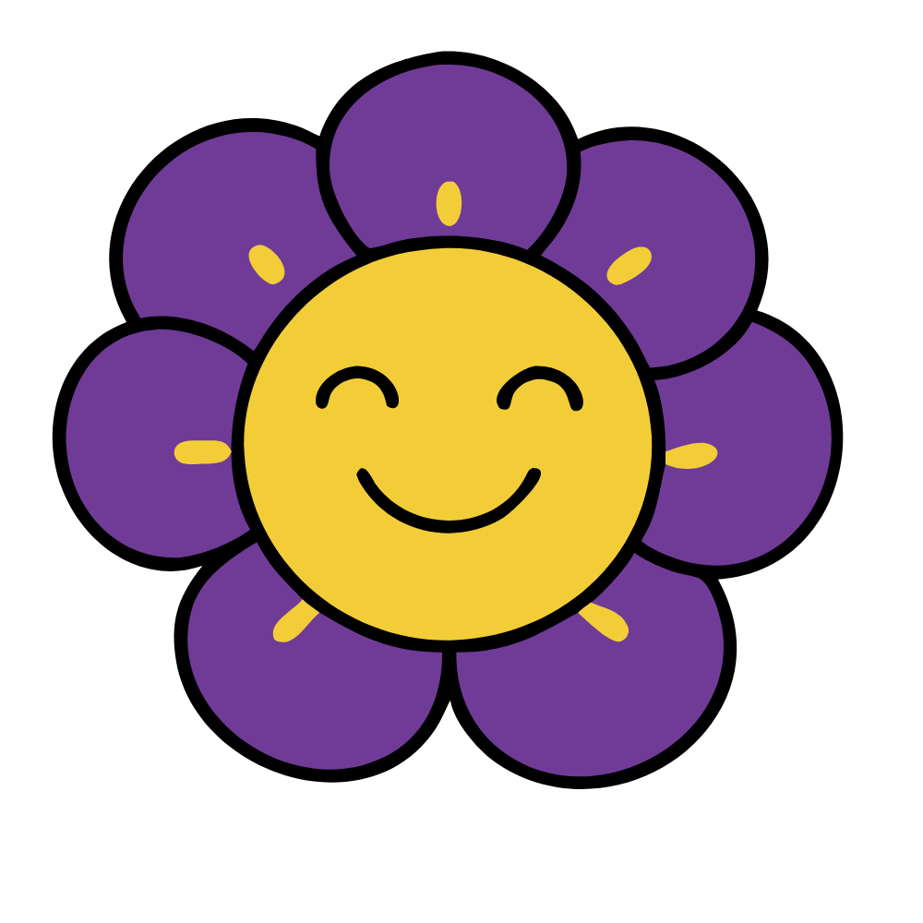
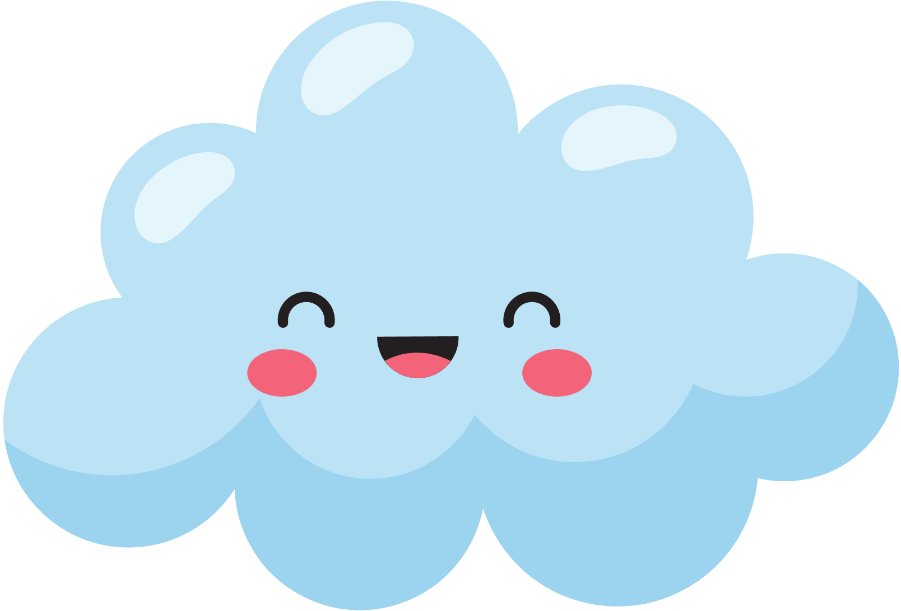
Session 1: Baby’s Brain
What’s going on, bird?
Yes indeed, yes indeed, yes indeed.
What’s going on, bird, yes indeed,
Yes indeed, my baby.
Bonjour, flowers.
Yes indeed, yes indeed, yes indeed.
Bonjour, flowers, yes indeed,
Yes indeed, my baby.
What’s up, clouds?
Yes indeed, yes indeed, yes indeed.
What’s up, clouds, yes indeed,
Yes indeed, my baby.
Use familiar tunes to bring a book to life.
Hello, sun.
Yes indeed, yes indeed, yes indeed.
Hello, sun, yes indeed,
Yes indeed, my baby.
Sing to the tune of
"Hello, Everybody, Yes Indeed."
Notes:
Use familiar tunes to bring a book to life. Let’s try singing the words to a book. We are going to use the book "Hello, My World" as our model. This book has pictures of a sun, a bird, flowers and clouds. We're going to sing about things we see in this book using the tune we sang at the beginning. So instead of Hello Everybody we’ll sing Hello Sun, yes indeed. [Sing book together!]
We hope you will enjoy using the books in your tote at home in all these ways too. Sharing books for even a few minutes each day builds strong language skills and a love of learning. It also creates a special connection between you and your baby while building wonderful memories of fun time spent together.

Slide 10
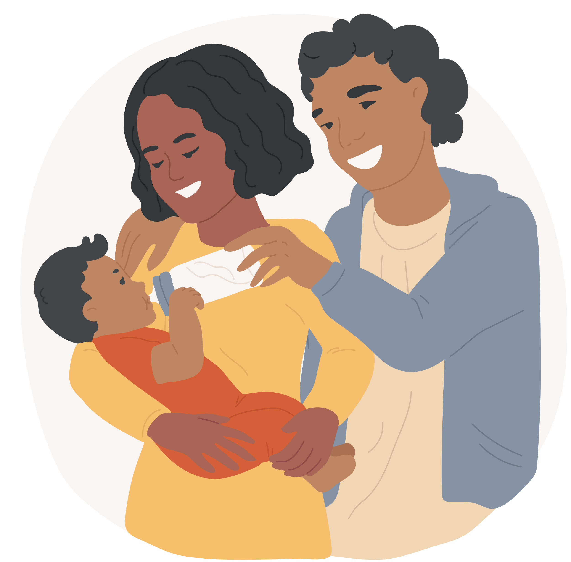
Session 1: Baby’s Brain
The brain likes to remember happy moments.
Your song is even more powerful if you smile while you sing.
If You're Happy and You Know It
Tune: Traditional
If you're happy and you know it clap your hands,
If you're happy and you know it clap your hands,
If you're happy and you know it
Then your face will surely show it,
If you're happy and you know it clap your hands.
Since I Love You Very Much I'll Give a Kiss
Tune: If You're Happy and You Know It
Since I love you very much, I'll give a kiss,
Since I love you very much, I'll give a kiss,
Since I love you, love you, love you,
And I'm always thinking of you,
Since I love you very much, I'll give a kiss.
Choose songs with words that focus on love and positivity!
Notes:
Once baby is born, they can do more than hear and feel you – they can see you too! They will delight in looking at your face, especially when you are looking back and smiling.
Here’s a playful song about being happy. It includes some actions. You can help baby clap their hands or model by clapping your own hands.
This song is “If You're Happy and You Know It.” We'll sing the first verse in the traditional way. Then we'll change it up a little, just for baby.
Let’s sing it now.
If You’re Happy and You Know It
If you're happy and you know it clap your hands,
If you're happy and you know it clap your hands,
If you're happy and you know it
Then your face will surely show it,
If you're happy and you know it clap your hands.
Since I Love You Very Much
Since I love you very much, I'll give a kiss,
Since I love you very much, I'll give a kiss,
Since I love you, love you, love you,
And I'm always thinking of you,
Since I love you very much, I'll give a kiss.
Why is it important to smile at your baby and create happy experiences with them? It feels good for you both! And studies show that children learn best when they feel happy and safe. Everyone (and especially babies) feels safer and learn better when things are predictable and familiar. That's why using a familiar tune to sing a song about something you are playing with or talking about is a great way to introduce these things to your baby.
Your loving voice and positive emotions can be felt by your baby. Thinking about happy memories activates reward centers in our brains and can help us feel more connected and accepted. You might notice that a lot of words in our songs include love and positivity. These joyful experiences help to form a strong learning foundation for your child. Because the brain likes to remember happy moments, it is easier to remember and learn from them.

Slide 11
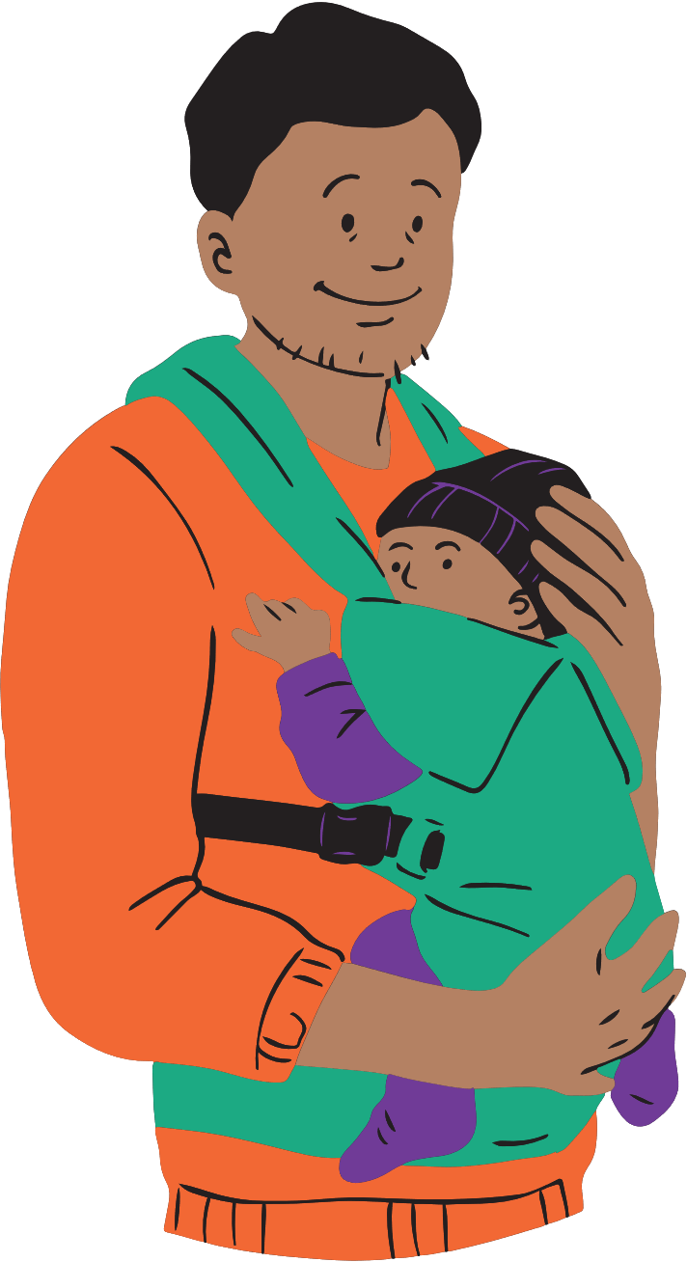
Session 1: Baby’s Brain
Name the parts of the body as you sing about them.
Can You Kick with Two Feet?
Tune: "Mary Had a Little Lamb" or
Tune: "Mary Wore Her Red Dress" by Raffi
Can you kick with two feet,
Two feet, two feet.
Can you kick with two feet
Kick kick kick kick kick!
Continue with:
  Clap with two hands...
  Wave with two arms...
  Kiss with two lips...
Wake Up Feet
Tune: "Wake Up Toes" by Uncle Ruthie Buell
Wake up feet, wake up feet,
Wake up feet and
Wiggle wiggle wiggle,
Wake up feet, wake up feet,
Wake up and wiggle
In the morning.
Learning about body parts helps build vocabulary, spatial awareness, and self-esteem!
Notes:
Young babies also love to look at their own body parts moving. They can't control their movements at first, but they enjoy them anyway – the kicking, waving, wiggling. Naming the body parts and how they move is fun and useful for building vocabulary.
Let's try singing this song together. It is called "Can You Kick with Two Feet?" [tune: Mary Wore Her Red Dress by Raffi OR Mary had a Little Lamb] [Act out song]
Can You Kick with Two Feet?
Can you kick with two feet,
Two feet, two feet.
Can you kick with two feet
Kick kick kick kick kick!
Remember that you can always change the lyrics in songs. Change the name of the action to do what you want to do. Sway, stretch, wiggle – whatever you enjoy doing!”
Sing songs in whatever way you want and feel free to use different words. If you learn one song, you've got song material for every day of the year. Anything can be a song!
Here's another fun "body parts" song, called "Wake Up Feet". You can sing this endlessly, swapping in different body parts like hands, nose, ears, elbows, even belly! You can sing a wake-up song like this to help create structure in your baby's day.
Wake Up Feet
Wake up feet, wake up feet,
Wake up feet and
Wiggle wiggle wiggle,
Wake up feet, wake up feet,
Wake up and wiggle in the morning.
Here's a TIP: Learning about and identifying their own body parts is very important for baby in many ways:
It boosts Vocabulary Development-- which can improve their ability to communicate with others and express their needs and intentions.
It increases their Body Awareness-- the ability to recognize where their body is in space. This not only helps children understand how to relate to others and to objects, but can also help them avoid falling, bumping into things, and balance challenges.
Finally, it improves Self-Esteem-- Learning body parts can help children develop a healthy appreciation for their bodies and a positive self-image.

Slide 12
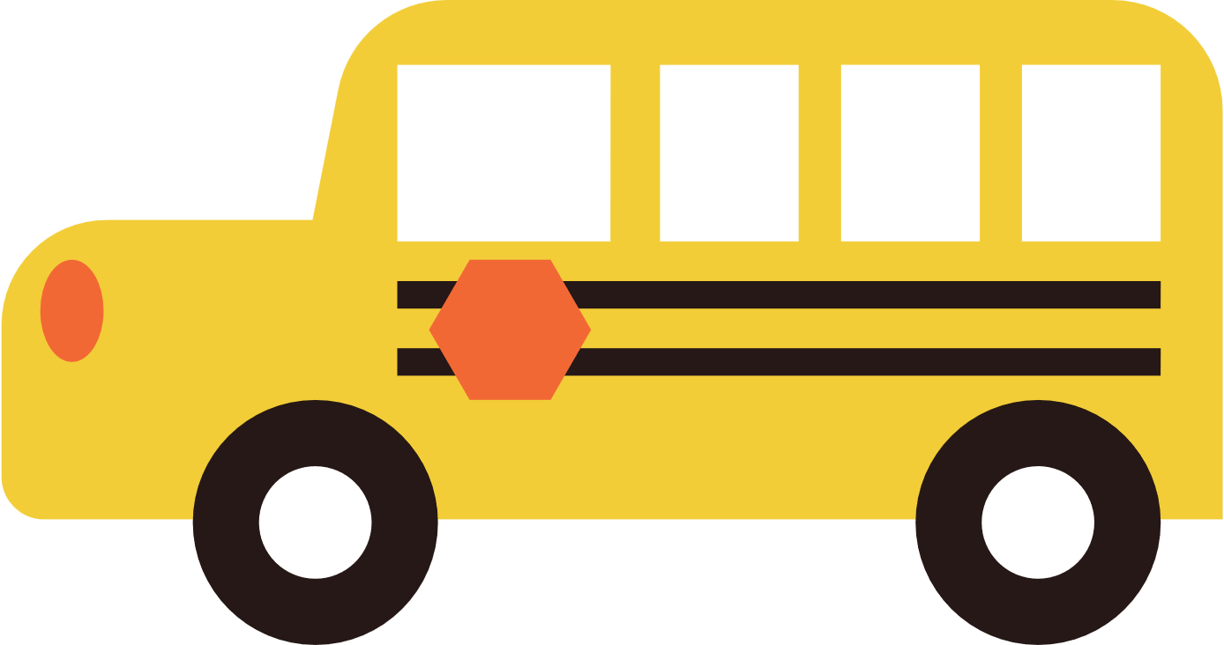


Session 1: Baby’s Brain
The Wheels on the Bus
Tune: Traditional
The wheels on the bus go round and round,
Round and round, round and round.
The wheels on the bus go round and round,
On our way to the library.
Any song is good!
You can always change the words.
Have fun and be playful!
Talk and sing about the things you see!
This is a great tune
for traveling!
Notes:
Any song is good! You can always change the words to fit just about anything. Have fun and be playful. Talk and sing about the things you see and do. Just remember to use positive, uplifting songs, without negative feelings or histories. Just because you change the words, doesn't erase the negative feels a tune may hold.
[STAFF NOTE: We do not want to include rhymes and songs that are connected to a negative past. Even using the music or melody of a song with racist or oppressive history should be avoided as the negative energy still exists in the songs. Just changing the words, doesn't remove the history behind the tune.]
A song that many people know is “The Wheels on the Bus.” This is a perfect example of a song that can be changed easily. Since we are at the library, we can sing the last line as “On our way to the library”. Let’s sing it, and you can join in whenever you’re ready!
The Wheels on the Bus
The Wheels on the bus go round and round
Round and round, round and round.
The wheels on the bus go round and round
On our way to the library.
Thank you all for singing along.
You might notice that baby loves animals and so you can change the lyrics of "Wheels on the Bus" to make it an animal song. If you see a cat, you can sing:
The cat that I see goes “meow, meow, meow”
“Meow, meow, meow. Meow, meow, meow”
The cat that I see goes “Meow, meow, meow”
All day long!
If you see a puppy you can sing...:
The puppy that I see goes “Woof,woof,woof”
“Woof, woof, woof. Woof, woof, woof”
The puppy that I see goes “Woof ,woof,woof”
All day long!
Maybe you are changing a diaper, or splashing in the bath? Any words work!

Slide 13
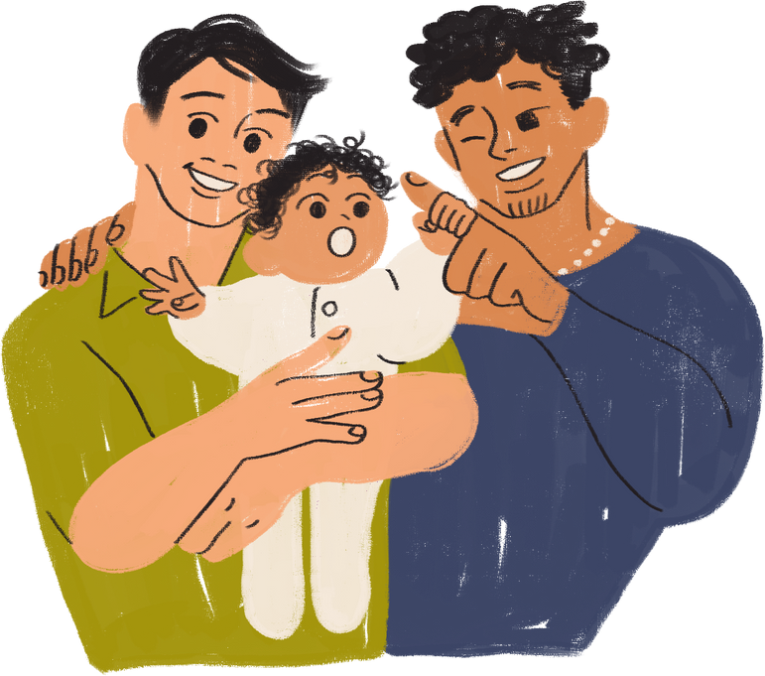

Session 1: Baby’s Brain
I Have a Little Shaker
Tune: "We're Going to Kentucky"
I have a little shaker.
I’ll shake it in the air.
I’ll shake it over here.
I’ll shake it over there.
It can be a carousel.
Going round and round.
It can be a shooting star
Falling to the ground.
I have a little shaker.
I’ll shake it in the air.
I’ll shake it over here.
I’ll shake it over there.
Shake along to the beat!
Find a song you and baby can move to.
Don’t limit yourself to children’s songs!
Notes:
Lots of simple items can be turned into musical instruments. For today's program, you will find a shaker toy in your bag.
Since these are small and make a soft sound, they are great for little babies.
Let’s do a little shaker song. We’ll sing and act it out. Feel free to join in when you’re ready. It’s called “I Have a Little Shaker”
I Have a Little Shaker (to the tune of I was Going to Kentucky)
I have a little shaker.
I’ll shake it in the air.
I’ll shake it over here.
I’ll shake it over there.
It can be a carousel.
Going round and round.
It can be a shooting star
Falling to the ground.
I have a little shaker.
I’ll shake it in the air.
I’ll shake it over here.
I’ll shake it over there.
Thanks, everyone, that was great! You can put your shakers back in the bag.
Feel free to sing any song you know; you don't have to limit yourself to children's songs. Maybe you want to sing a little Beyonce, Taylor Swift or any song with a good beat like “La Bamba”. Choose songs you enjoy, and your baby will enjoy them too.
Remember what we said, your voice is the most beautiful sound in the world to your baby. You don't have to be a great singer for your baby to enjoy and benefit from your singing.

Slide 14
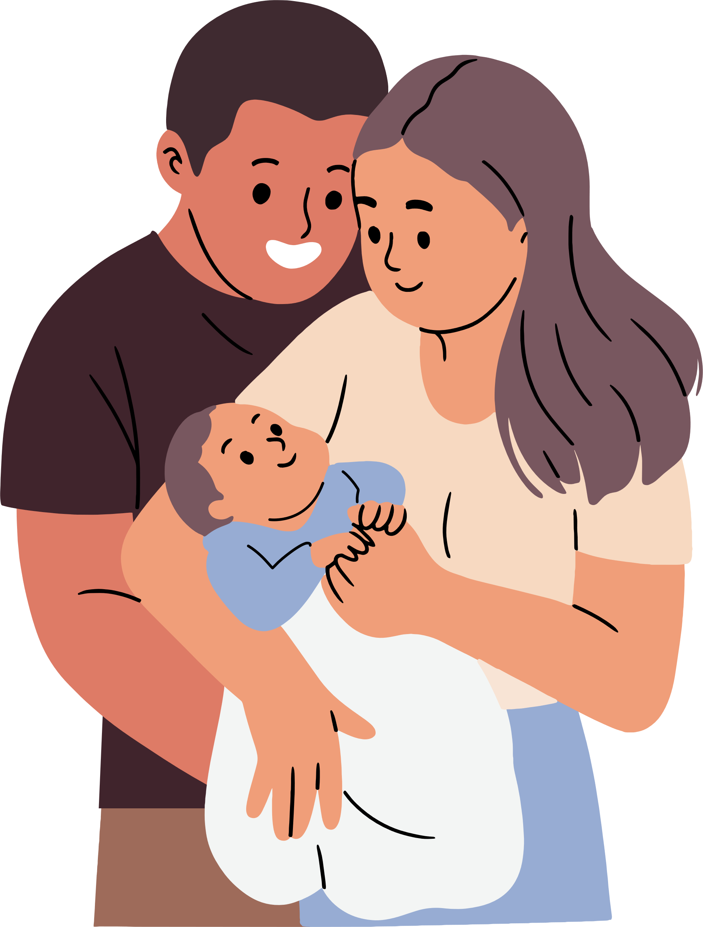
Session 1: Baby’s Brain
Twinkle, Twinkle, Little Star
Tune: Traditional
Twinkle, twinkle, little star,
How I wonder what you are.
Up above the world so high,
Like a diamond in the sky.
Twinkle, twinkle, little star
How I wonder what you are.
More lullaby ideas:
  Mr. Moon
  Rock-a-bye Baby
  Sleepy Feet adapted from "Wake Up Feet"
  Yo te amo by Uncle Ruthie Bell
  You Are My Sunshine
  by Jimmie Davis and Charles Mitchell
Lullabies help you and baby relax.
Any song can be a lullaby, just sing it softly and slowly.
Sing a lullaby remembered from your childhood.
Notes:
Sometimes you or your baby or both of you are too tired to dance. The soft, slow pace of lullabies helps both you and your baby relax. There is some evidence that singing to infants can help boost a parent's confidence too. One study found that when parents sang to their babies every day, they had higher feelings of wellbeing and self-esteem.
Singing a lullaby while rocking a baby stimulates early language development, promotes attachment, and supports babies' growing spatial awareness as the babies experience their bodies' moving in space.
Newborns remember the songs that were sung or hummed to them before they were born and can be comforted by hearing them after they are born.
Slow, soft, repetitive music will actually slow down the heart rate and allows for calmer and deeper breathing. All babies have their cranky moments, so having a lullaby at the ready is essential.
Let’s sing “Twinkle, Twinkle, Little Star”. Please join in as you are ready.
Twinkle, Tinkle, Little Star
Twinkle, twinkle, little star.
How I wonder what you are.
Up above the world so high.
Like a diamond in the sky.
Twinkle, twinkle, little star.
How I wonder what you are.
Lullabies are found in every culture and sung in every language around the world. Maybe you remember a lullaby that your parents or grandparents sang to you. It is wonderful to pass down traditional songs and stories that have been part of your family’s history and culture!
Now it is your turn! We are going to take a minute or two so you can sing a lullaby to your baby. You can sing Twinkle, Twinkle or any lullaby you know or make one up now. Any song can be a lullaby as long as you sing it slowly and softly.

Slide 15


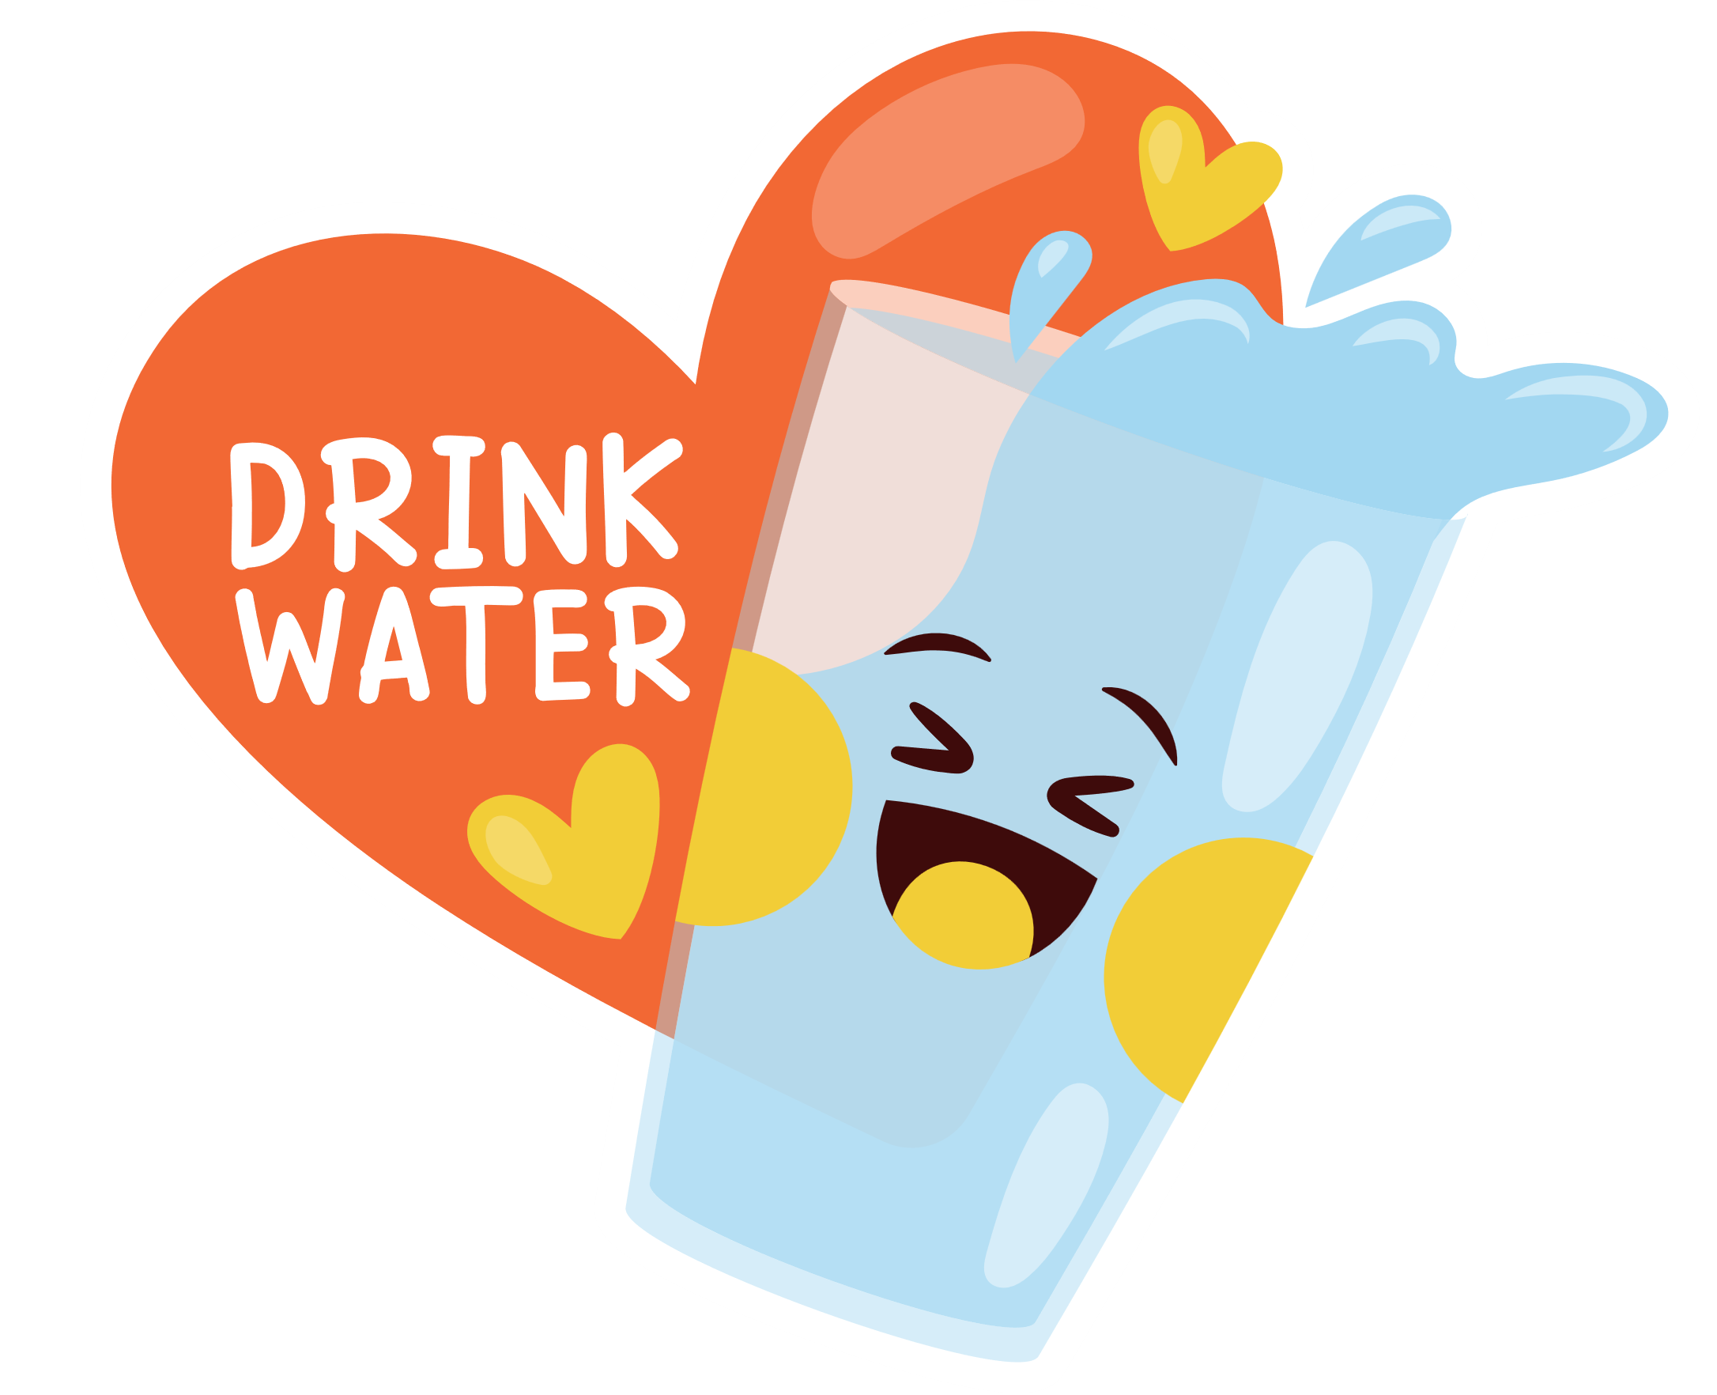
Session 1: Baby’s Brain
Self-care is important.
Visit your library
Talk with your doctor
Stay hydrated
Create a support system that works for you.
Notes:
Having a baby is exhausting! New parents often feel tired, unsure, and vulnerable.
It’s not surprising since the new responsibility in your life takes up most of your attention and you are probably not getting a full night’s sleep.
Despite this, you all made the effort to come here to learn more about your babies and to experience new ways to talk, sing, share books, and play with them. These babies are really lucky to have you!
As expectant and new parents, be sure to take some time to take care of yourselves and do something that makes you happy.
Before your baby is born, and especially right after, be sure to be in touch with your health care provider for any health or well-being concerns, including emotional concerns.
It’s important to create a support system that works for you. That might include your health care provider, family and friends, or local community groups. Just remember you are not alone!
For any questions about resources here in the library, please know you are always welcome to ask me or any of my library colleagues.

Slide 16
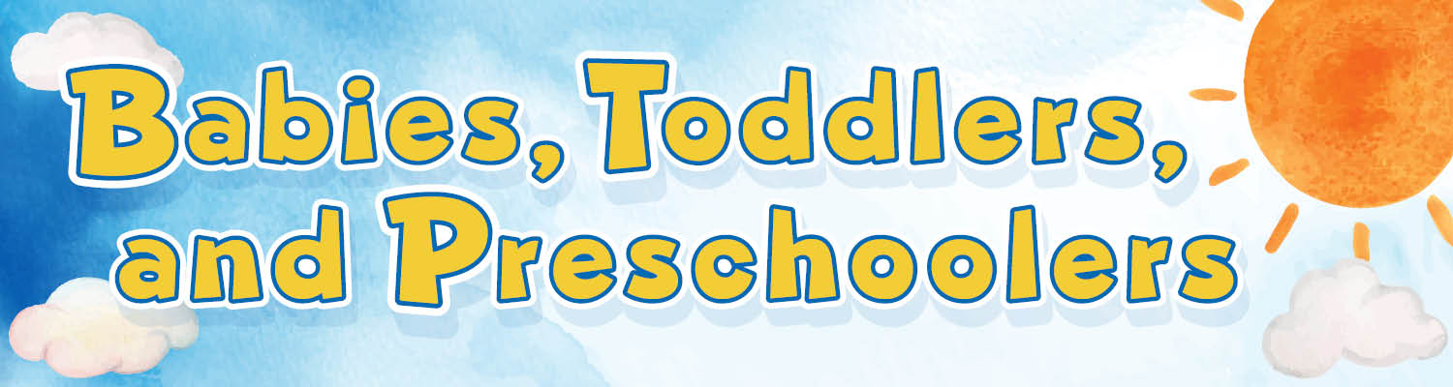
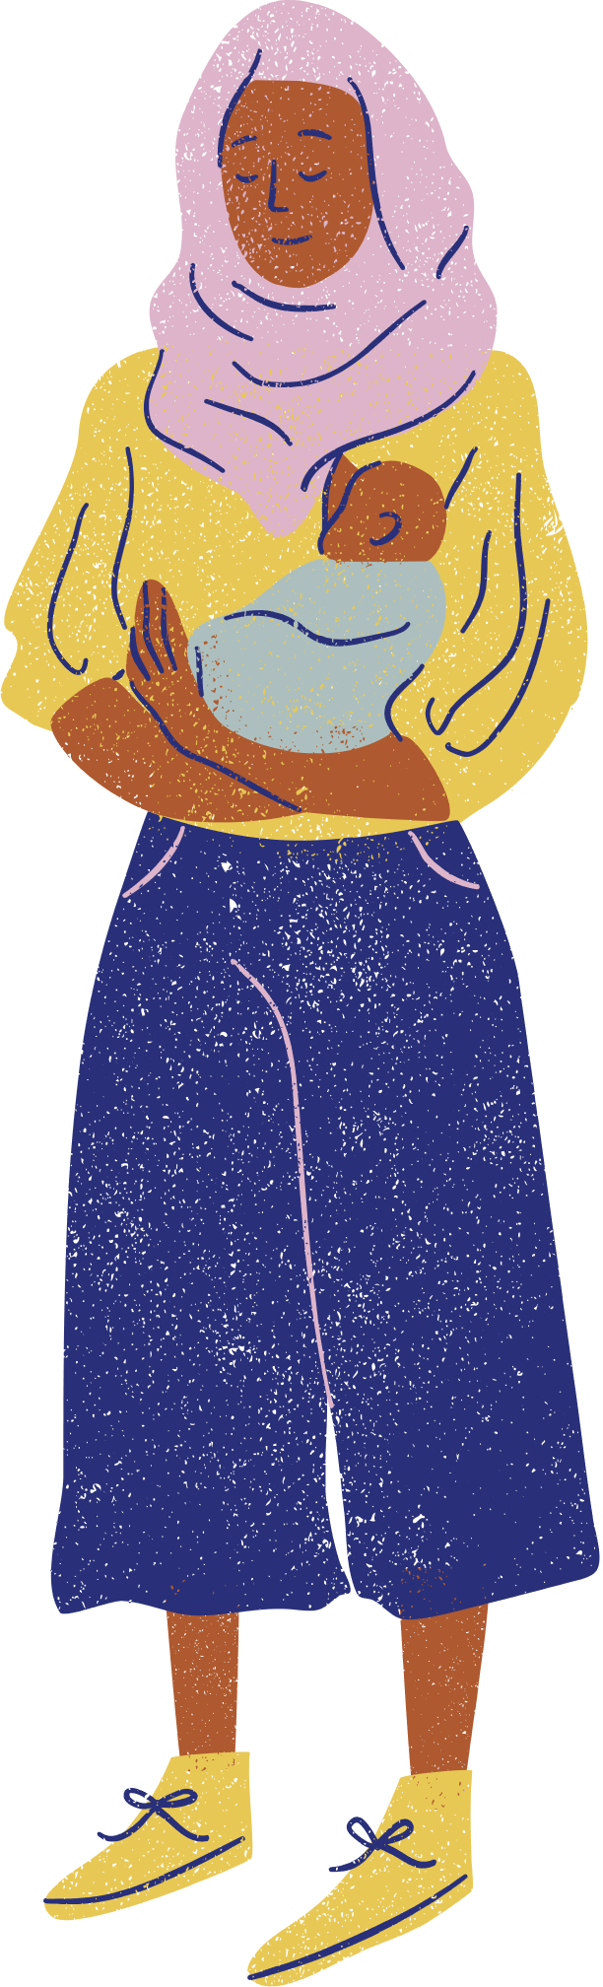



Session 1: Baby’s Brain
The library has so much to offer, and it’s all free!
Books
Friendly and helpful librarians
Storytimes and other children's events
Adult programs
Computers and Launchpad tablets
Other families
New friends
Baby
Storytime
Talk, Sing,
Read, Write & Play
Explore all the resources MCPL has to offer for babies, toddlers, & preschoolers on our website!
Notes:
Thank you so much for being here with us today. The library has so much to offer, and it's all free! Workshops like these are part of our library’s mission.
We have many free family programs and events for all ages, with songs, rhymes, stories, and more. ​
At any of our branches you can find:
Books
Friendly and helpful librarians
Storytimes and other children's events
Adult programs
Computers and Launchpad tablets
Other families
New friends
Make visiting the library part of your weekly routine. Library staff are happy to help you find what you are looking for. That is our job!
When you and your baby are ready, we’d love to see you again at these programs. They are a great way to find new ways to play with your baby and also to meet other new parents. We love seeing families playing here together. ​
Plus, anyone can get a library card and borrow books, movies, music, and more! And it is all for free. ​You can explore all the resources MCPL has to offer babies, toddlers, preschoolers, and their caregivers on our website.

Slide 17
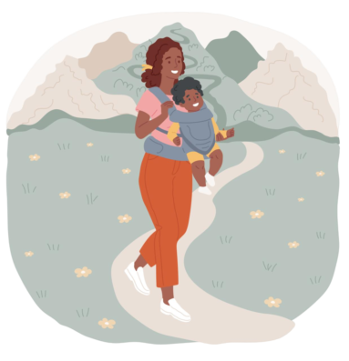
Session 1: Baby’s Brain
Thanks for coming!
See you at session 2 on (insert date)
Before you leave…
Return kits
Get a library card!
Ask about other programs for you and baby
Are there any questions?
Notes:
Does anyone have a question about anything we have done or discussed today? ​I hope it has been fun and helpful. ​
Hatchlings was created especially for expectant and new parents and their babies.
There are two more sessions in this series over the next two weeks.
We look forward to seeing you next week for session 2, when we will share more about reading, talking and singing with your baby.
Before you leave, please:
Return kits
Get a library card, if you don’t already have one
Ask about other programs for you and baby
Thank you again for being here today. ​

