Slide 1
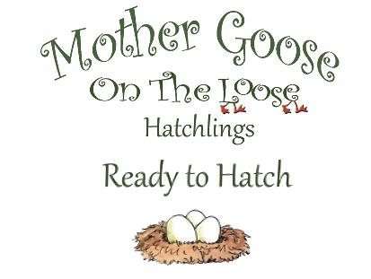
Get ready for baby!
Hatchlings: Ready to Hatch
is an interactive early literacy program for expectant parents. Learn more about your baby-to-be through songs and fun activities.
When:
October 9, 2023
10:30-11:30am
Where:
Everyone’s Free Library
Registration required; to sign up, contact:
Youremailhere@gmail.com
FREE book, calendar and song sheet for attendees!
Space is limited to only expectant parents for this session.
IN PARTNERSHIP WITH:
Notes:
This is in the form of a powerpoint slide because you can easily change the date and add a location.
Once it is done, go to file and download as a jpg or a png the current slide. Print from there as is.

