Slide 1
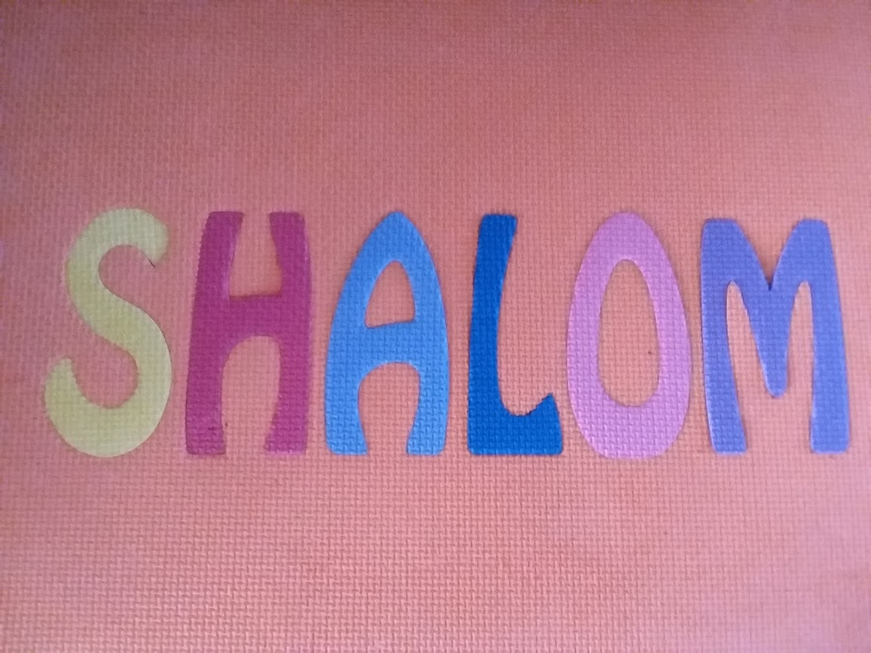

Slide 2
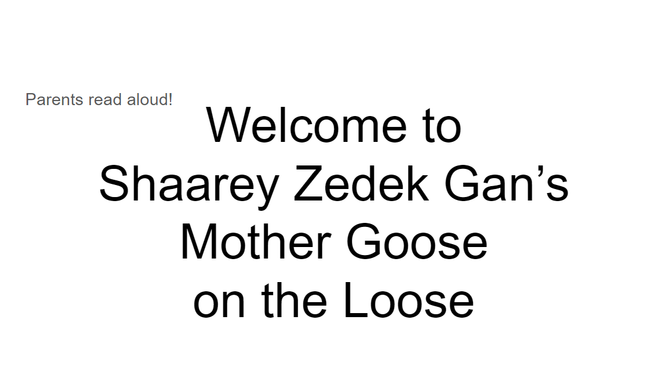

Slide 3
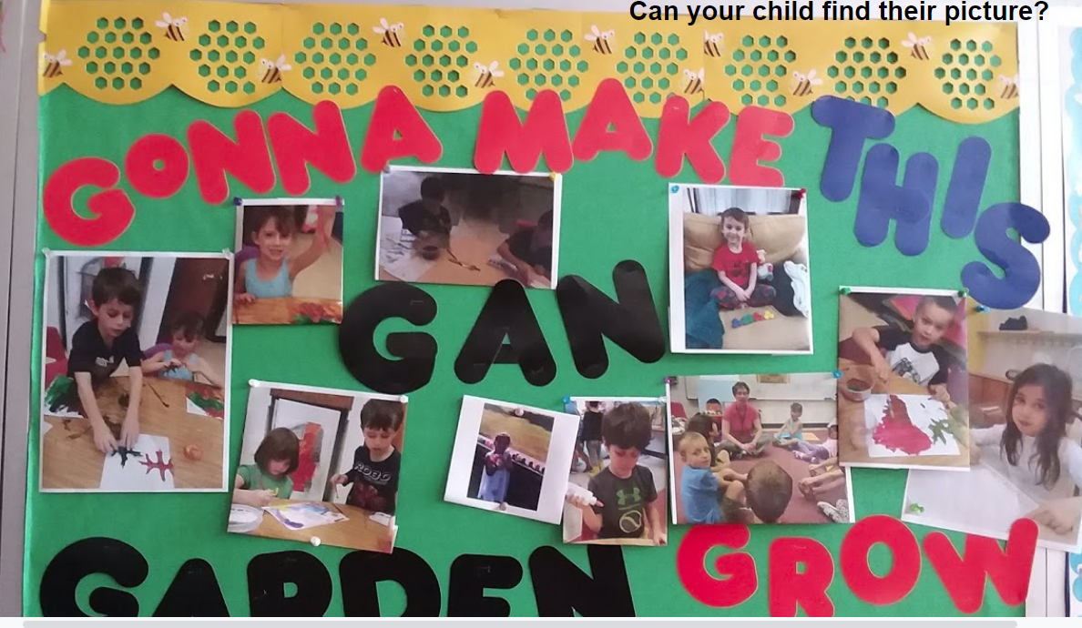

Slide 4
Two things you’ll need before we start
--a small box or jar which can be used to collect coins for charity
(unless you have a tsedakah box or bank at home already)
--some coins

Slide 5
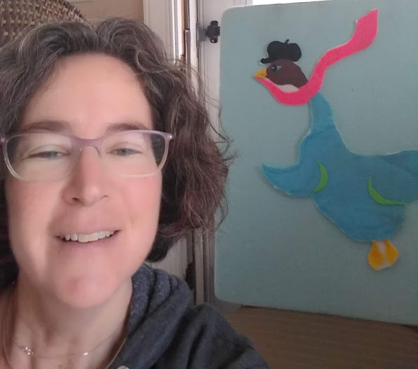
Opening Rhyme: Old Mother Goose
Sit close to your child,
they can be on your lap or next to you.
Do the rhyme and hand motions
together with your child.
They know the rhymes, so they can teach you!
Click on the link for the video:
https://photos.app.goo.gl/a4ABYg2xJ1pozKJz5

Slide 6
Goosey Goosey Gander
https://drive.google.com/open?id=1GfMQiolpSREYU8QktRAlcXNj_8-H4Gtk
Give your child a big hug at the end!

Slide 7
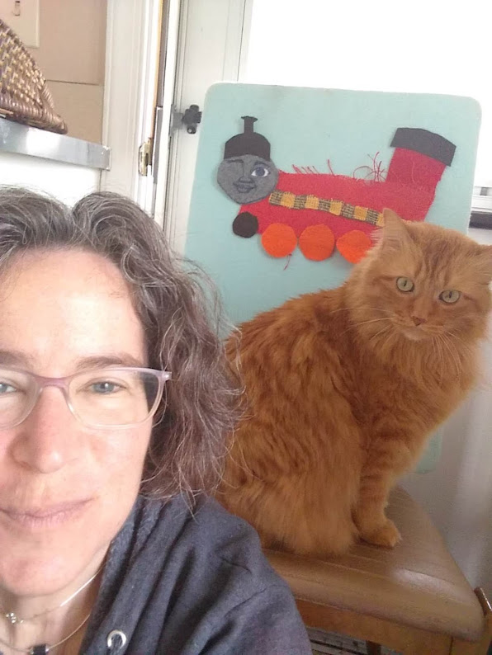
The Little Train
https://photos.app.goo.gl/htga6V59zJmYttaK8

Slide 8
HaRakevet הרכבת
And a Hebrew version:
https://photos.app.goo.gl/bfCEKVuTadZcTbDL6

Slide 9

My Face Is Round
Your children have added to this rhyme, at the end!
https://drive.google.com/open?id=1SDsAFA3U3PTKt_ZoaFolVR68G70jczUQ

Slide 10

A Book!
https://drive.google.com/open?id=1OVymvu71n7r0nAqBHoQIoBMjW_150jCq

Slide 11
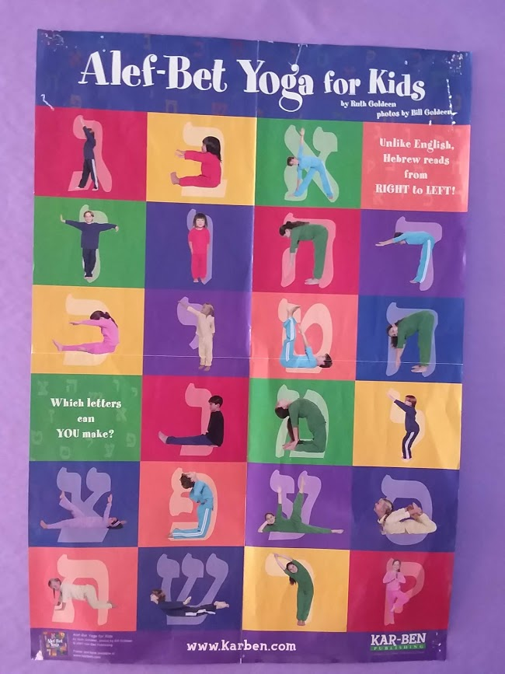
Alef Bet Yoga

Slide 12

Alef א
Alef is the first letter of the Hebrew alphabet
Sometimes it has the sound of “aaahhhh”
like in the word Alef (say Aaaahhh--lifff)
The pose for Alef is Triangle Pose
Here is a video of a kid teaching Triangle Pose:
https://www.youtube.com/watch?v=_jH2OPM6guU

Slide 13
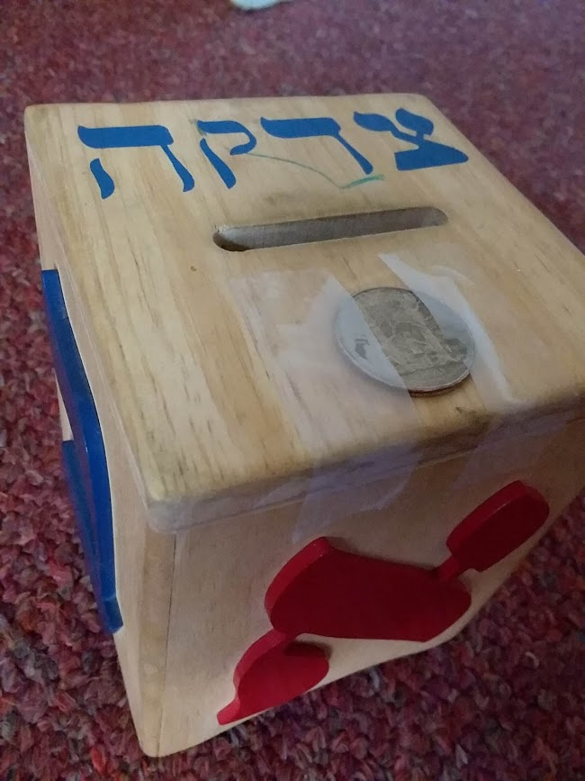
Family Activity: Tsedakah Giving
If you do not have a tsedakah (charity) box for coins,
go find a jar or other small box to use.
And get some coins!
Discuss together where you’d like the money to go,
such as:
To help people who don’t have enough food
To help the environment
To help people who had to leave their country due to war
Now, have your child add the coins to the jar or box.
Give your child a big round of applause!

Slide 14
Closing Song:We’re So Happy
That Everyone Was Here!
https://photos.app.goo.gl/bYtnH6PotKkAo6pJ6
See the next slide for an optional craft!

Slide 15
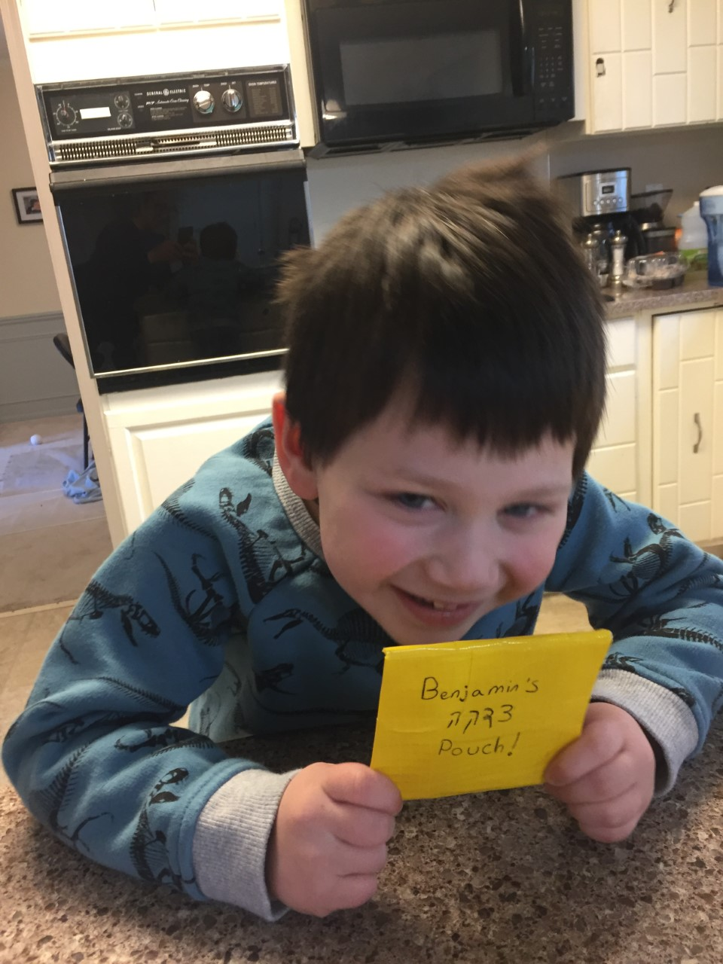
Decorate a Tsedakah Box or Make a Pouch
Decorate your Tsedakah jar or box
with stickers or paint.
OR
Make a Tsedakah Pouch for your child to bring coins to Religious School in. Use Duct Tape and velcro
See next slide...

Slide 16
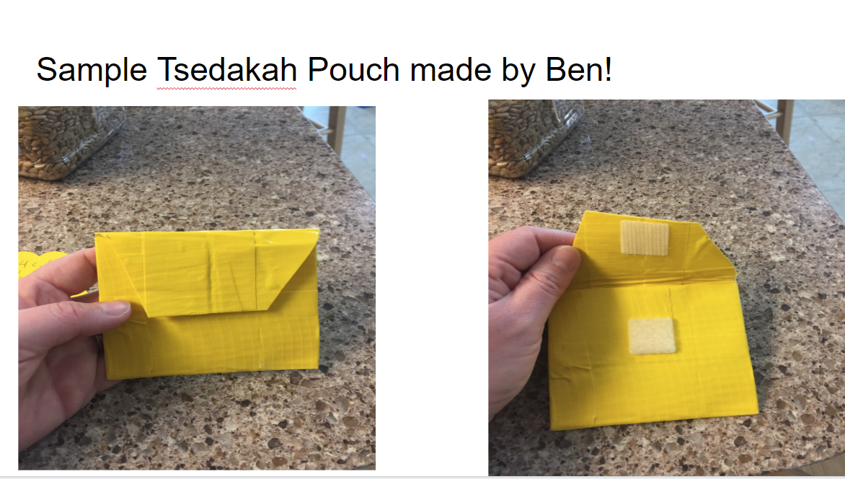

Slide 17
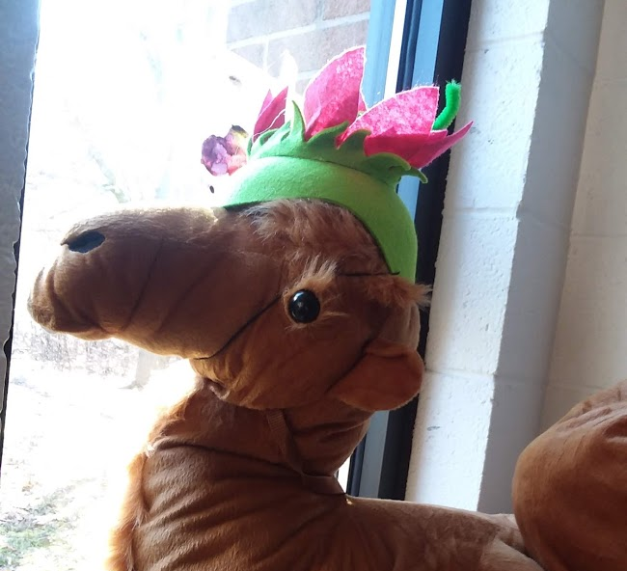
Bye for Now!

